Slide 1
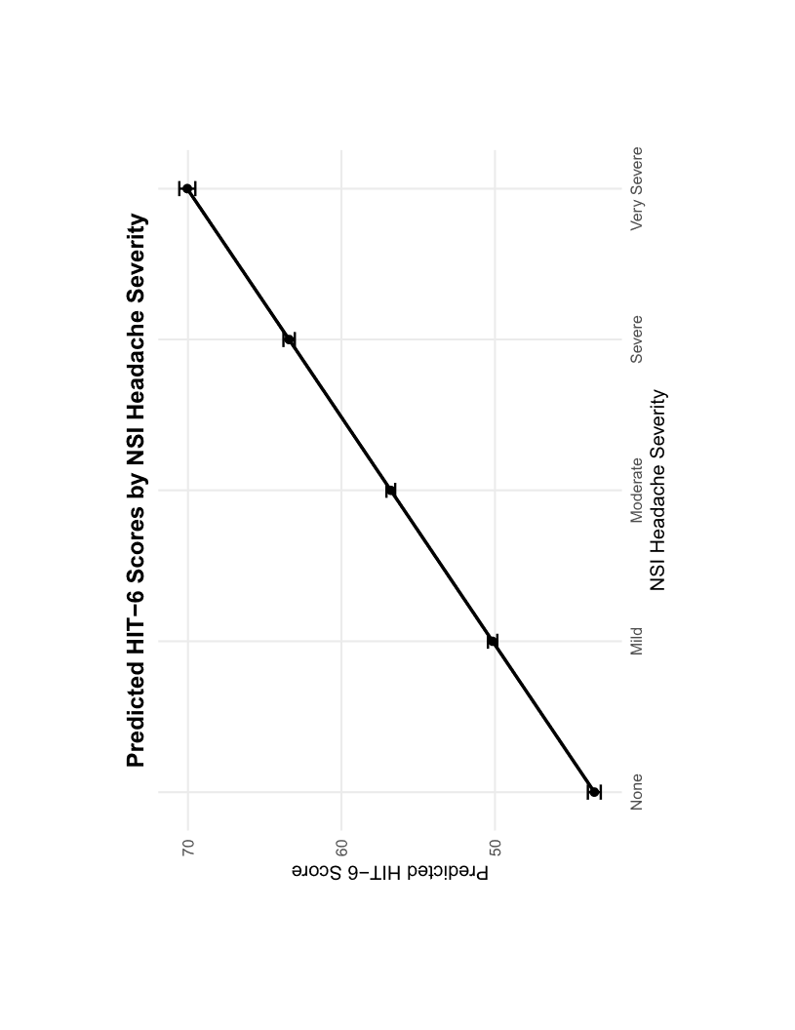
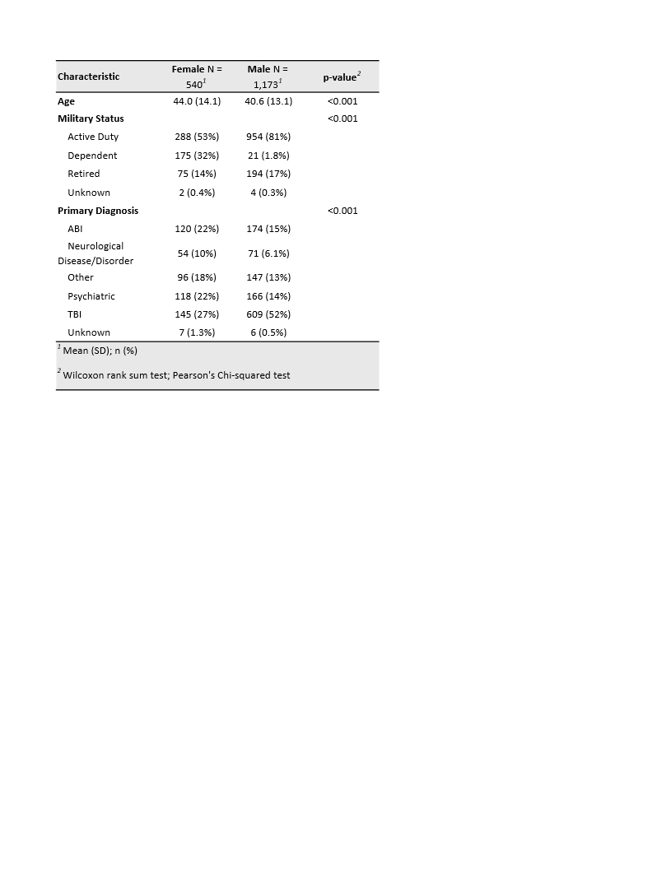
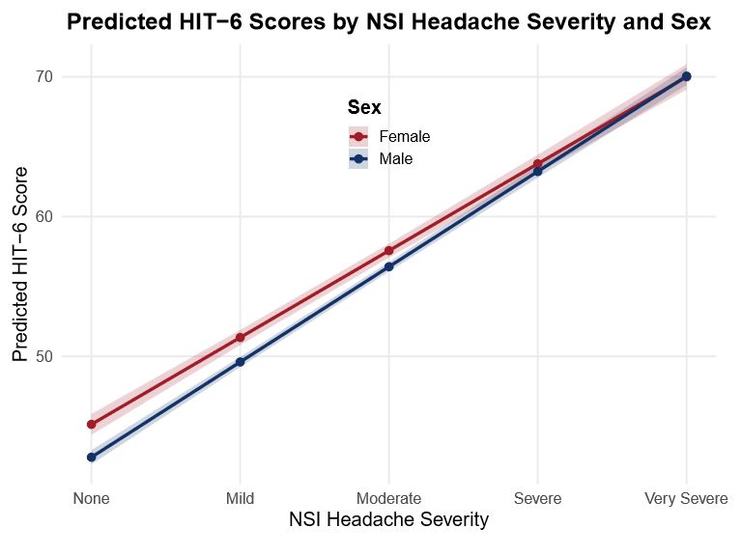
Sex Differences in Military Headache:
NSI Single Item as HIT-6 Proxy Validation Beyond TBI Cohorts
Andrew Sojka¹, Kelly Marshall², Julian Burke³, Louis M. French,^{3,4} Katherine Sullivan³
¹Georgetown University; ²Audiology and Speech Center, Walter Reed National Military Medical Center, Bethesda, MD; ³National Intrepid Center of Excellence,
Walter Reed National Military Medical Center, Bethesda, MD; ⁴Uniformed Services University of the Health Sciences, Bethesda, MD.
Background
Methods Continued
Results Continued
Problem. Survey burden reduces efficiency and readiness in Military Health. Concurrently, headaches are highly prevalent across various diagnoses and exposures.
Measures. The 6-item Headache Impact Test (HIT-6) and the single-item headache question on the 22-item Neurobehavioral Symptom Inventory (NSI-Q4)^{1,2}.
  Gap. Though designed for traumatic brain injury (TBI), the NSI is now used in other populations to gauge general symptom distress. However, NSI-Q4/HIT-6 validation has focused on predominantly male, military TBI samples, leaving a gap in data for females, non-military and non-TBI patients.^{3,4}
Objective. Validate NSI-Q4 as a proxy for HIT-6 within a clinically diverse population to generalize previous findings and mitigate survey burden.
Clinical Population:
Primary Finding. When accounting for sex in the mixed-effects model, NSI Q4 was a statistically significant predictor of HIT-6 total scores across both sexes (p < 0.001).
Sex Interaction. A secondary analysis revealed a modest but significant difference in the Sex x NSI-Q4 interaction (p = 0.003). The association was slightly stronger in males (slope = 6.82) than females (slope = 6.21)
Baseline Differences. This difference could be explained by females reporting higher HIT-6 scores at lower NSI severity levels (β_{Males}= -2.35, p < 0.001)
Figure 1: Demographic comparison between prior studies and the current sample
Previous Studies
As shown in Figure 1, the current study includes a higher proportion of females, non–TBI individuals, and non–Active-Duty participants compared to previous samples.
Current
Study
Note. Prior study data represent aggregated percentages from Hoover et al. (2020) and Lu et al. (2021). AD = Active Duty; VET = Veteran.
Measurements:
Male vs. Female
TBI vs. Non-TBI
AD/VET vs. Other
Table 2. Headache Impact Test – 6 items and Neurobehavioral Symptom Inventory Question 4
Conclusions
Headache Impact Test - 6
1. When you have headaches, how often is the pain severe?
2. How often do headaches limit your ability to do usual daily activities including household work, work, school, or social activities?
3. When you have a headache, how often do you wish you could lie down?
4. In the past four weeks, how often have you felt fed up or irritated because of your headaches?
5. In the past 4 weeks, how often have you felt fed up or irritated because of your headaches?
6. In the past 4 weeks, how often did headaches limit your ability to concentrate on work or daily activities?
Research Questions:
What is the relationship between NSI and HIT in a clinically diverse population
Does sex modulate this relationship?
Neurobehavioral Symptom Inventory
4. Headaches
Clinical Validation. This study successfully generalizes the NSI-Q4/HIT-6 relationship, previously established in male-dominated TBI cohorts, to a more diverse, general clinical population including females, dependents, and non-TBI patients.
Operational Impact. Using the NSI-Q4 is an appropriate alternative to using the HIT-6 to evaluate headache symptom severity. Reducing screening burden in the Military Health System can streamline workflow and reduce patient survey fatigue.
Sex-Specific Considerations. While the NSI-Q4 is a valid proxy for both sexes, clinicians should note the identified sex interaction. Female patients may experience or report higher overall headache impact (HIT-6) even when their isolated headache severity (NSI-Q4) is low.
Future Directions. Outcomes: Investigate long-term headache treatment outcomes and clinic efficiency metrics in settings where HIT-6 administration is replaced by NSI-Q4 tracking. Disparities: Further research should explore the drivers behind sex-based intercept differences, such as the potential influence of varying headache etiologies (e.g., migraine vs. tension-type) between males and females.
Note. Participants were asked to rate each item on the NSI on a scale from 0 (none) to 4 (very severe).
Methods
Note. Participants were asked to rate each item on the HIT-6 on a scale from 0 (never) to 5 (always).
We analyzed 3,369 longitudinal HIT-6/NSI-Q4 evaluations from 1,713 unique patients (31.5% female) at Walter Reed National Military Medical Center (WRNMMC). A linear mixed-effects model was utilized to evaluate the NSI-Q4 as a proxy for HIT-6 while accounting for repeated measures within subjects.
Statistical Method:
  A mixed effects model examined the effect of sex on the relationship between NSIQ4 and HIT-6 scores
Results
Figure 2. Graph of Predicted HIT-6 Scores by NSI Headache Severity.
Figure 3. Graph of Predicted HIT-6 Scores by NSI Headache Severity and Sex
Table 1. Population Demographics
References
¹Kosinski, M., Bayliss, M. S., Bjorner, J. B., J. E. Ware, Jr., Garber, W. H., Batenhorst, A., Cady, R., Dahlöf, C. G. H., Dowson, A., & Tepper, S. (2003). A Six-Item Short-Form Survey for Measuring Headache Impact: The HIT-6™. Quality of Life Research, 12(8), 963-974. http://www.jstor.org/stable/4038952
²Cicerone, K. D., & Kalmar, K. (1995). Persistent postconcussion syndrome: The structure of subjective complaints after mild traumatic brain injury. The Journal of Head Trauma Rehabilitation, 10(3), 1-17. https://journals.lww.com/headtraumarehab/fulltext/1995/06000/persistent_postconcussion_syndrome the structure.2.aspx
³Lu, L. H., Bowles, A. O., Kennedy, J. E., Eapen, B. C., & Cooper, D. B. (2019). Single-Item Versus Multiple-Item Headache Ratings in Service Members Seeking Treatment for Brain Injury. Military Medicine, 185(1-2), e43-e46. https://doi.org/10.1093/milmed/usz173
⁴Hoover, P. J., Nix, C. A., Llop, J. Z., Lu, L. H., Bowles, A. O., & Caban, J. J. (2022). Correlations Between the Neurobehavioral Symptom Inventory and Other Commonly Used Questionnaires for Traumatic Brain Injury. Military Medicine, 188(7-8), e2150-e2157.https://doi.org/10.1093/milmed/usab559
Disclaimer
The identification of specific instrumentation is considered an integral part of the scientific endeavor and does not constitute endorsement or implied endorsement on the part of the authors, Department of War, or any component agency. The views expressed in this poster are those of the authors and do not necessarily reflect the official policy of the Department of War or the U.S. Government.
Acknowledgements
Thank you to the Georgetown Physiology and Pharmacology Department, WRNMMC, the University of Maryland Program of Neuroscience and Cognitive Science, and the National Intrepid Center of Excellence for supporting this research. Thank you to the Military members and their families for their time and contributions to this study.
As shown in Figure 2, the single-item NSI was a statistically significant predictor of HIT score in the clinical population (p < 0.001).
As shown in figure 3, NSI-Q4 significantly predicted higher HIT-6 scores across both sexes (p < 0.001). This association was stronger in men (β_{Males} − β_{Females} = +0.60, p = 0.003), although females exhibited higher baseline HIT-6 scores at an NSI-Q4 of 0 (β_{Males}= -2.35, p < 0.001).
Note. ABI = acquired brain injury (e.g., stroke, brain tumor); TBI = traumatic brain injury; Psychiatric = psychiatric disorders (e.g., posttraumatic stress disorder, anxiety); Other = an otherwise unlisted neurobehavioral condition; Unknown = missing data.

