Slide 1


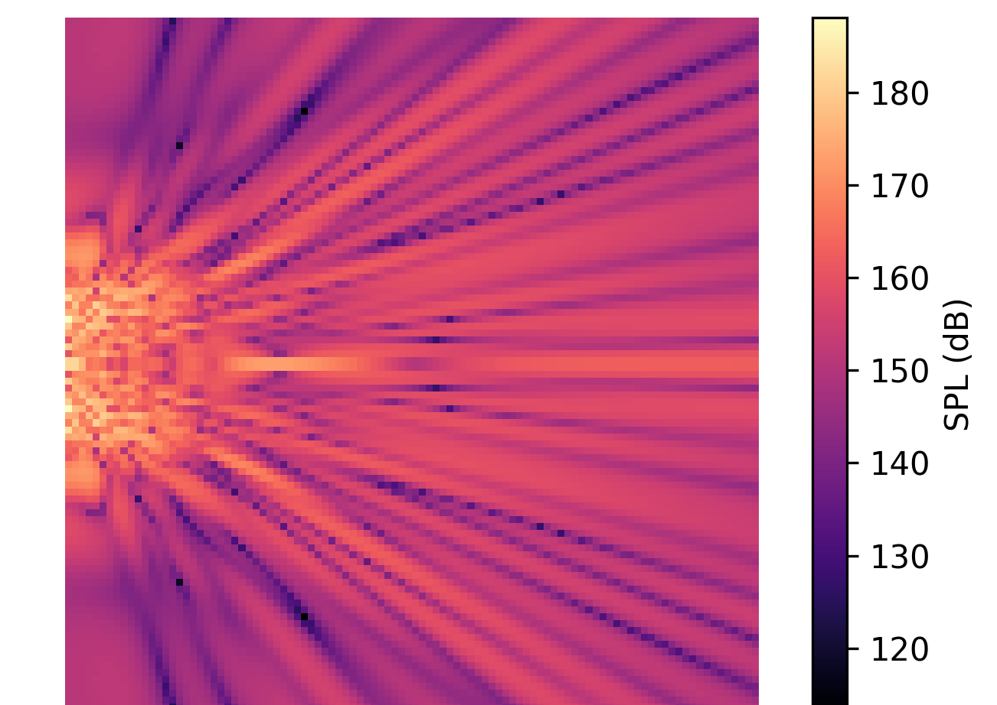
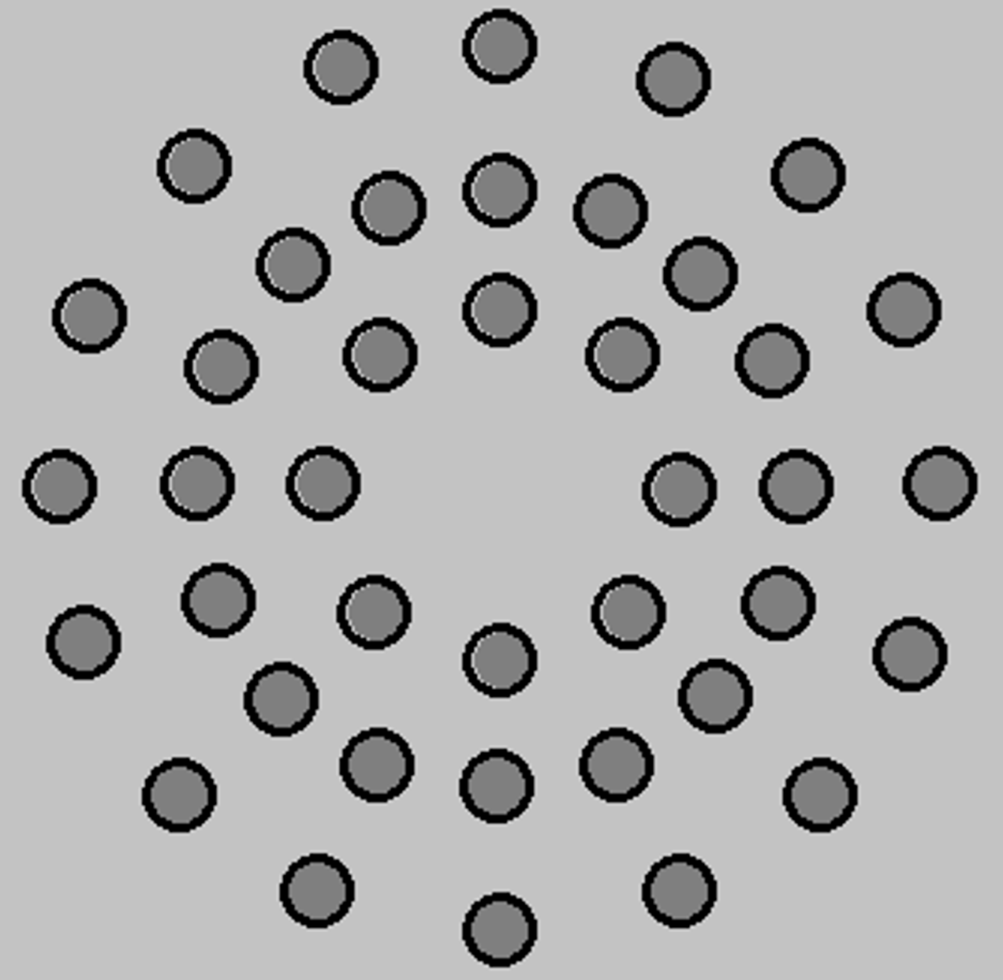
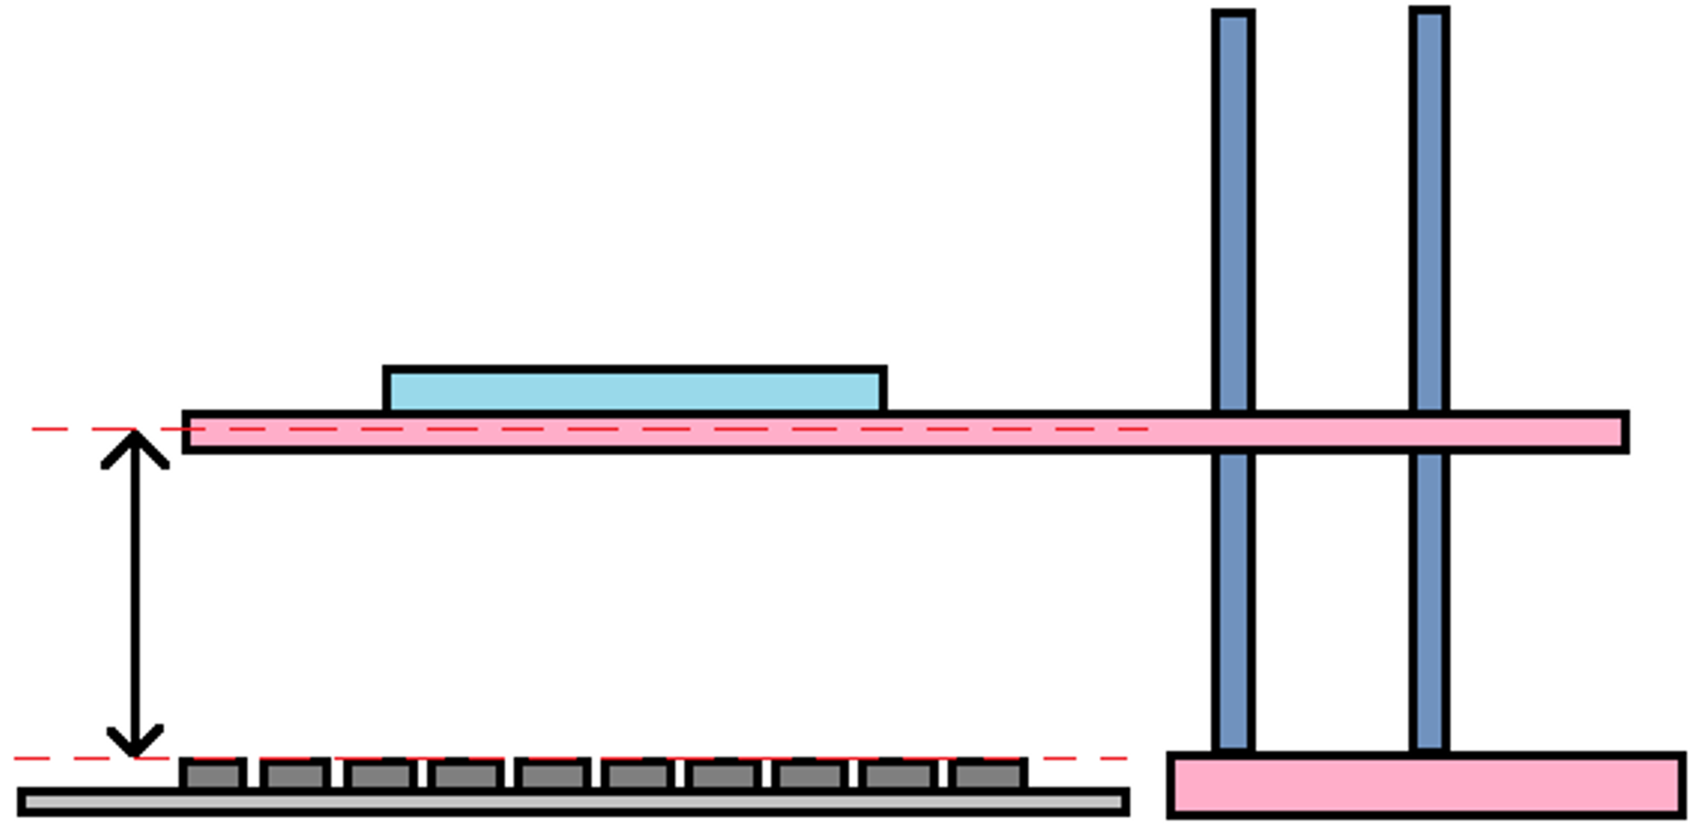
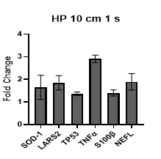
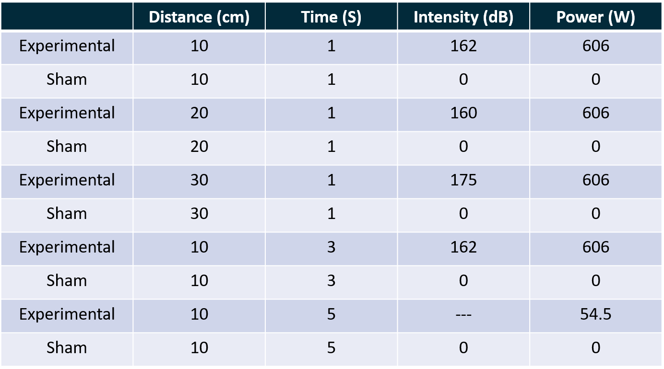
HIGH-POWER ACOUSTIC MODEL FOR EARLY CELLULAR STRESS SIGNALING
Cally Moore, MS^{1,2} , Isaac Abaasah, MS^{1,2}, Clint Boldt, BS^{1,2}, Jenny Mendez, MS^{1,2}, Brooke McGill, BS^{1, 2}, Shourya Mukherjee, BS^{1,2}, Jenny Raines, PhD^{1,2}, Hector Lopez, MS^{1,2} , Meaghan Rose, PhD^{1,2},Jayson M. Rhoton, LT, MSC, USN, PhD,¹ Cameron M. Burnett, LCDR, MSC, USN, PhD¹
¹Naval Medical Research Unit San Antonio, JBSA-Fort Sam Houston, Texas 78234, USA; ²Leidos Inc., Health Solutions, Reston, VA 20190, USA
Navy Medicine Research & Development’s efforts in trauma repair help the Department of War provide proper healthcare to the Warfighter, better preparing them to accomplish their mission.
Introduction
Figure 2
Figure 4
Modern operational environments increasingly expose personnel to high-intensity, air-coupled ultrasound, yet biologically anchored dosimetry frameworks remain undefined. To address this force health protection gap, this study characterizes the in vitro biological effects of a high-power parametric acoustic array. We exposed human SH-SY5Y neuroblastoma cells to air-delivered, 40 kHz ultrasound at experimental high-power (606 W) and modeled high-intensities (160–175 dB SPL). By evaluating cellular responses at precise stand-off distances (10 cm, 20 cm, and 30 cm), and varying timepoints of 1s, 3s, and 5s, this research bridges acoustic physical dosimetry with biological outcomes to inform future exposure limits and hazard-zone mapping.
Figure 2: Computational Acoustic Field and Beam Wave Propagation. Modeled spatial pressure field of the 40 kHz parametric acoustic array operating at high power (606 W), illustrating directional beam geometry and intensity distribution. The wave propagation profile maps the transition from near-field to far-field, demonstrating sustained predicted high-intensity levels (160–175 dB SPL) along the central acoustic axis.
Figure 4: Differential protein expression determined by PLGS. Mean log ratio values (Log₂ FC) for selected stress response proteins identified with >95% confidence. HS - heat shock, DNA/protein repair; HY - hypoxia stress control; DN - DNA damage repair. Log ratio values report relative abundance between sham:exposed with three injections for each replicate. Positive values indicate higher expression in sham, negative values indicate higher expression in exposed. Error bars represent log ratio variance from technical replicate analyses. Relative protein abundance determined by label-free quantification (n = 1).
Materials and Methods
Array Design and Construction: The custom parametric acoustic array was constructed using 40 piezoelectric transducers (40 kHz) mounted on a plexiglass substrate, arranged in three concentric rings computationally optimized to produce maximum constructive interference (modeled at 160–175 dB SPL). To achieve these targeted high-intensity levels, the system was driven by a Keysight waveform generator coupled to an AE Techron 7224 power amplifier to permit high-voltage driving without thermal burnout. The resulting acoustic fields were continuously mapped and validated using high-frequency Earthworks M50.
In Vitro Exposure: Human SH-SY5Y neuroblastoma cells were cultured and exposed to the targeted acoustic field at controlled stand-off distances of 10 cm, 20 cm, and 30 cm.
Mass Spectrometry: Post-exposure cell lysates were subjected to protein extraction, enzymatic digestion, and LC-MS/MS proteomics to map shifts in metabolic and stress pathways.
Gene Expression: RNA was extracted immediately and reverse-transcribed. RT-qPCR was performed utilizing a targeted 10-gene panel to quantify acoustic-induced molecular trauma.
Figure 3
Figure 5
Figure 3: SH-SY5Y Gene Expression Dynamics Post-Exposure. Relative fold-changes are shown for low-power controls compared to high-power 40 kHz acoustic exposures at 1 s, 3 s, and 5 s durations across all tested stand-off distances (10 cm, 20 cm, and 30 cm). Fold change values report sham:exposed. All molecular targets are normalized to GAPDH and ACTB housekeeping controls to isolate temporal and spatial cellular stress responses (n=1).
Figure 5: Proteomic Response Shift Toward Neuroprotection. Mass spectrometry reveals upregulation of structural proteins in exposed samples (green/negative fold-change), specifically featuring increased α-tubulin and β- tubulin abundance (n=1).
Figure 1
Figure 1: Parametric acoustic array and setup. The left is a photograph of the parametric acoustic array used and to the right is the experimental setup for cell exposure.
Cell culture plate
Variable Exposure Distance
 | A | B | C | D | E
Exposure Time (s) | 5 | 1 | 1 | 1 | 3
Distance (cm) | 10 | 10 | 20 | 30 | 10
Input Power (W) | 54.5 | 606 | 606 | 606 | 606
dB | >140* | 162 | 161 | 175 | 162
Transducer Array
Table 1
*Modeled Value
Table 1: Experimental parameters.
A
B
C
D
E
Summary and Future Directions
We have successfully established a scalable, multi-omics pipeline to evaluate high-power, air-coupled acoustic exposures (40 kHz) across both controlled indoor facilities. While findings remain preliminary, our initial in vitro data successfully connects physical acoustic dosimetry with biological outcomes, demonstrating measurable upregulation and downregulation of targeted stress and structural biomarkers at both the genetic and proteomic levels.
To refine this exposure model, ongoing engineering efforts are focused on developing a next-generation phased acoustic array; this advanced design will improve spatial focusing and precise sample targeting while mitigating transducer failure caused by acoustic reflections and impedance mismatch. Concurrently, follow-on biological studies will expand our dosimetric framework by evaluating additional longer and relevant distances, tracking extended post-exposure recovery time points, and incorporating additional cell lines to directly model acoustic trauma in operationally relevant auditory tissues.
Disclaimer: The views expressed in this article are those of the author and do not necessarily reflect the official policy or position of the Department of the Navy, Department of Defense, nor the U.S. Government.
Source of support: This work was supported by DHA work unit number G2404.
Human subject research protections: No human subjects used for this work.
Copyright statement: Some authors are military service members and employees of the U.S. Government. This work was prepared as part of their official duties. Title 17 U.S.C. §105 provides that “Copyright protection under this title is not available for any work of the United States Government”. Title 17 U.S.C. §101 defines a U.S. Government work as a work prepared by a military service member or employee of the U.S. Government as part of that person’s official duties.

