Slide 1

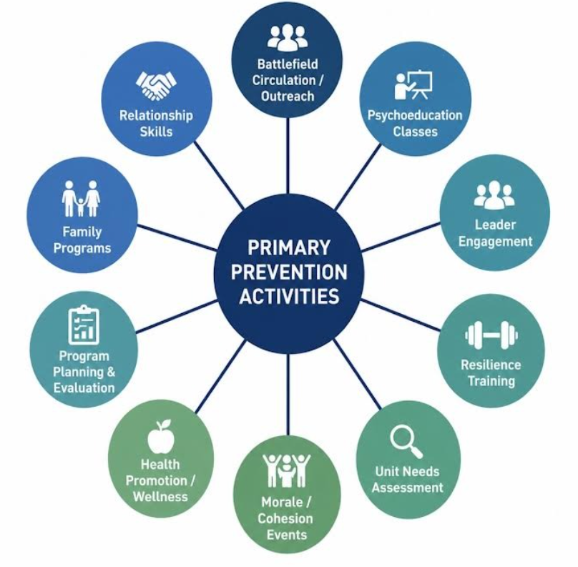
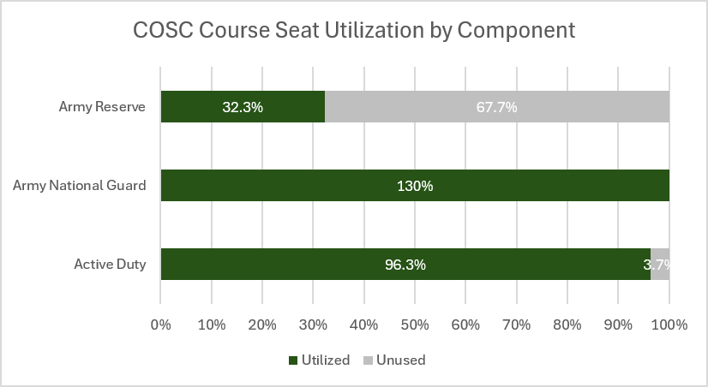
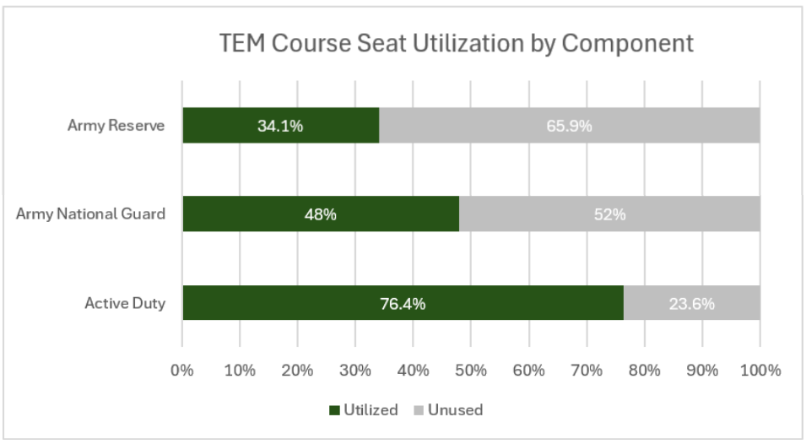

Primary Prevention Training Gaps Among Deploying National Guard and Reserve Behavioral Health Officers:
Implications for Readiness
MAJ Jennifer Nevers, MSW;¹ MAJ Staci Molinar, DSc;²
¹Indiana Army National Guard; ²United States Army Reserve
BACKGROUND
METHODS
Primary prevention is a core competency of the Army Behavioral Health (BH) mission and is essential to sustaining force readiness.¹ A 2025 snapshot of the Central Command (CENTCOM) area of responsibility found that approximately 73% of Behavioral Health Officers (BHOs) were from the Army Reserve (USAR) or Army National Guard (ARNG), many of whom reported having primary clinical civilian positions in which prevention activities are less emphasized or absent. 2026 ALARACT guidance directs that 50% of BH efforts should focus on non-clinical force health protection, including prevention activities.² A 2024 scoping review found the majority of Combat Operational Stress Control programs focused on selective prevention over universal prevention, with priorities largely shaped
An iterative, multi-phase review was conducted to identify Army training opportunities that support BHO competence and confidence in designing and executing prevention activities. This review included examination of BH doctrine, historical ALARACTS, current BH course offerings, course POI and curricula, and ATRRS data, including seat allocation and utilization for BH courses. Semi-structured interviews were conducted with instructors of select BH courses to determine the extent to which prevention-focused content was incorporated into each course. Course schedules and instructional materials, including PowerPoint presentations, were reviewed to identify the presence and relative amount of prevention-focused content within selected courses (COSC and TEM). A comparative review of the depth and breadth of prevention topics included in the 60-hour IPPW mandatory initial training and COSC/TEM was subsequently conducted.
by local stakeholders.³ Although prevention concepts are incorporated into formal Army BH courses, a non-standardized curriculum prepares ARNG and USAR BHOs to execute prevention-focused duties in deployed environments, leaving providers ill-prepared to respond to the heightened demands of future large-scale combat operations (LSCO). This training gap may reduce BHO’s preparedness to implement primary prevention strategies to support Soldier health, readiness, and operational effectiveness in the deployed environment.
CONCLUSIONS
Although prevention concepts are incorporated into formal Army BH courses, access to courses is not mandatory for Behavioral Health Officers (BHOs), and their scope of prevention concepts is limited. Findings suggest a growing mismatch between the operational expectations placed on BHOs in deployed environments and the training currently available to support prevention-focused responsibilities. ATRRS data suggest prevention training opportunities are underutilized or insufficiently aligned with USAR and ARNG participation patterns. Pre-deployment training remains inconsistent, leaving providers insufficiently prepared to meet the heightened demands of future LSCO. These findings may indicate barriers related to awareness, accessibility, prioritization, funding, or command support for prevention-focused professional development.
OBJECTIVE
IMPLICATIONS AND FUTURE DIRECTIONS
The purpose of this study is to examine current prevention-focused training opportunities available to ARNG and USAR BHOs and identify disparities in training access and preparedness that may impact their ability to effectively execute prevention-focused initiatives in deployed environments. The scope and availability of prevention training is hypothesized to be insufficient to execute prevention activities.
Current literature and operational guidance emphasize the importance of universal and selective prevention initiatives for sustaining force readiness; however, limited research has examined whether ARNG and USAR BHOs receive adequate preparation to execute these responsibilities.
ATRRS attendance data alone cannot fully explain barriers commonly experienced. As this project is in the early stages of development, findings should be interpreted as exploratory and hypothesis-generating.
Future research should further examine perceived preparedness, operational utilization, and specific barriers to prevention-focused training among USAR and ARNG BHOs through survey and qualitative methodologies.
Standardized pre-deployment, prevention-focused competencies and training pathways aligned with current operational requirements are needed, especially for USAR and ARNG BH personnel.
RESULTS
*Prevention curriculum hours obtained through collaboration with MEDCoE course instructors and review of course point of instruction (POI) and hourly training schedules.
References
1. U.S. Department of Defense. Department of Defense Instruction 6400.11: DoD Integrated Primary Prevention Policy for Prevention Workforce and Leaders. December 20, 2022. https://www.esd.whs.mil/Portals/54/Documents/DD/issuances/dodi/640011p.pdf.
2. Department of the Army. ALARACT 009/2026: Medical Planning and Execution Considerations for Combat and Operational Stress Control. February 26, 2026. https://armypubs.army.mil/epubs/DR_pubs/DR_a/ARN45919-ALARACT_0092026-000-WEB-1.pdf.
3. Cooper, D. C., Campbell, M. S., Baisley, M., Hein, C. L., & Hoyt, T. (2024). Combat and operational stress programs and interventions: A scoping review using a tiered prevention framework. Military Psychology, 36(3), 253–265. https://doi.org/10.1080/08995605.2021.1968289
Disclaimer: The opinions and assertions expressed herein are those of the authors and do not reflect the official policy or position of the Indiana Army National Guard, United States Army Reserve, the Department of War, and/or the United States Government. The authors have no conflicts of interest to disclose. References available upon request. Corresponding Author: jennifer.j.nevers.mil@army.mil

