Slide 1
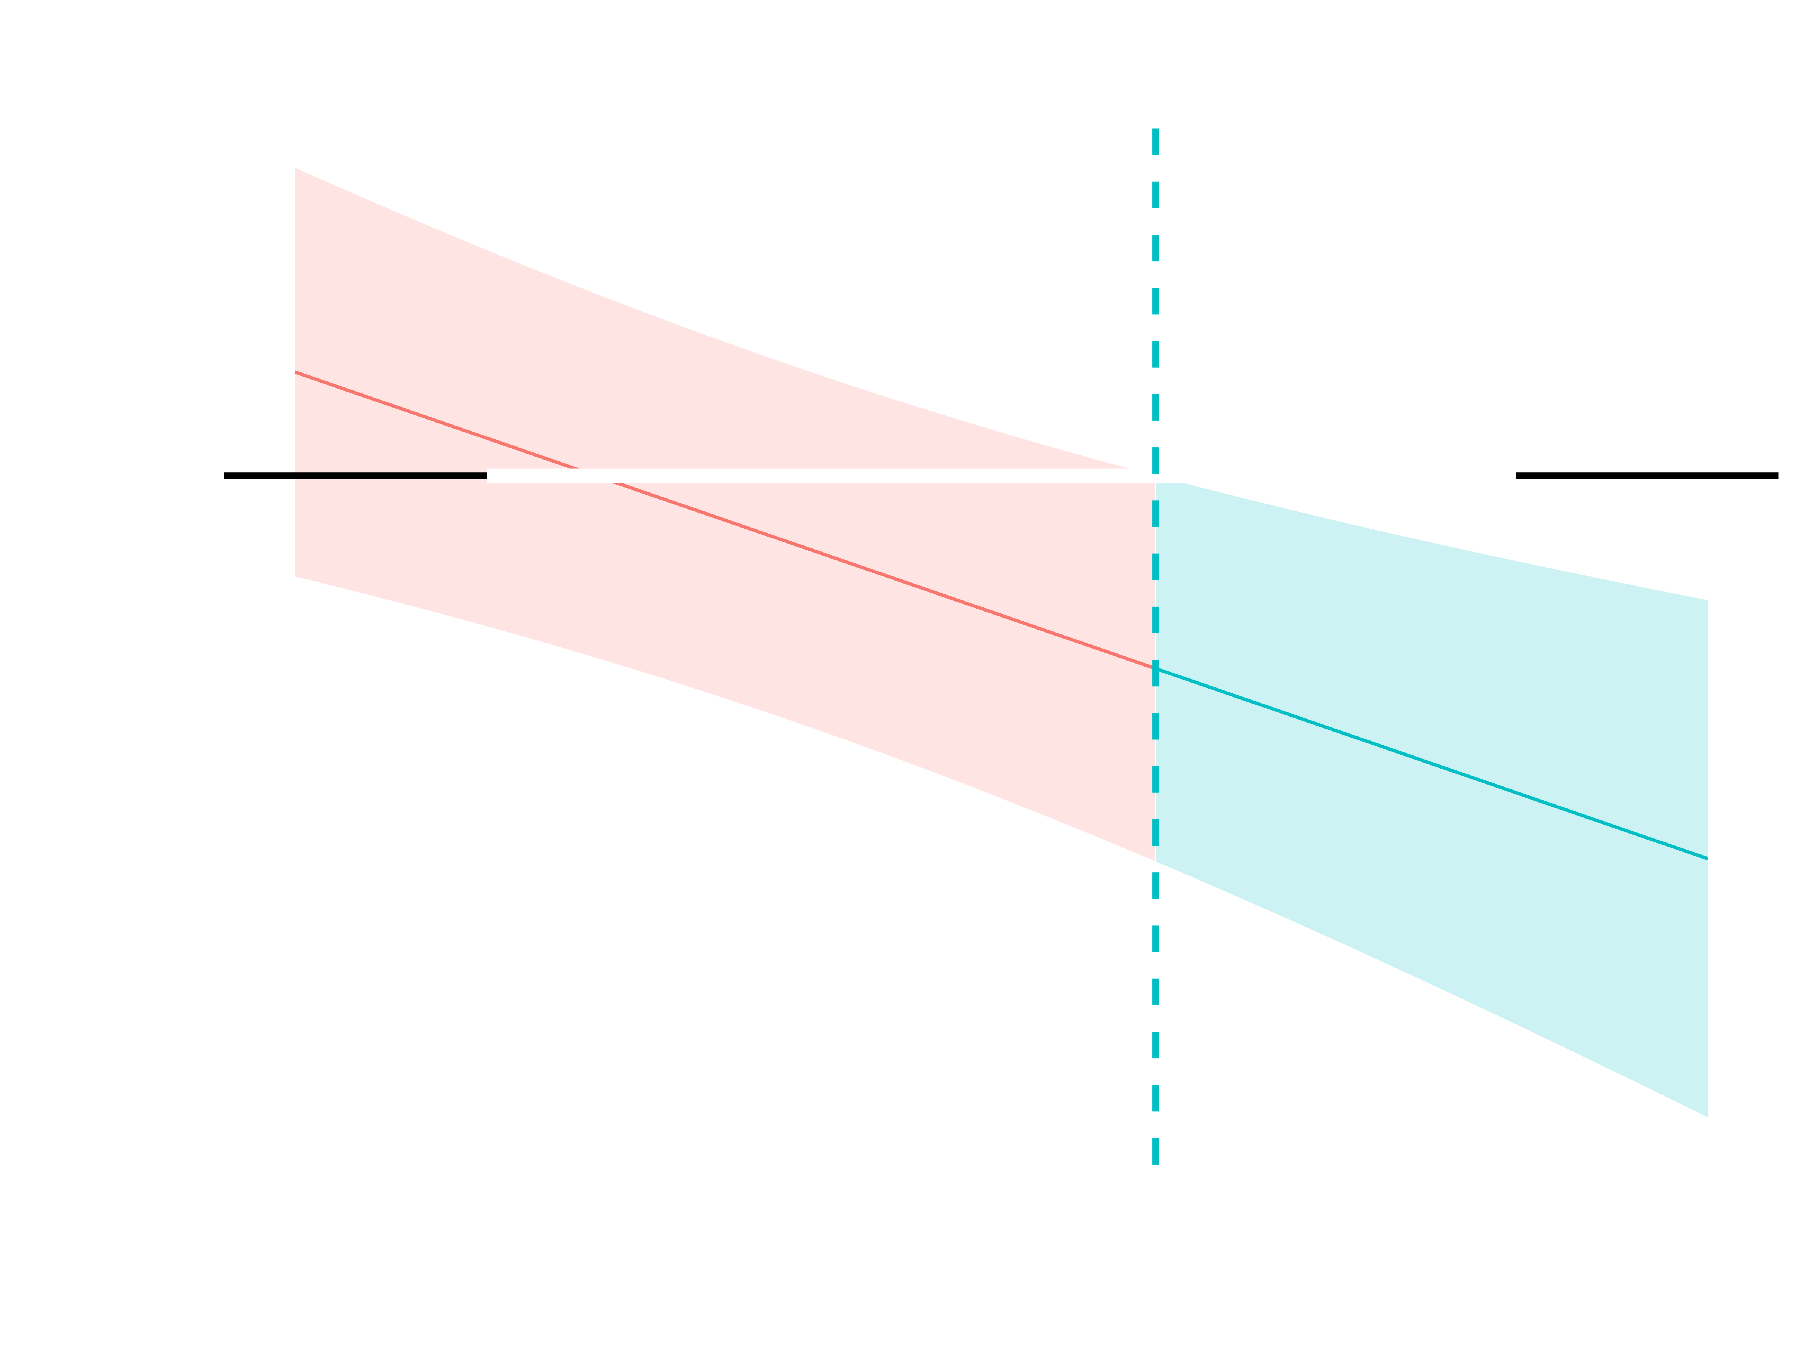
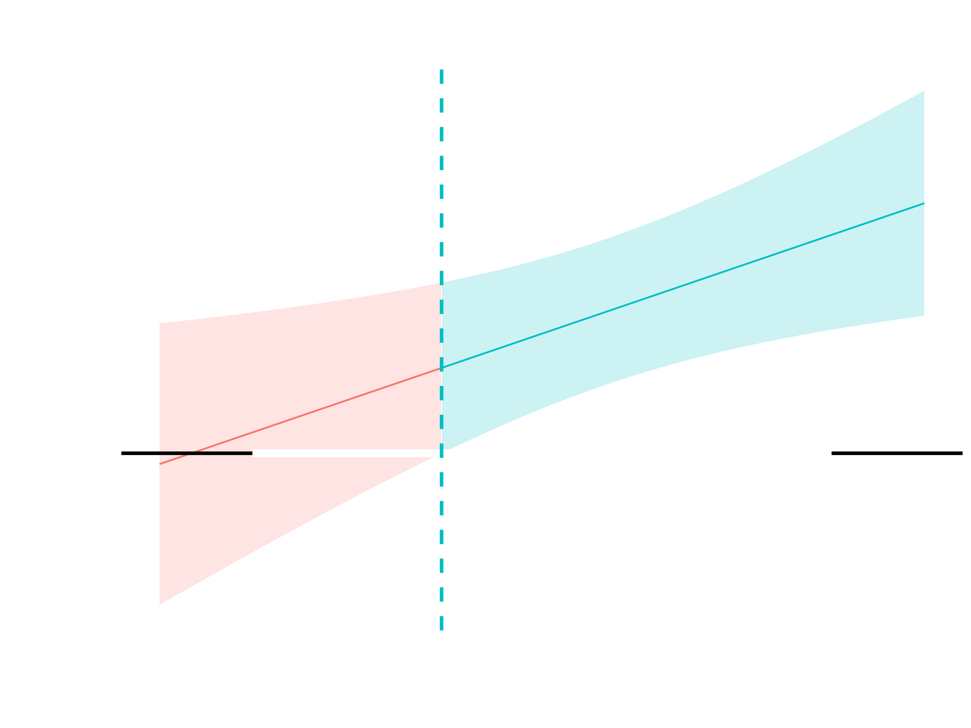

Grit as Both Shield and Risk: A Moderation Analysis of Hopelessness and Suicide Risk in Military Personnel
Melissa Renee Clark, M.S., Adrian Cuffley, M.B.A., Stephanie Ragazzo, M.S., Keyne Law, Ph.D.
Department of Clinical Psychology, Seattle Pacific University
BACKGROUND
Suicide mortality has increased by 33% in the last 20 years in the United States (CDC, 2023).
Military service members are disproportionally impacted by suicide, and suicide is the second-leading cause of death among military personnel as of 2025 (ABCT, 2026).
Grit is defined as perseverance and passion for long-term goals, influencing professional, academic, and personal success (Duckworth et al., 2007)
Grit consists of two related but distinct dimensions: passion (consistency of interests) and perseverance (persistence of effort), which may have different relationships with suicide risk (Gonzalez et al., 2019).
Most suicide research has examined grit as a single construct, leaving the unique contributions of passion and perseverance relatively understudied (Pennings et al. 2015; Chen et al. 2022; White et al., 2017).
In a military population, the interaction between grit's subfactors may affect ideation and behaviors in unique ways that have not been explored before.
AIMS
In a replication study, we aim to separate the grit subfactors of passion and perseverance to examine the differential influence they have on the relationship between hopelessness and suicidal ideation (SI), plans, and preparatory actions.
We hypothesized that the grit subfactors would differentially influence the relationship between hopelessness and suicidal ideation (SI), plans and preparatory behaviors.
METHOD
Participants (N=754)
Beck Hopelessness Scale (BHS; Beck et al. 1974) was utilized to measure hopelessness.
Grit Scale (Duckworth & Quinn, 2009) was broken down into the two subscales, passion and perseverance.
The Beck Scale for Suicidal Ideation (BSS; Beck & Steer, 1991) assessed for current SI.
Depressive Symptom Index-Suicidality Subscale (DSI-SS; Metalsky & Joiner, 1997) assessed for suicide plans and preparatory action.
The Patient health Questionnaire (PHQ-9, Spitzer et al. 1999) assessed for depression as a covariate.
BSS scores were log transformed to reduce the positive skew and minimize the influence of extreme values.
DSI-SS scores were highly zero inflated and a binary variable was created to reflect the presence versus absence of planning behavior.
RESULTS
Passion and perseverance both significantly moderated the relationship between hopelessness and SI.
  Passion attenuated the relationship (β = -0.08, p = .007)
  Perseverance strengthened it (β =.07, p < .01).
Logistic regression indicated that both higher levels of passion (OR = 0.54, p = .04) and perseverance (OR = .42, p < .01) were significantly linked to lower likelihood of suicidal plans and preparatory behaviors.
Passion and perseverance did not moderate the relationship between hopelessness and suicidal plans and preparatory behaviors.
Simple slopes analyses indicated that at high levels of perseverance, hopelessness was strongly associated with increased SI, whereas at low levels of perseverance, this relationship was substantially attenuated.
DISCUSSION
Grit is both shield and risk. Although both passion and perseverance are components of grit, they functioned differently. Passion appeared to buffer the relationship between hopelessness and SI, whereas perseverance strengthened this relationship. This suggests that grit may not be uniformly protective.
Distinguishing thoughts versus behaviors. Passion and perseverance demonstrated different relationships with SI than with plans and preparatory behaviors. These findings support the idea that cognitive and behavioral stages of suicide risk may be influenced by different processes.
Rethinking grit. Examining grit as two distinct subfactors revealed meaningful differences that would have been obscured by using a single grit score.
FUTURE DIRECTIONS
Replication studies: Running analyses using more current data, using convergent and divergent validity for passion and perseverance, in both military and civilian populations.
Understanding grit and suicide: Investigate the mechanisms that influence passion and perseverance in the context of suicide.
Interventions focused on unique processes: Reexamine current interventions and tailor as more information becomes available.
LIMITATIONS
Outdated Contexts and Changing Conditions
Temporal Scope
Limited Representativeness
Int
Questions to: mrclark@spu.edu
Notes:
Although typically protective, grit combined with maladaptive perfectionism may lead to persistent pursuit of unrealistic standards, undermining well-being.

