Slide 1
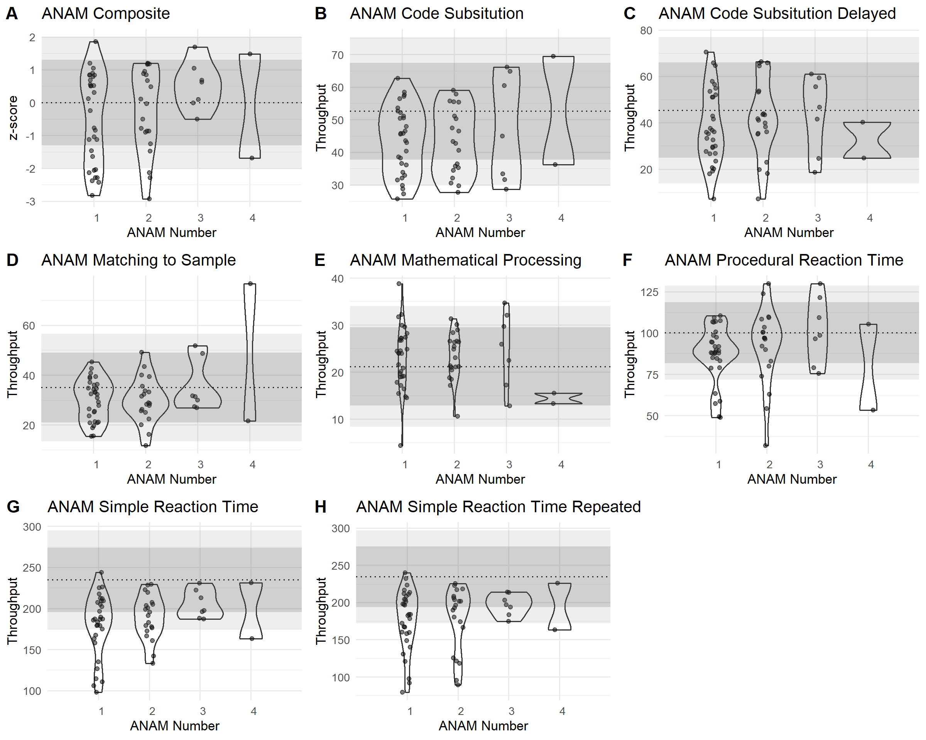
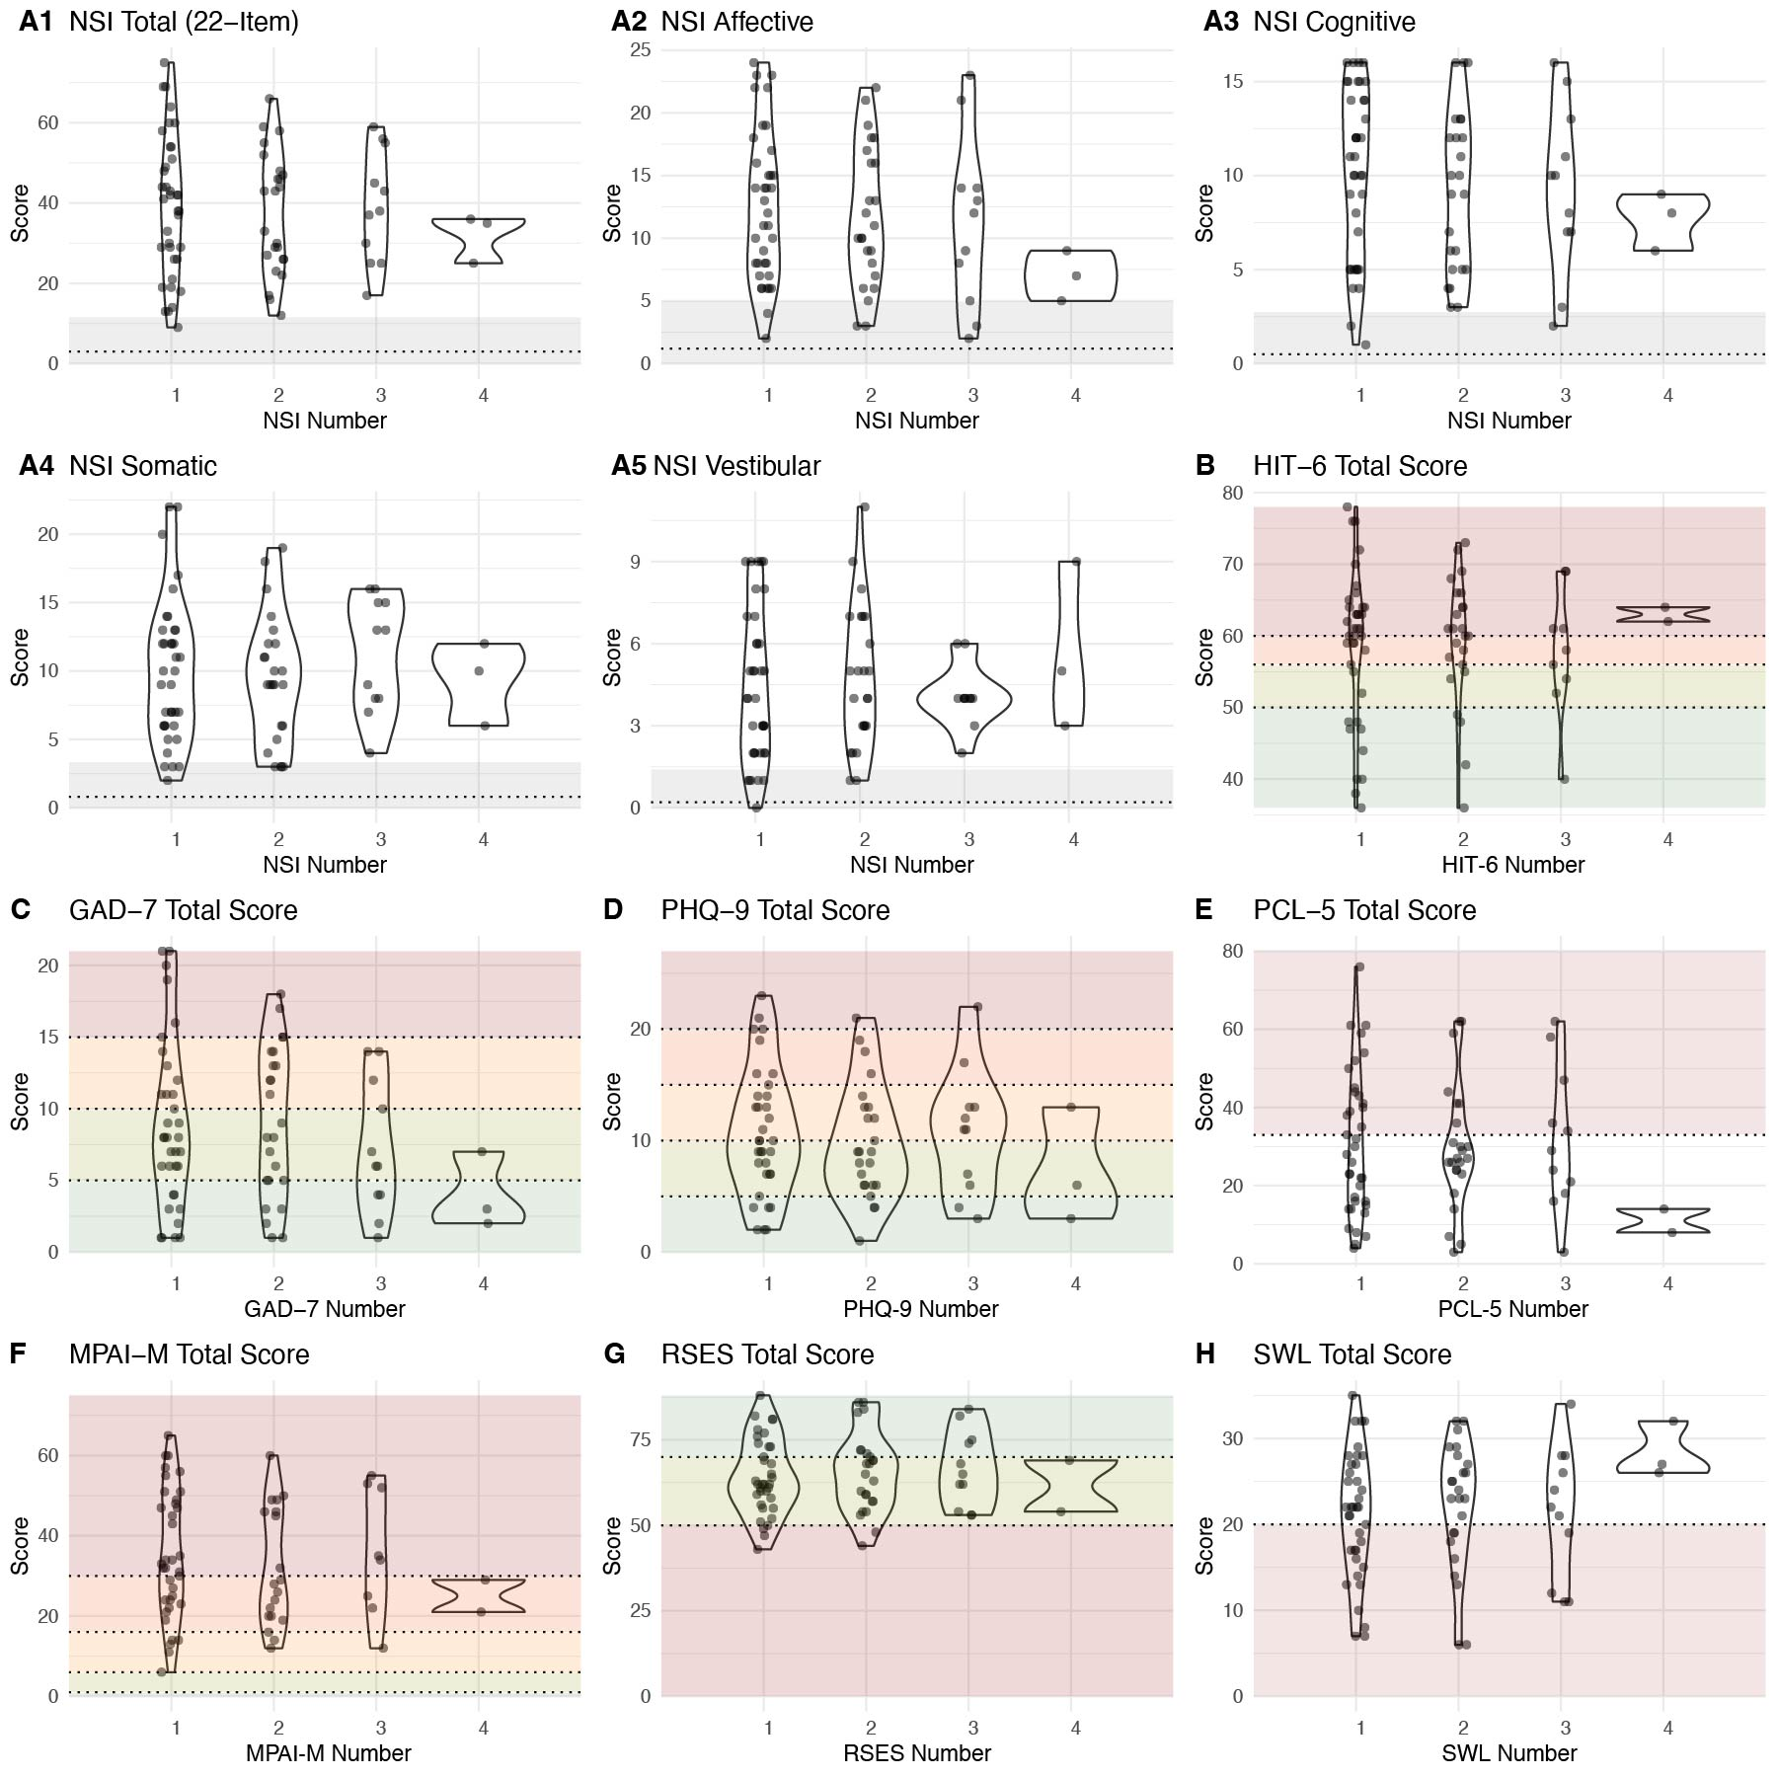
Clinical presentation and engagement with a cognitive rehabilitation clinic in individuals reporting Anomalous Health Incidents
Kelly Marshall¹, Katherine Sullivan¹, Louis M. French^{1,2}
¹ National Intrepid Center of Excellence, Walter Reed National Military Medical Center, ² Uniformed Services University of the Health Sciences
Background
Results
Beginning in 2017, a population of United States (US) Government employees and their families have reported Anomalous Health Incidents (AHI) – unusual sensory experiences, typically accompanied by the sudden onset of vertigo, head pain, tinnitus, or cognitive changes
Patients with persistent cognitive symptoms in this population experience significant difficulty in returning to work and functional activities¹
Little is known about the clinical presentation of this group, limiting clinical decision making^{2,3}
No study has documented response to cognitive rehabilitation interventions in this population
The goals of this study were to:
Explore the clinical presentation of patients with cognitive concerns following potential exposure to AHI
Evaluate a potential intervention for improving cognitive efficiency
Clinical Presentation
Program Engagement
Objective Cognitive Testing
Patients adhered to clinicians’ suggested use.
Most individual scores were within clinically normal limits.
 | N | Mean | SD | Min | Max
Days Used | 25 | 48.60 | 86.97 | 1 | 399
Minutes/Day | 25 | 21.73 | 19.43 | 1.72 | 99.62
But, mean performance was significantly worse than a healthy normative sample for subtests assessing attention and reaction time.
Table 1: Descriptive statistics for cognitive training tool use for patients with available data.
Patient Satisfaction
Figure 1: Distribution of scores on repeated administrations of the ANAM. Outlines show the distribution of the data. Points represent individual patients’ scores. Dark grey boxes represent +/-1.3 standard deviations from the mean normative value. Light grey boxes represent +/-2 standard deviations from the mean normative value. Dotted line represents normative mean (Vincent et al., 2012). Red lines represent mean throughput for administrations where the mean score was significantly below the normative mean (p<0.001). ANAM administrations with performance validity index >10 were excluded (n=3 test sessions).
Patients agreed most strongly with :
Access to education materials and brain injury specialist was helpful
I would recommend this computer program to other service members.
I am glad I participated in this program
Symptom Self-Report
Patients reported substantially higher symptom severity than a healthy normative sample.
Patients endorsed benefit specifically in domains addressed by the cognitive training tool
Methods
We completed a retrospective review of de-identified data from an existing clinical database
Patients
40 US Government employees or family members referred to the NICoE Brain Fitness Center (BFC) following a report of an AHI
Assessment/Intervention
Patients received the BFC standard of care
Intake interview and initial assessment
Subscription to an online gamified cognitive training tool with recommended use 20-30 minutes/day 3-5 times/week
Consultation with a clinician to review the program and provide recommendations on use
Follow-up consultation and repeat testing every 6-8 weeks
Measures
Objective cognitive performance: Automated Neuropsychological Assessment Metric (ANAM)
Symptom self-report: Neurobehavioral Symptom Inventory (NSI), Headache Inventory Test (HIT-6), Generalized Anxiety Disorder 7-item (GAD-7), Patient Health Questionnaire-9 (PHQ-9), Post-Traumatic Stress Disorder (PTSD) Checklist, DSM-5 (PCL-5), Mayo-Portland Adaptability Inventory-M (MPAI-M), Response to Stressful Experience Scale (RSES), Satisfaction with Life Survey (SWLS)
Patient satisfaction survey
Cognitive training tool utilization
We analyzed clinical presentation on patients’ first visit and change over repeated test sessions
Figure 2: Distribution of scores on repeated administrations of the Neurobehavioral Symptom Inventory. Outlines show the distribution of the data. Points represent individual patients’ scores. Panels show subscale factor scores (Vanderploeg et al., 2015). Dotted horizontal lines represent the mean normative value for the non-clinical, non-deployed national guard sample. Grey boxes represent +/-1.5 standard deviations from the mean normative value (Soble et al., 2014).
Figure 6: Percent of patients endorsing improvement by skill domain
Mental Health Factors
Self-Reported Functional Impact
Conclusions
Most patients reported mild-moderate anxiety and depression symptoms. PTSD symptoms ranged from low to high.
Patients reported strong negative impact of symptoms on functional activities, despite reports of good resilience and satisfaction with life.
Patients presented with sub-clinical but significant differences in objective performance from healthy normative samples
Patients presented with high levels of symptom severity across domains on the NSI, but not on mental health measures
Patients showed good participation in the intervention
Improvements in objective cognitive performance are possible with participation in cognitive rehabilitation programs for this population
Patients endorsed improvement in cognitive domains but there were no changes in symptom report surveys
Severe
Severe
High
Moderate
Mod-Sev
Likely PTSD
Severe
Mod
Less than Neutral Satisfaction
Mild
Mod
Mod-Sev
Minimal
Mild
Mild-Mod
Low
Minimal
Mild
Figure 3: Distribution of scores on repeated administrations of each measure (GAD-7 measures anxiety; PHQ-9 measures depression; PCL-5 measures PTSD symptoms). Outlines show the distribution of the data. Points represent individual patients’ scores
Figure 4: Distribution of scores on repeated administrations of each measure (MPAI-M measures limitation to participation in functional activities; RSES measures resilience; SWL measures satisfaction with life). Outlines show the distribution of the data. Points represent individual patients’ scores
Change in Performance
Objective cognitive scores improved over time for composite scores subtests measuring attention, memory, and reaction time.
*
*
*
*
References
1. Green-McKenzie, J. et al. (2022) “Clinical and Psychological Factors Associated With Return to Work Among United States Diplomats Who Sustained a Work-Related Injury While on Assignment in Havana, Cuba,” Journal of Occupational & Environmental Medicine, 64(3)
2. Swanson, R.L. et al. (2018) “Neurological Manifestations Among US Government Personnel Reporting Directional Audible and Sensory Phenomena in Havana, Cuba,” JAMA, 319(11)
3. Chan, L. et al. (2024) “Clinical, Biomarker, and Research Tests Among US Government Personnel and Their Family Members Involved in Anomalous Health Incidents,” JAMA, 331(13)
Funding
This study was partially funded by DoD research grant CCCRP-AHI-23-01.
*
There was no change in subjective reports.
Figure 5: Distribution of scores on repeated administrations of the ANAM. Outlines show the distribution of the data. Points represent individual patients’ scores. Dark grey boxes represent +/-1.3 standard deviations from the mean normative value. Light grey boxes represent +/-2 standard deviations from the mean normative value. Dotted line represents normative mean (Vincent et al., 2012). Red braces represent significant differences between administrations (p<0.05). ANAM administrations with performance validity index >10 were excluded (n=3 test sessions).
Disclaimer: The views expressed in this poster are those of the authors and do not reflect the official policy of the Defense Health Agency, Department of War, or the U.S. Government.

