Slide 1


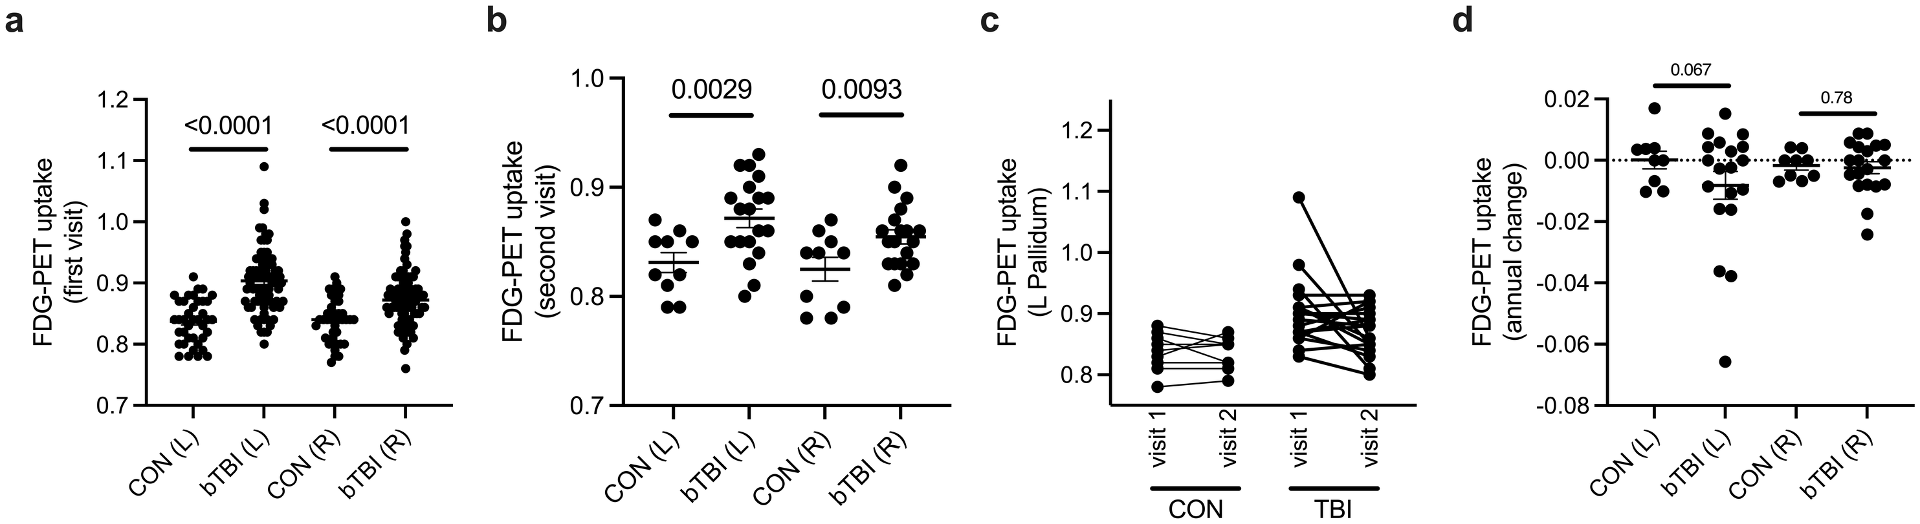
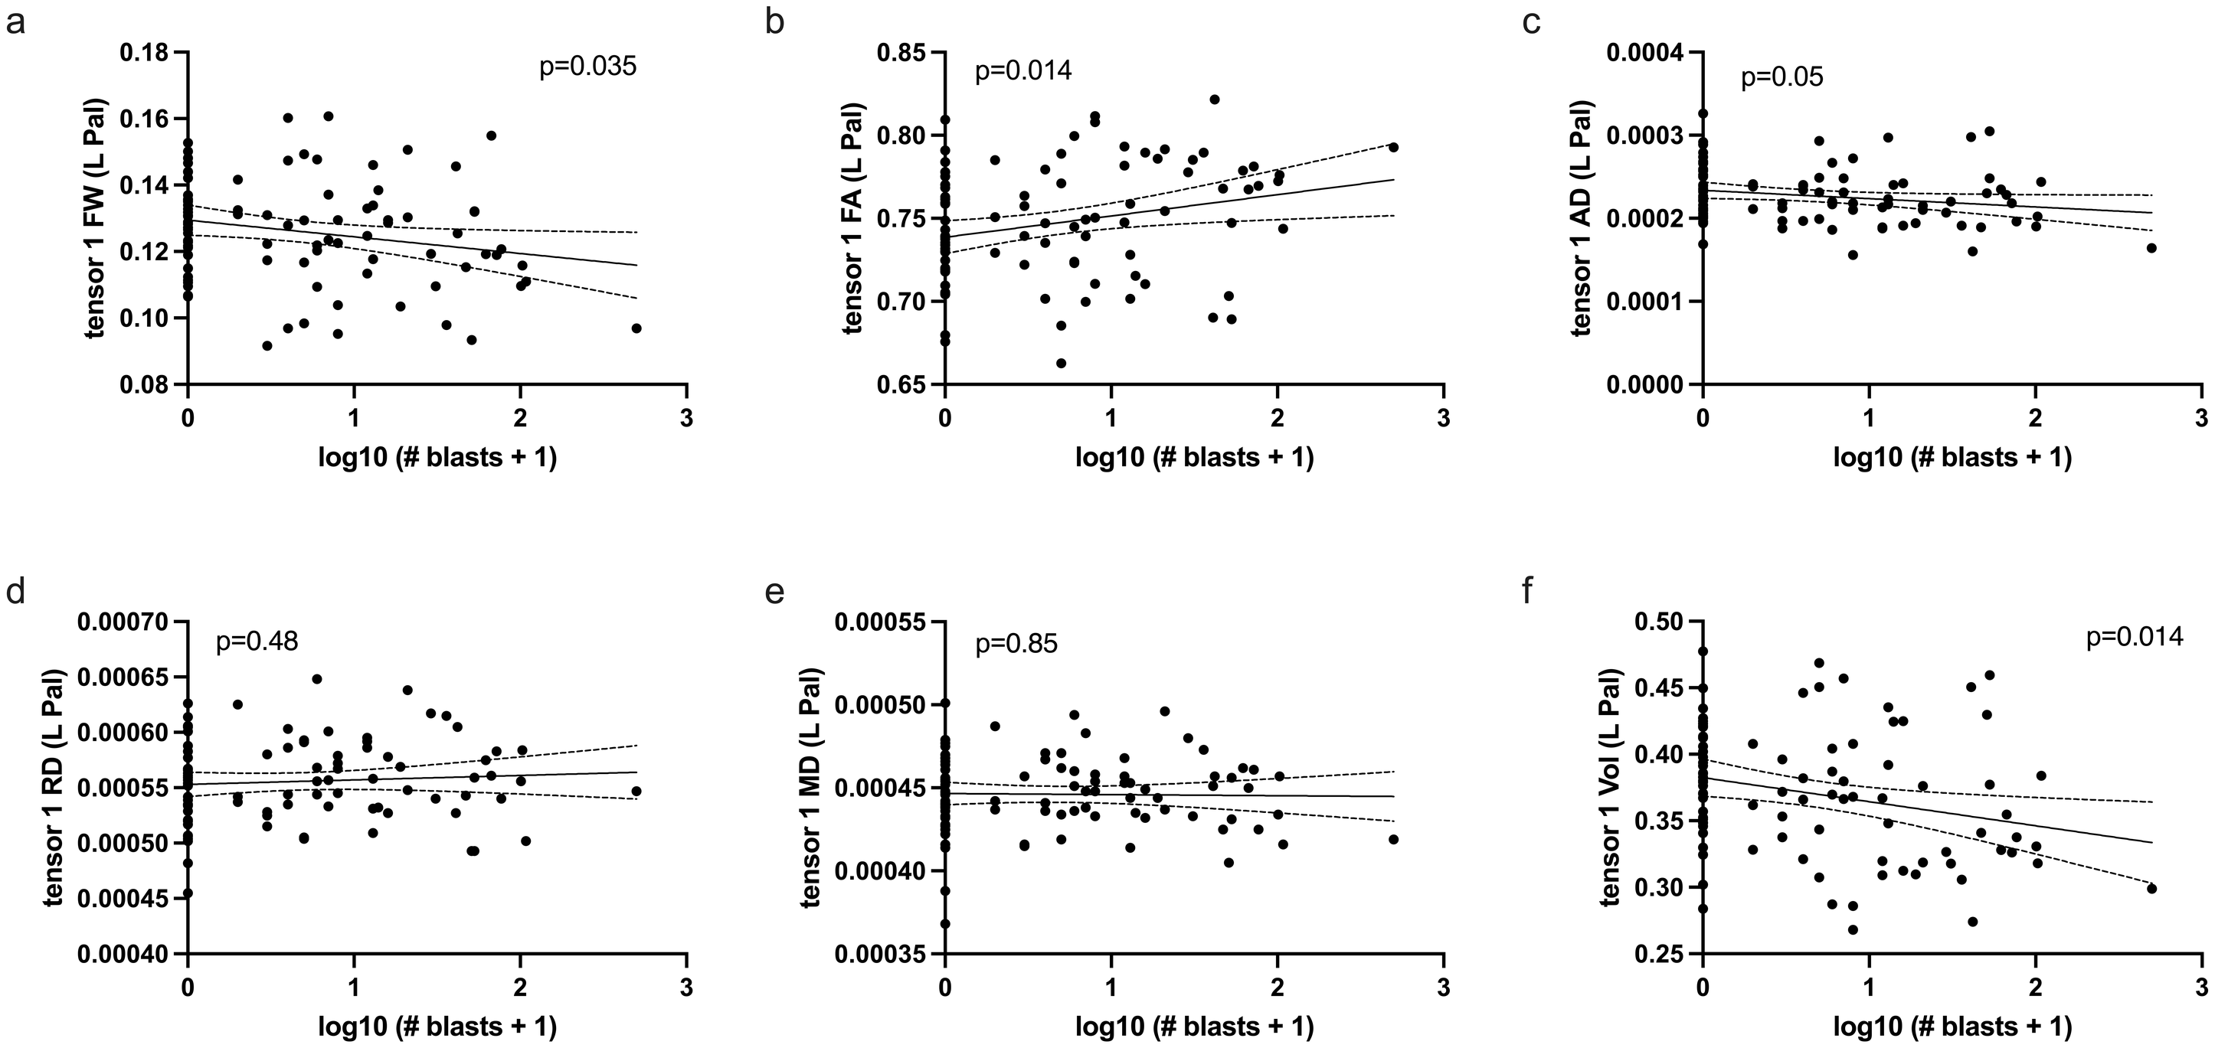
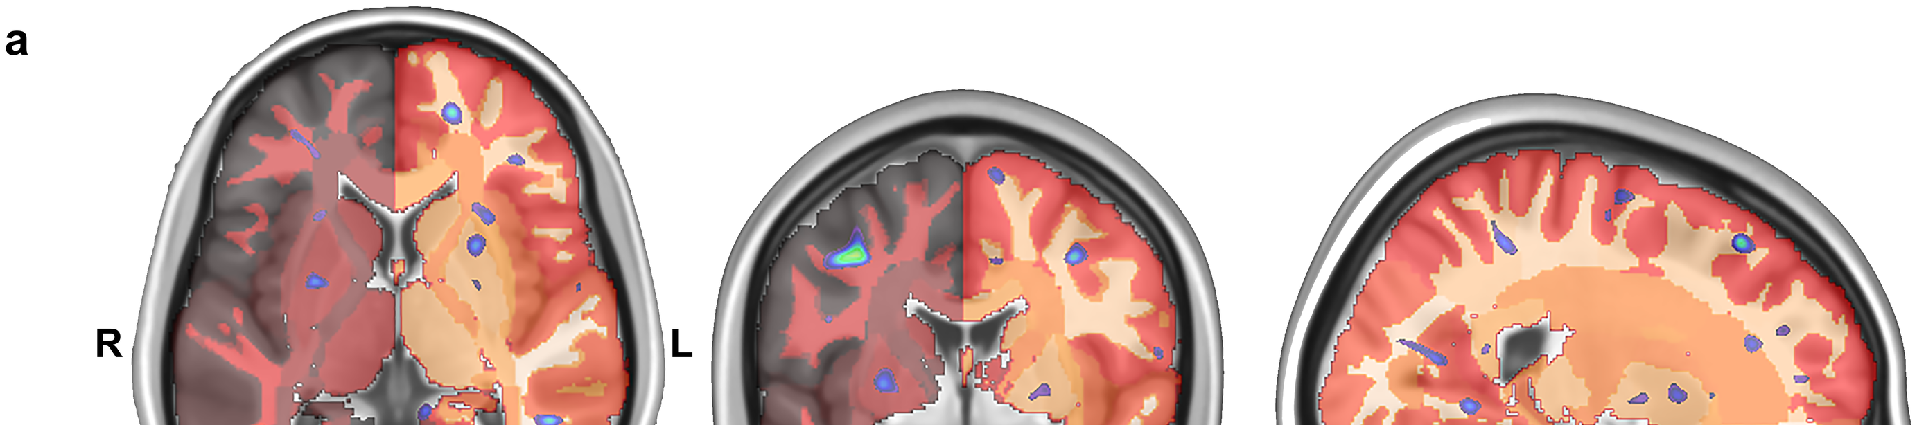
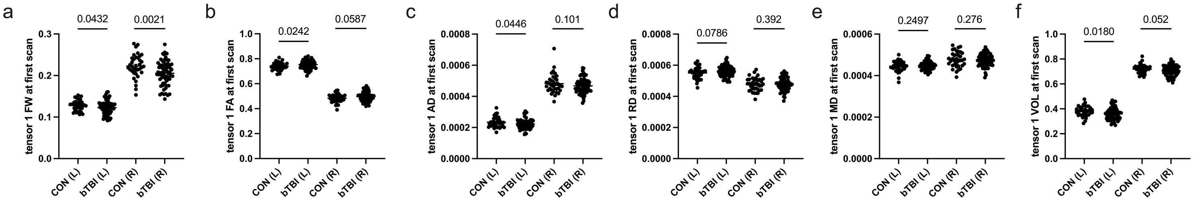
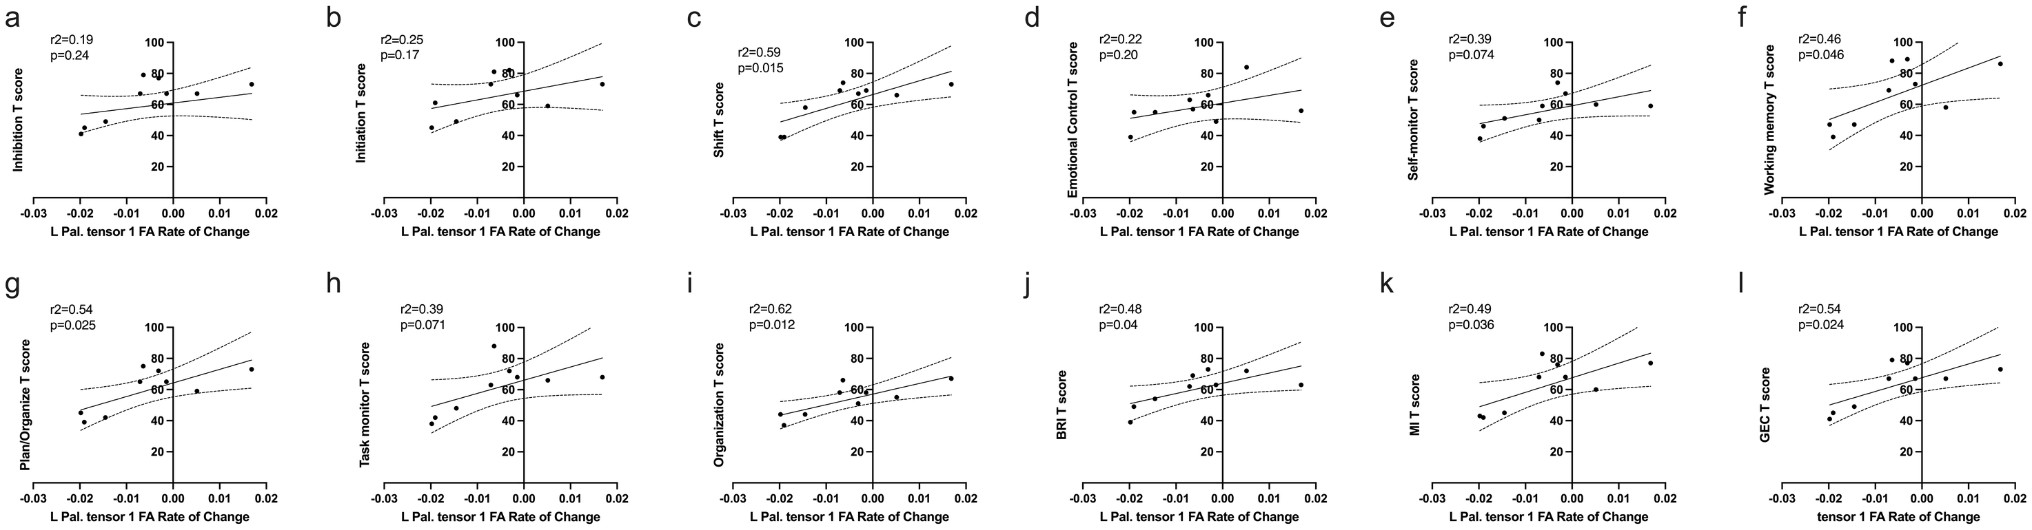
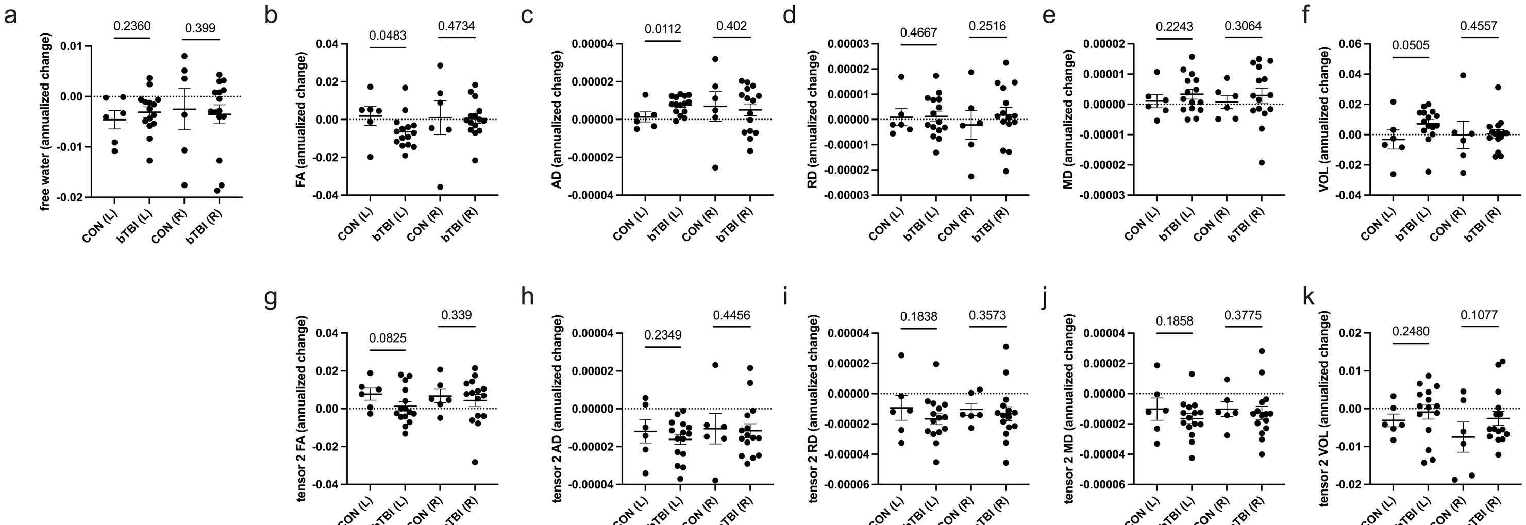
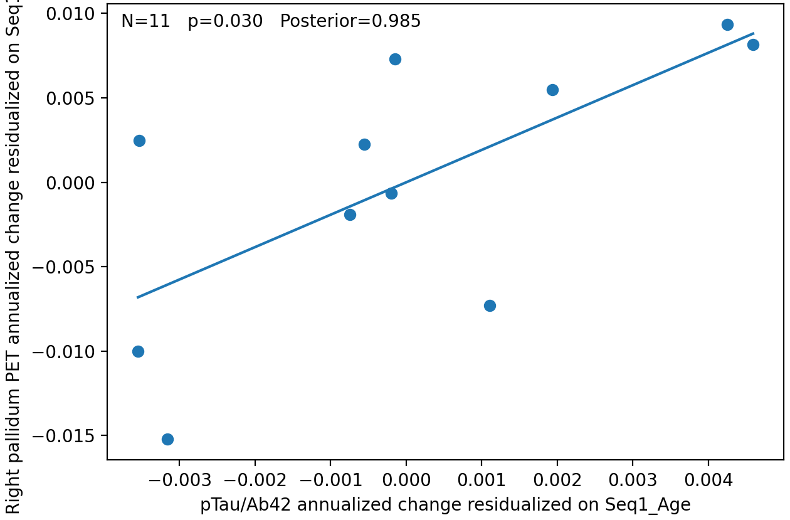
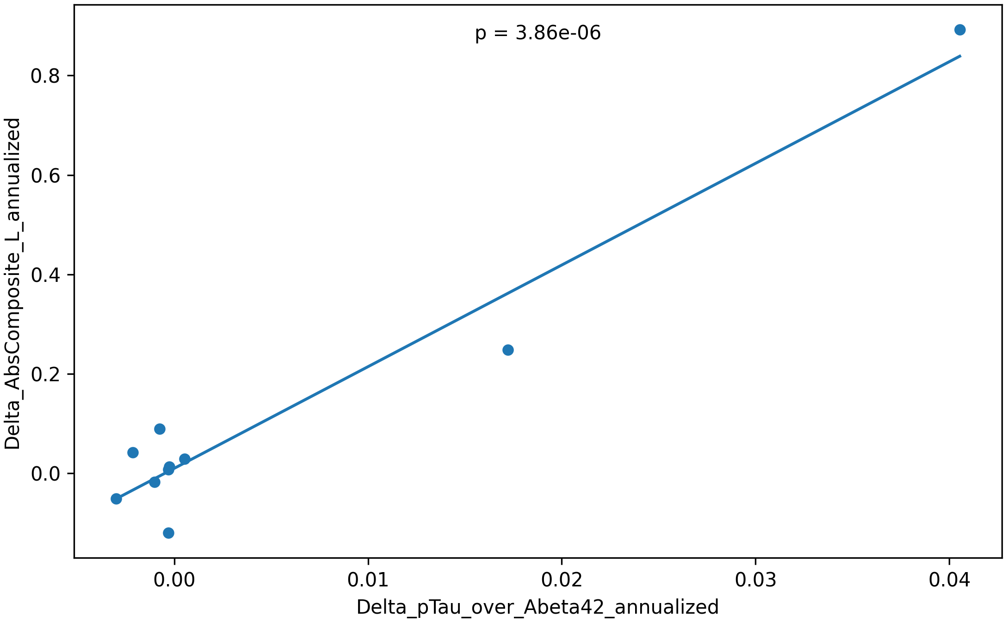
Longitudinal Pallidal PET and DTI Distinguish Persistent Injury From Partial Remodeling After Repetitive Blast-mTBI
James S. Meabon^{1,2}, PhD Garth Terry^{1,2,3}, MD PhD Elaine Peskind^{1,2}, MD
1 Mental Illness Research, Education and Clinical Center (MIRECC), VA Puget Sound Health Care System, Seattle, WA • 2 Department of Psychiatry and Behavioral Sciences, University of Washington, Seattle, WA • 3 Department of Radiology, University of Washington, Seattle, WA
THE PALLIDAL TRAJECTORY │ BASELINE → FOLLOW-UP → RATE OF CHANGE
1
BASELINE
Pallidal FDG uptake is elevated
Left and right pallidal [18F]FDG uptake were higher in blast-mTBI than controls at the first scan — both p < 0.0001. n = 41 control / 79 blast-mTBI.
2
FOLLOW-UP
Elevation persists ~3 years later
Uptake remained elevated at repeat PET a mean of 3.2 ± 0.7 years later (left p = 0.0029; right p = 0.0093). n = 10 / 19.
3
RATE OF CHANGE
Diffusion abnormalities attenuate
Annualized diffusion change indicates attenuation of several left pallidal abnormalities over time rather than uniform progression.
INTRODUCTION
1
METABOLIC TRAJECTORY
BLAST BURDEN DOSE–RESPONSE
— Repetitive blast-induced mild traumatic brain injury (blast-mTBI) is linked to chronic neuropsychiatric morbidity, but biomarkers that distinguish persistent degeneration from longer-term repair or remodeling remain poorly defined.
— The pallidum regulates executive and behavioral control and is vulnerable in blast injury, making it a strong candidate site for trajectory-sensitive imaging biomarkers.
— We tested whether longitudinal pallidal [18F]FDG-PET and advanced diffusion MRI metrics identify clinically relevant trajectories in combat Veterans.
Figure 1. Pallidal [18F]FDG-PET across two study visits. (a) First visit; (b) second visit; (c) intrasubject change, left pallidum; (d) annualized change. Uptake is higher in blast-mTBI at both visits while annualized change does not differ from controls — elevation persists rather than escalating. Wilcoxon.
Left pallidum, voxelwise. FA increases correlated with self-reported blast-mTBI count (Pearson; adj. p < 0.05 in blue), falling along laminar white-matter separations within the left pallidum. R, right; L, left.
2
MICROSTRUCTURE AT BASELINE
Figure 4. Left pallidal tensor-1 metrics scale with cumulative blast burden: (a) free water (p = 0.035), (b) FA (p = 0.014), (c) AD (p = 0.05), (d) RD, (e) MD, (f) volume (p = 0.014) versus log10(# blasts + 1). Higher burden tracks lower free water, higher FA, and lower AD and volume; RD and MD are unrelated.
METHODS
EXECUTIVE FUNCTION PREDICTS CHANGE
— Participants. Veterans with chronic repetitive blast-mTBI and non-TBI controls (deployed control Veterans and community civilians, combined). Any lifetime moderate or severe TBI was exclusionary. All participants gave written informed consent under a VA Puget Sound IRB-approved protocol.
— PET. Resting 15-min [18F]FDG brain PET after a 60-min uptake period. Images were transformed to MNI space, intensity-scaled to parenchyma, and segmented with the AAL2 atlas. A subset underwent repeat PET.
— Diffusion MRI. 3.0 T, 64 directions, b = 0 and 3,000 s/mm². Data were modeled with a two-tensor Unscented Kalman Filter that explicitly models a free-water compartment, yielding free-water–corrected FA, AD, RD, MD, free-water fraction (FW) and tensor volume.
— Measures & statistics. Blast burden and neurobehavioral measures — including the Behavior Rating Inventory of Executive Function-Adult (BRIEF-A) — were analyzed with age-adjusted voxelwise, region-of-interest, longitudinal and regression models, with FDR adjustment across multiple comparisons.
Figure 2. Pallidal tensor-1 diffusion metrics at the first scan: (a) free water, (b) FA, (c) AD, (d) RD, (e) MD, (f) volume, left (L) and right (R). Blast-mTBI shows lower free water bilaterally, higher left FA, and lower left AD and volume. Tensor-2 diffusivities were also lower bilaterally (AD p = 0.031 / 0.023; RD p = 0.021 / 0.011; MD p = 0.022 / 0.013). 1-tailed t-tests.
3
RATE OF CHANGE
LEARNING OBJECTIVES
1. Describe how pallidal FDG-PET and advanced DTI metrics differ between Veterans with repetitive blast-mTBI and controls.
2. Interpret how cumulative blast burden and executive dysfunction relate to longitudinal pallidal structural change.
3. Discuss how multimodal pallidal biomarkers could support risk stratification and longitudinal monitoring in blast-exposed populations.
Figure 5. Baseline BRIEF-A self-report versus subsequent left pallidal tensor-1 FA rate of change: (a–i) subscales, (j) Behavioral Regulation Index, (k) Metacognition Index, (l) Global Executive Composite. Worse baseline executive dysfunction predicts more adverse future left pallidal structural change, most strongly for Organization of Materials (r² = 0.62, p = 0.012), Shift (r² = 0.59, p = 0.015), Plan/Organize (r² = 0.54, p = 0.005) and the Global Executive Composite (r² = 0.54, p = 0.024); both summary indices are also significant (BRI p = 0.04; MI p = 0.036).
CSF pTau/Aβ42 TRACKS THE TRAJECTORY
Table 1. Cohort and imaging coverage.
 | Control | Blast-mTBI
Baseline FDG-PET, n | 41 | 79
Repeat FDG-PET, n | 10 | 19
PET interval, y | 2.8 ± 0.7 | 3.3 ± 0.7
Baseline dMRI, n | 45 | 66
Repeat dMRI, n | 8 | 16
Age at baseline, y | 33.0 ± 9.0 | 34.4 ± 9.3
Blast burden, median (range) | 0 | 10 (1–500)
BRIEF-A GEC T-score | 51.3 ± 12.1 | 68.9 ± 13.2
Figure 3. Annualized change between scans. Left pallidal FA falls (p = 0.0483) and AD rises (p = 0.0112) in blast-mTBI relative to controls — movement back toward control values for the two metrics that were most abnormal at baseline. Most other comparisons are non-significant, consistent with attenuation rather than uniform progression. ALS-diagnosed participant excluded; 2-tailed.
Figure 6. Left: annualized change in right pallidal FDG uptake versus annualized change in CSF pTau/Aβ42, residualized on baseline age (β = 1.92, p = 0.030, R² = 0.59, N = 11; holds after adding PTSD symptoms, p = 0.036). Right: annualized change in the left pallidal absolute diffusion composite versus the same CSF ratio (β = 20.4, p = 3.9 × 10⁻⁶, N = 10).
CONCLUSIONS
Multimodal pallidal biomarkers capture chronic blast-mTBI effects.
Elevated pallidal glucose metabolism persists roughly eight years after the last reported blast-mTBI (baseline here represent 5 yrs after the last blast-mTBI), while the diffusion abnormalities most tied to blast burden move back toward control values — two signals that separate rather than move together.
They may distinguish persistent injury from partial remodeling.
A persistently elevated metabolic set-point alongside attenuating microstructural abnormality is not what uniform progressive degeneration looks like, and argues for measuring trajectory rather than a single cross-sectional snapshot.
Trajectory could support risk stratification and precision surveillance.
Baseline executive dysfunction predicted worse future left pallidal change, and exploratory CSF pTau/Aβ42 change tracked both metabolic and microstructural trajectories — candidate enrichment markers for monitoring blast-exposed warfighters.
FUNDING
VA Northwest MIRECC and the Department of Veterans Affairs (JSM, I01BX004896); VA Puget Sound Health Care System.
DISCLAIMER
The opinions and assertions contained herein are the private views of the authors and are not to be construed as official or as reflecting the views of the Department of Veterans Affairs, the U.S. Army, the Department of Defense, or the U.S. Government. The authors declare no conflict of interest related to these materials.

