Slide 1


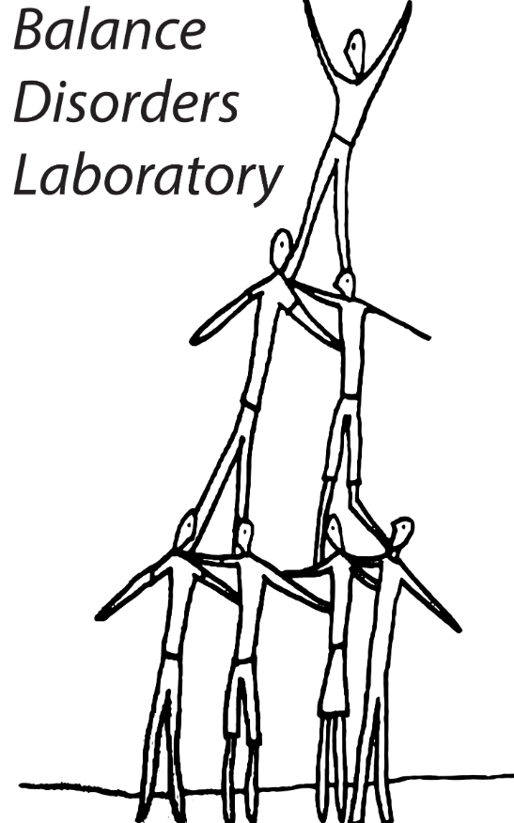
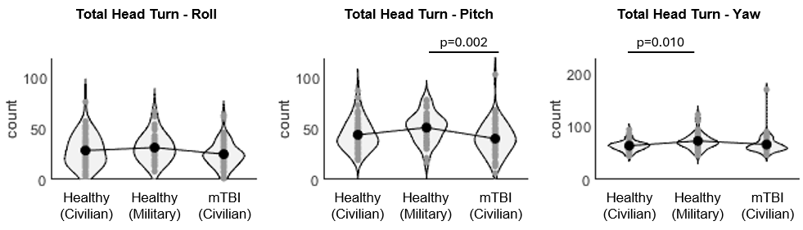
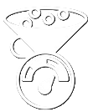
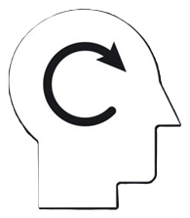
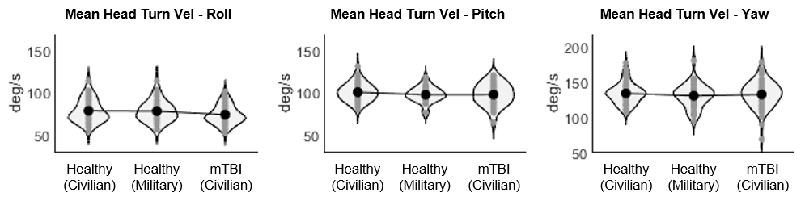
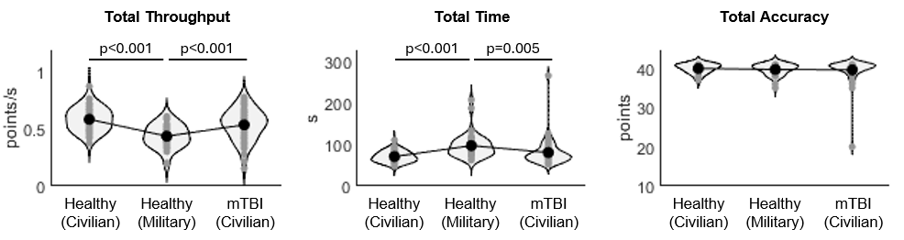
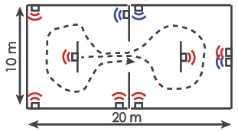
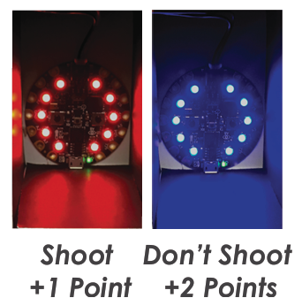
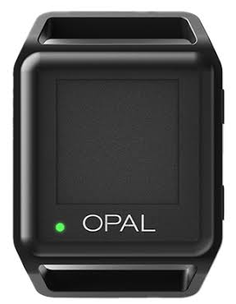
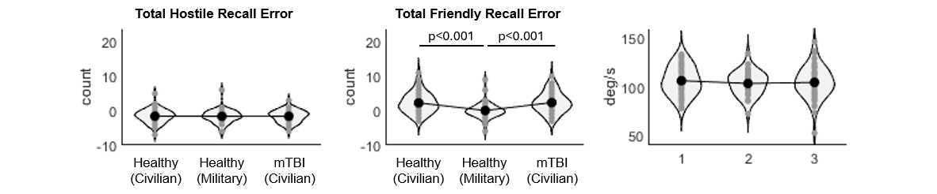
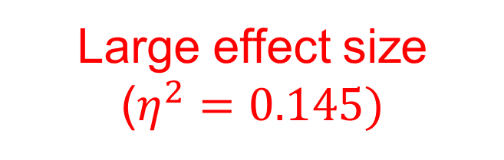
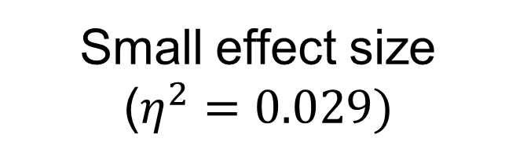
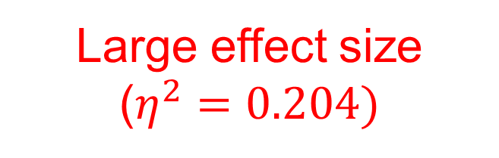
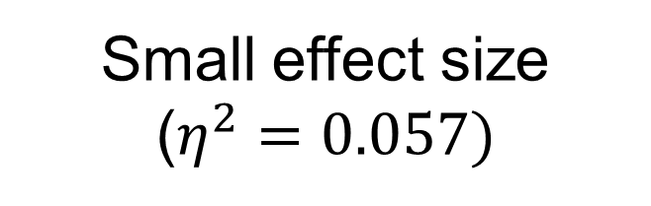
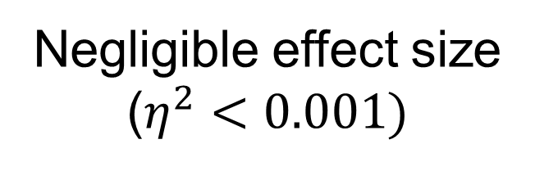
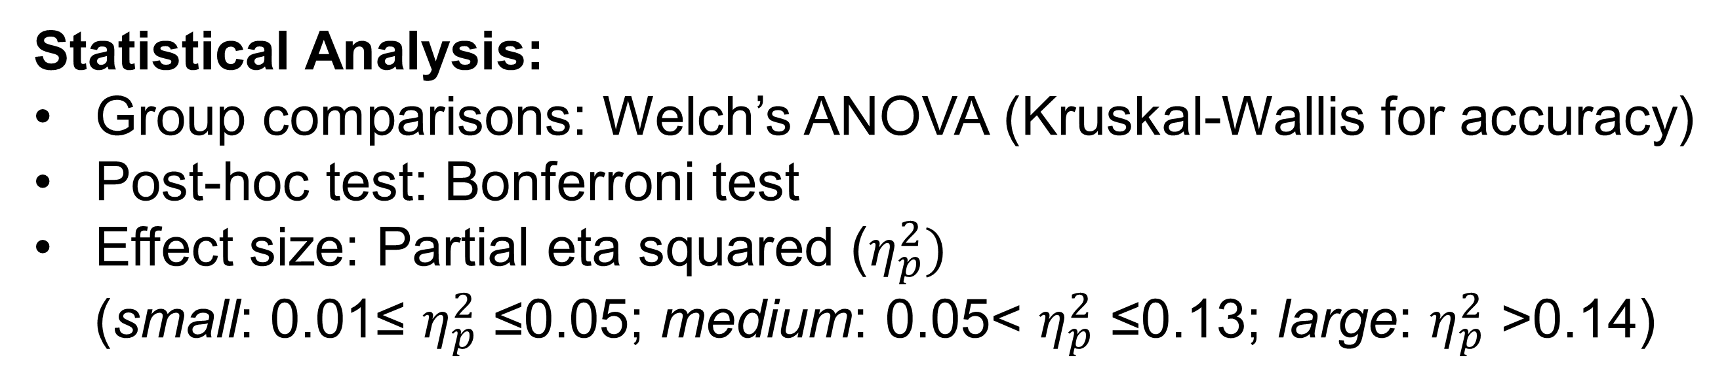
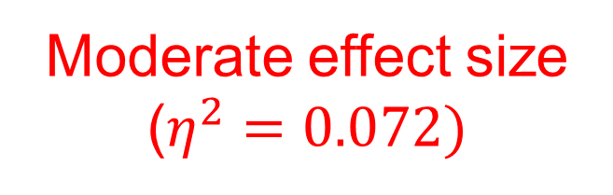
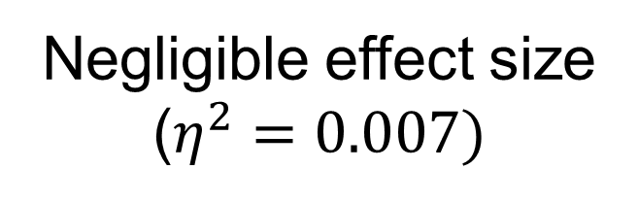

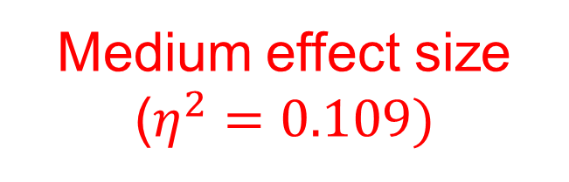

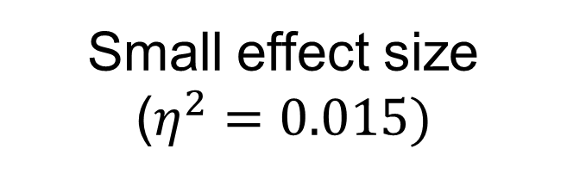
Motor and Cognitive Performance During a Simulated Urban Patrol (SUP) Task
J. W. Lee¹, A. R. Weston², M. Sadeghi¹, P. C. Fino³, M. M. Weightman⁴, L. E. Dibble³, L. A. King^{1,5}, C. W. Hoppes⁶
¹Oregon Health & Science University, Portland, OR, USA; ²Joint Base San Antonio, San Antonio, TX, USA; ³University of Utah, Salt Lake City, UT, USA;
⁴Courage Kenny Research Center – Allina Health, Minnesota, MN, USA; ⁵Veterans Affairs Portland Health Care System, Portland, OR, USA;
⁶Joint Base San Antonio-Lackland Air Force Base, San Antonio, TX, USA
Department of Neurology
BACKGROUND
METHODS (cont.)
RESULTS (cont.)
Recognizing the unique combination of intense motor and cognitive skills required of warfighters, ecologically valid assessments are critical for making return-to-duty decisions in active-duty service members (SMs) after mild traumatic brain injury (mTBI).
The Simulated Urban Patrol (SUP) task is a novel clinical test incorporating military-relevant movements that has recently been developed to detect turning deficits after mTBI.
Outcome measures:
3
SMs exhibited more head turns in pitch and yaw directions than civilian cohort
Task performance
From the laser-tag patrol task
Head movement
From the head-worn sensor
Time
Total across 3 trials
Accuracy
Comstock method
Head turns
Count: roll, pitch, yaw
Throughput
Accuracy / time
Recall error
Recalled - actual
Turn velocity
Average: roll, pitch, yaw
OBJECTIVE
Statistical Analysis:
Group comparisons: Welch’s ANOVA (Kruskal-Wallis for accuracy)
Post-hoc test: Bonferroni test
Effect size: Partial eta squared ($η_{p}^{2})$
(small: 0.01≤ $η_{p}^{2}$ ≤0.05; medium: 0.05< $η_{p}^{2}$ ≤0.13; large: $η_{p}^{2}$ >0.14)
Examine how the performance of the SUP task differed between healthy civilians, civilians with mTBI, and healthy SMs.
Small effect size
($η^{2}=0.033)$
Moderate effect size
($η^{2}=0.072)$
Small effect size
($η^{2}=0.057)$
4
Average head turning velocity was similar across all cohorts
METHODS
RESULTS
Participants:
Significantly lower throughput for healthy SMs, driven by longer completion time
 | Healthy Civilians (n=57) | Healthy SMs (n=40) | Civilians with mTBI (n=57)
Age (yrs) | 31.1 ± 9.5 | 27.4 ± 4.8 | 32.3 ± 9.6
Sex (M, (%)) | 16 (28.1%) | 26 (63.4%) | 12 (21.1%)
Height (cm) | 170.6 ± 9.8 | 175.6 ± 10.8 | 169.7 ± 9.4
Body mass (kg) | 72.4 ± 17.1 | 76.9 ± 15.1 | 73.1 ± 18.9
Days since injury | – | – | 311.3 ± 265.0
1
Small effect size
($η^{2}=0.029)$
Small effect size
($η^{2}=0.015)$
Negligible effect size
($η^{2}=0.007)$
DISCUSSION/CONCLUSION
Experimental Procedures:
People wore a wearable sensor on the head (Clario) while navigating through a shoot house with two rooms separated by a doorway using a laser tag weapon. They were instructed to clear all hostile (red) targets as fast as possible without tagging friendly (blue) targets. Three trials were completed with targets switching across trials. Targets were at varying heights
Military SMs completed the SUP task more slowly, with fewer friendly target recall errors, and with more head turns, implying more visual scanning
mTBI did not affect the performance of SUP task for civilians. However, we did not have SMs with mTBI
Our results suggest that return-to-duty decisions for SMs should be made from normative SM performance not from civilians
Large effect size
($η^{2}=0.204)$
Large effect size
($η^{2}=0.145)$
Negligible effect size
($η^{2}=0.005)$
2
SMs had significantly lower friendly recall error compared to both civilian cohorts
REFERENCES
Shoot
+1 point
Don’t shoot
+2 points
Opal V2C System
(Clario, part of Thermo Fisher Scientific)
[1] Fino et al., Front Neurol, 11:544812, 2021
[2] Fino et al., J Neurotrauma, 42(11-12): 929-943, 2025.
[3] U.S.P.S Association, USPSA Competition Rules, USPSA/IPSC Inc., 2019
This work was supported by the Assistant Secretary of Defense for Health Affairs under Award #W81XWH1820049 (King; PI). Opinions, interpretations, conclusions and recommendations are those of the author and are not necessarily endorsed by the Department of Defense.
Negligible effect size
($η^{2}<0.001)$
Medium effect size
($η^{2}=0.109)$
Notes:
Check Peter’s main DoD4 paper for that schematic?

