Slide 1


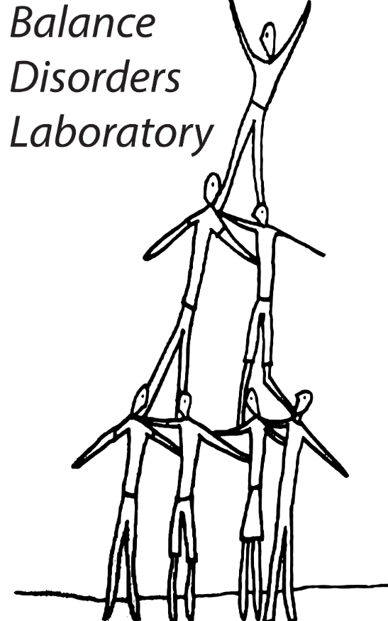
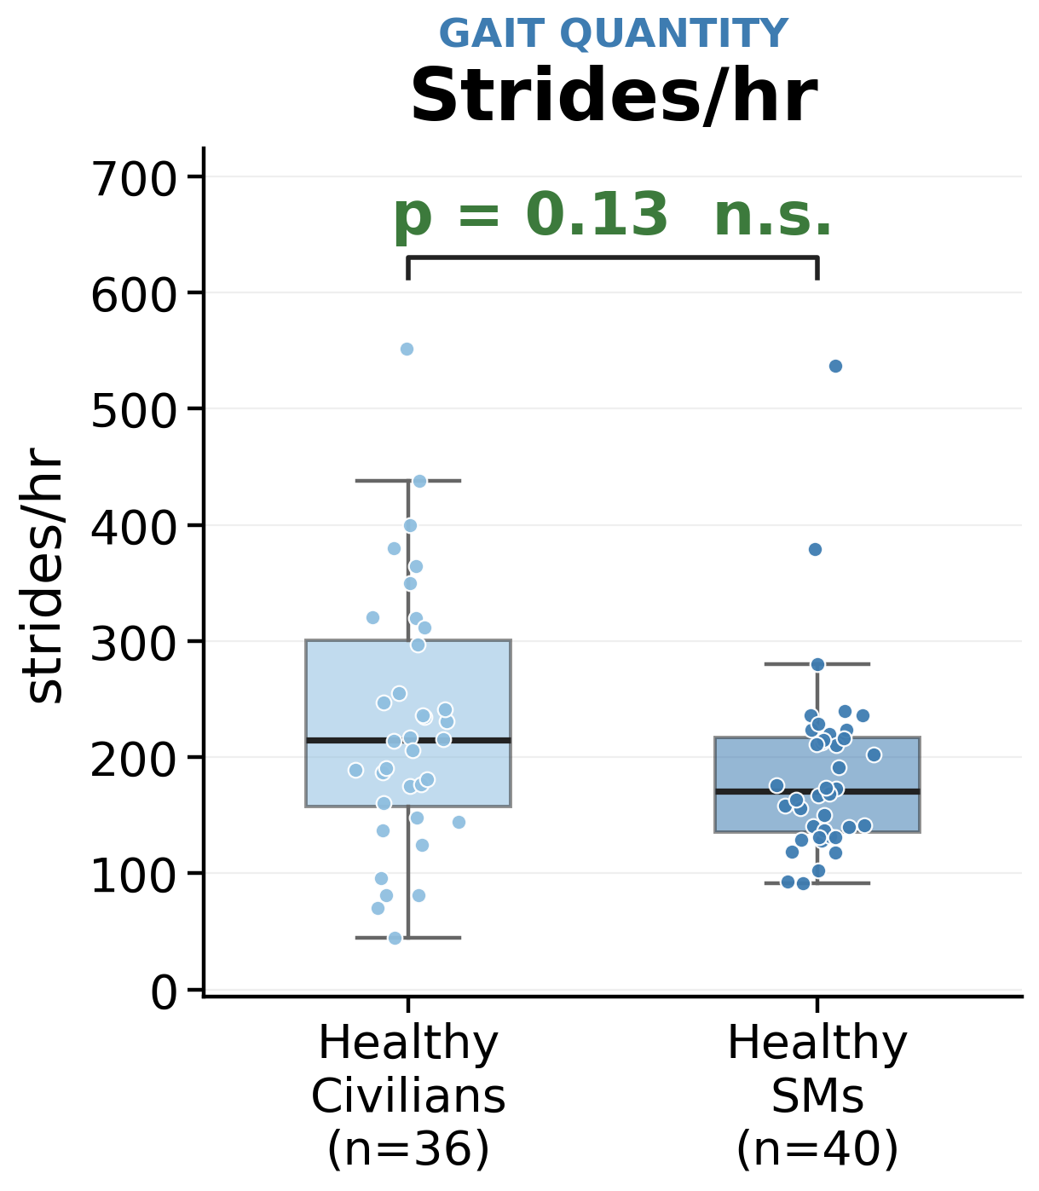
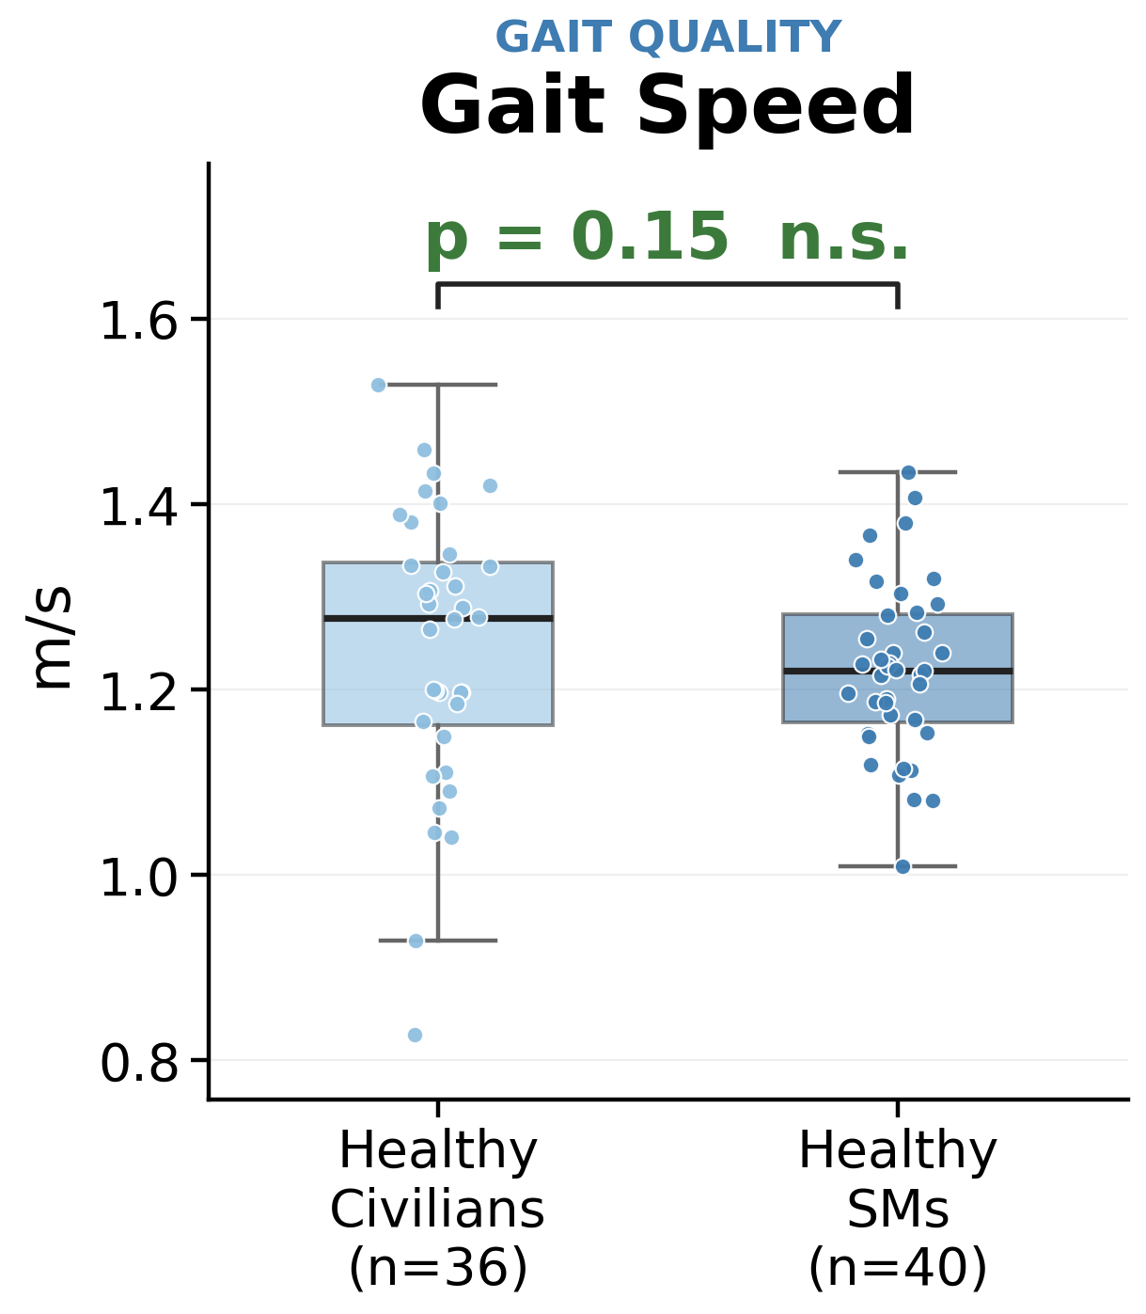
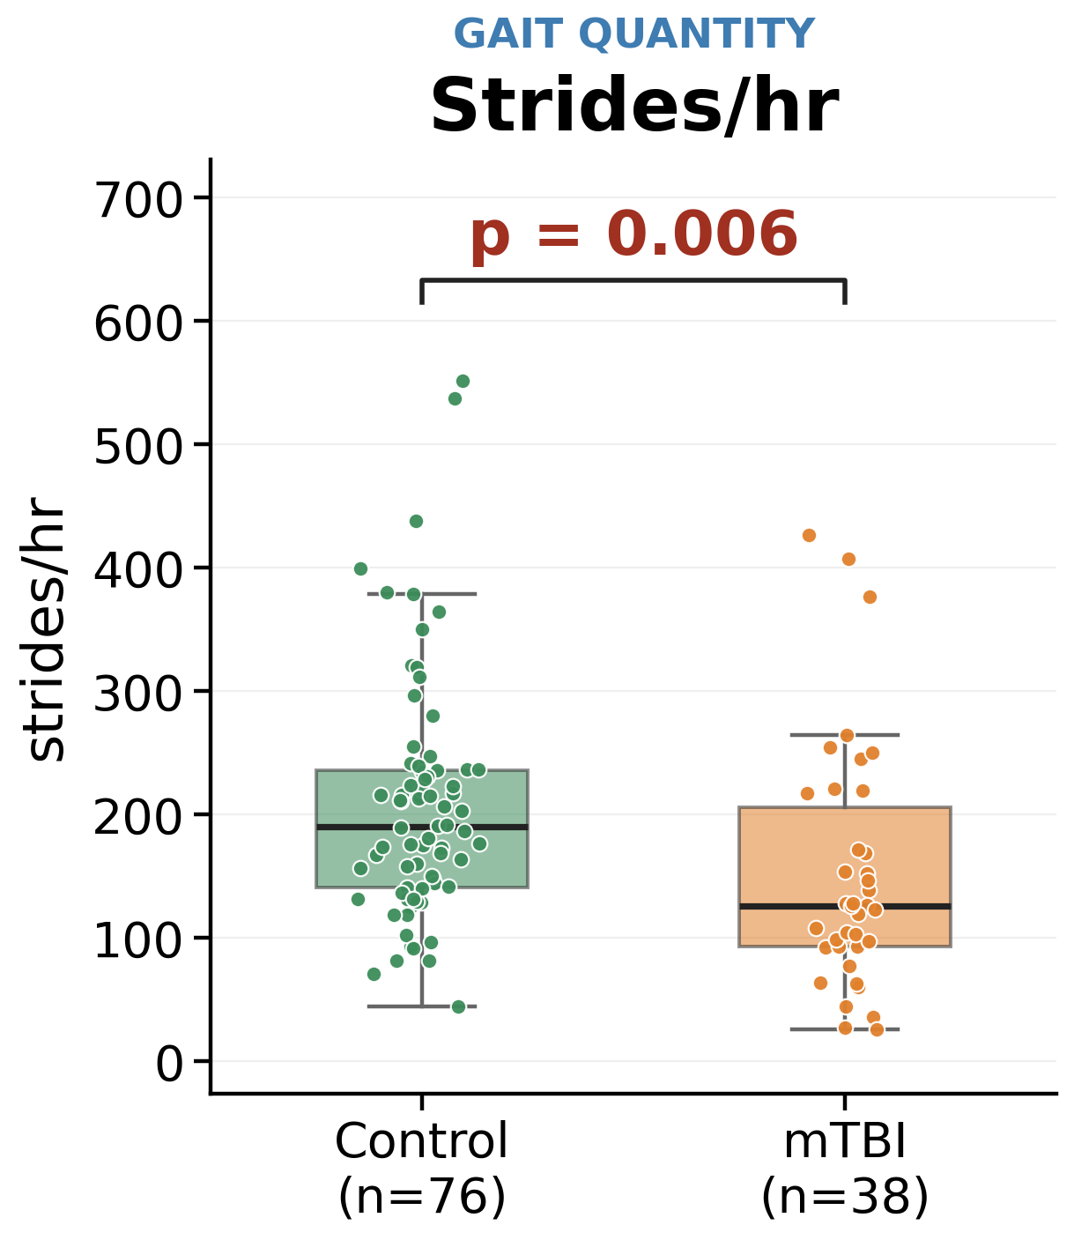
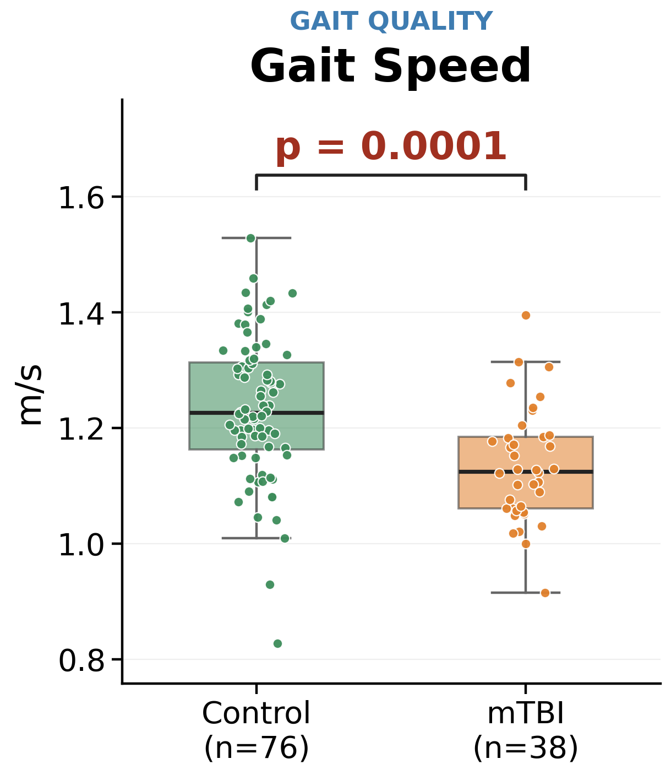
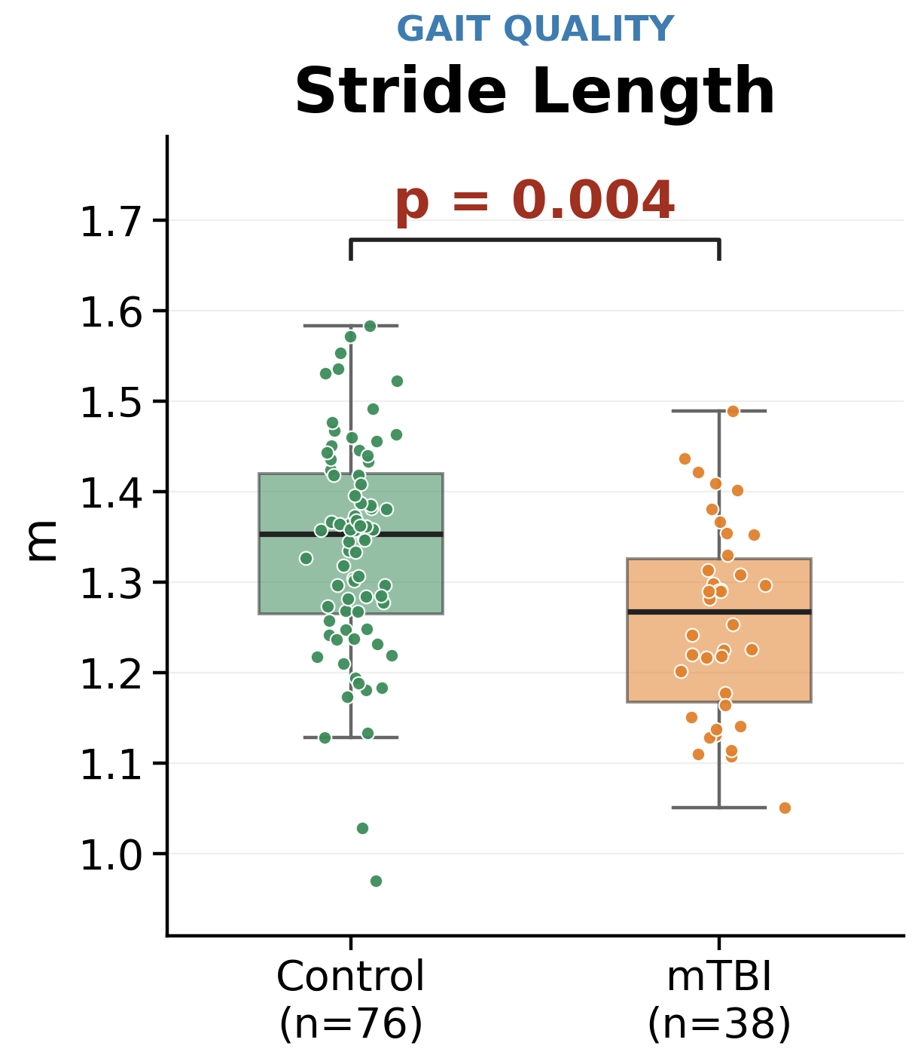
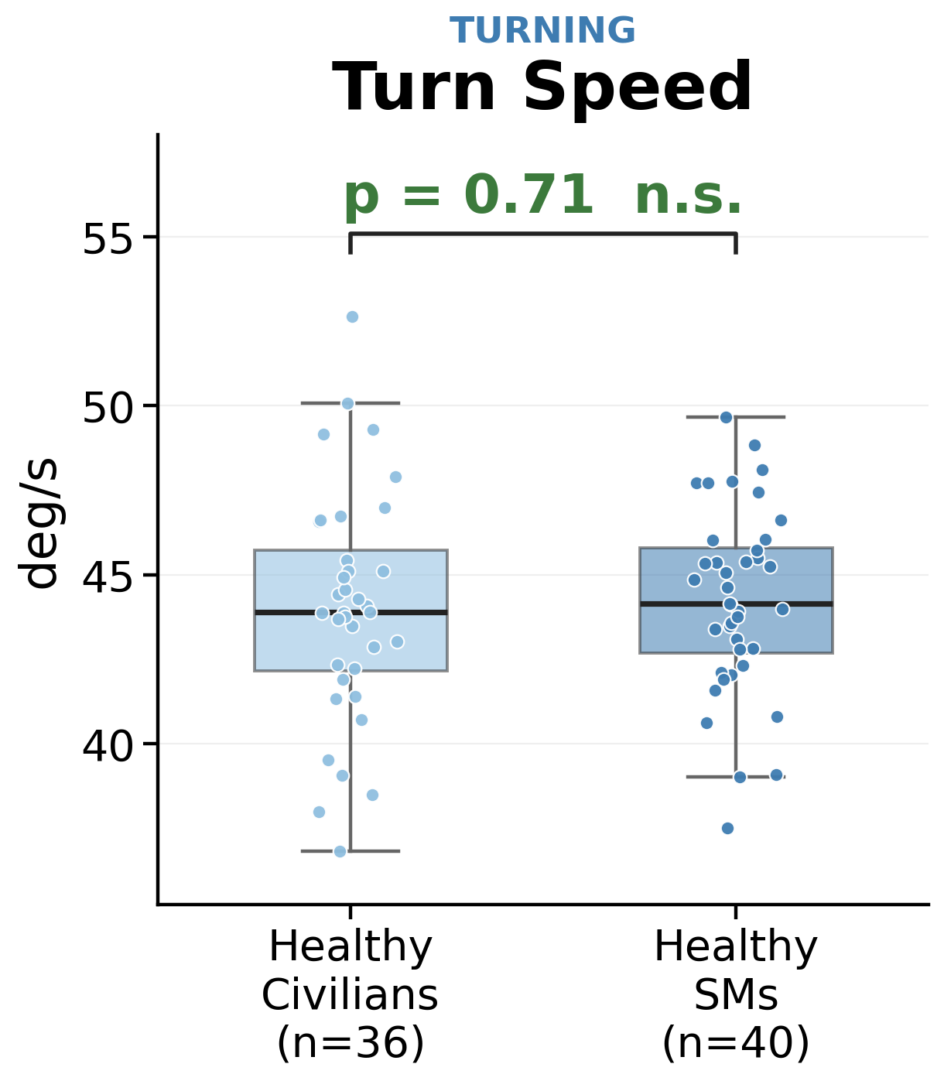
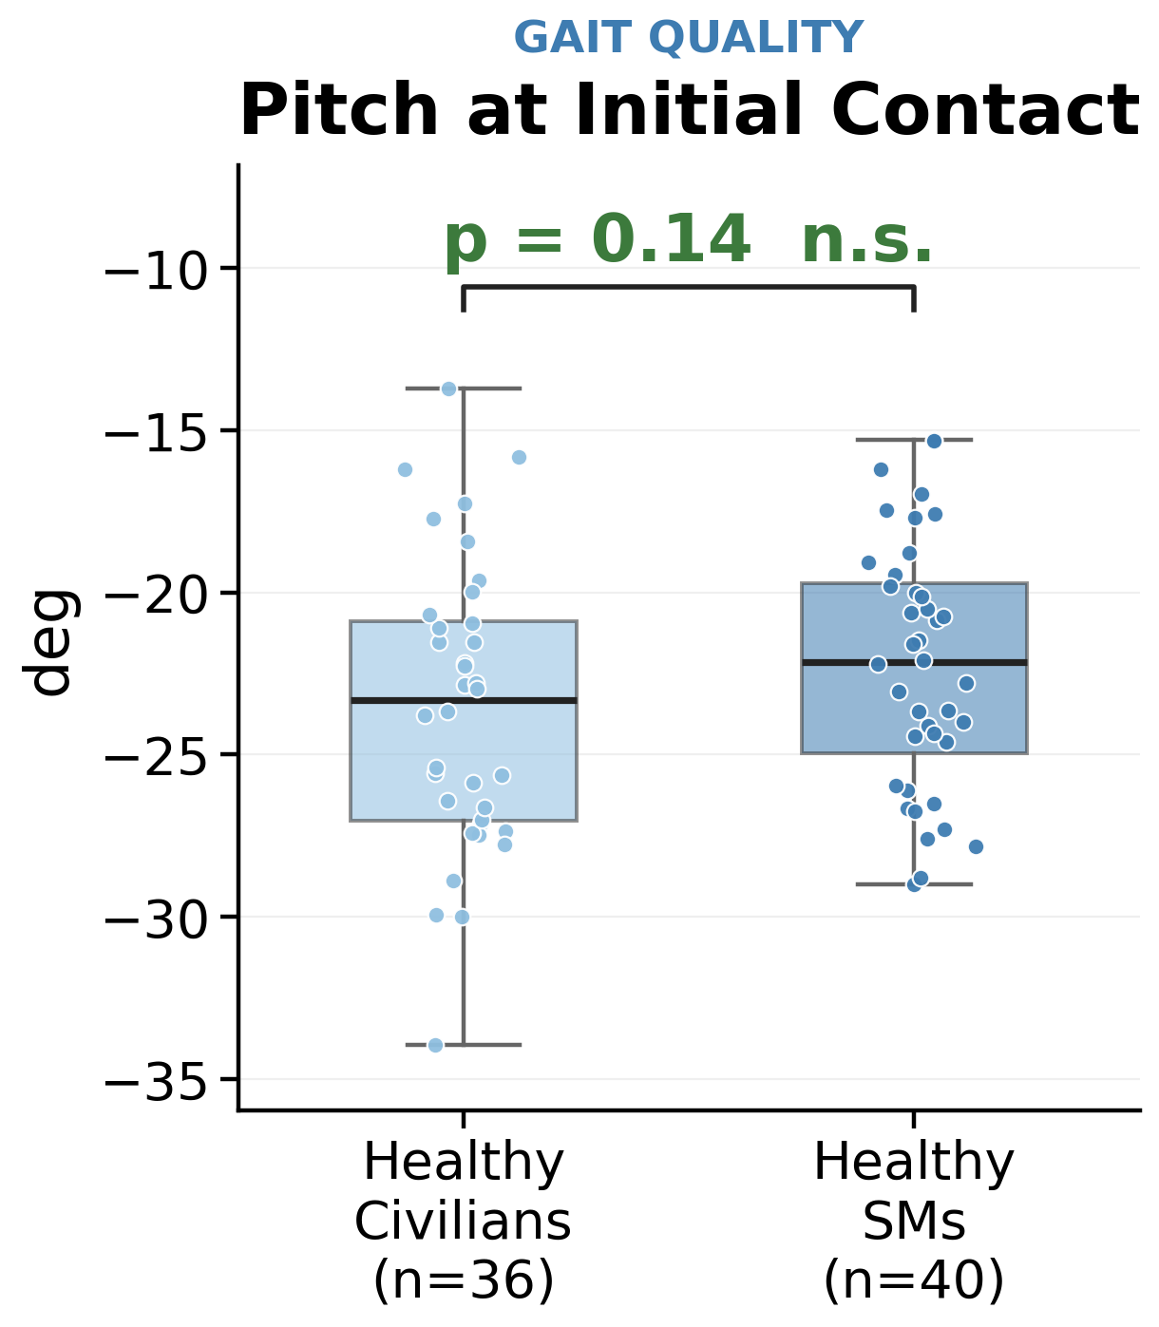
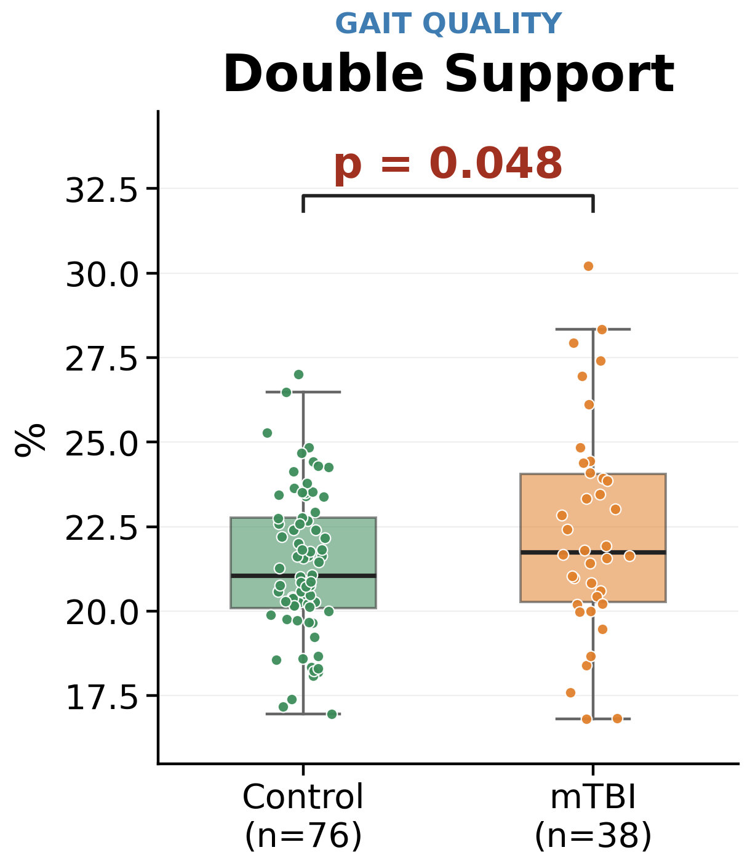
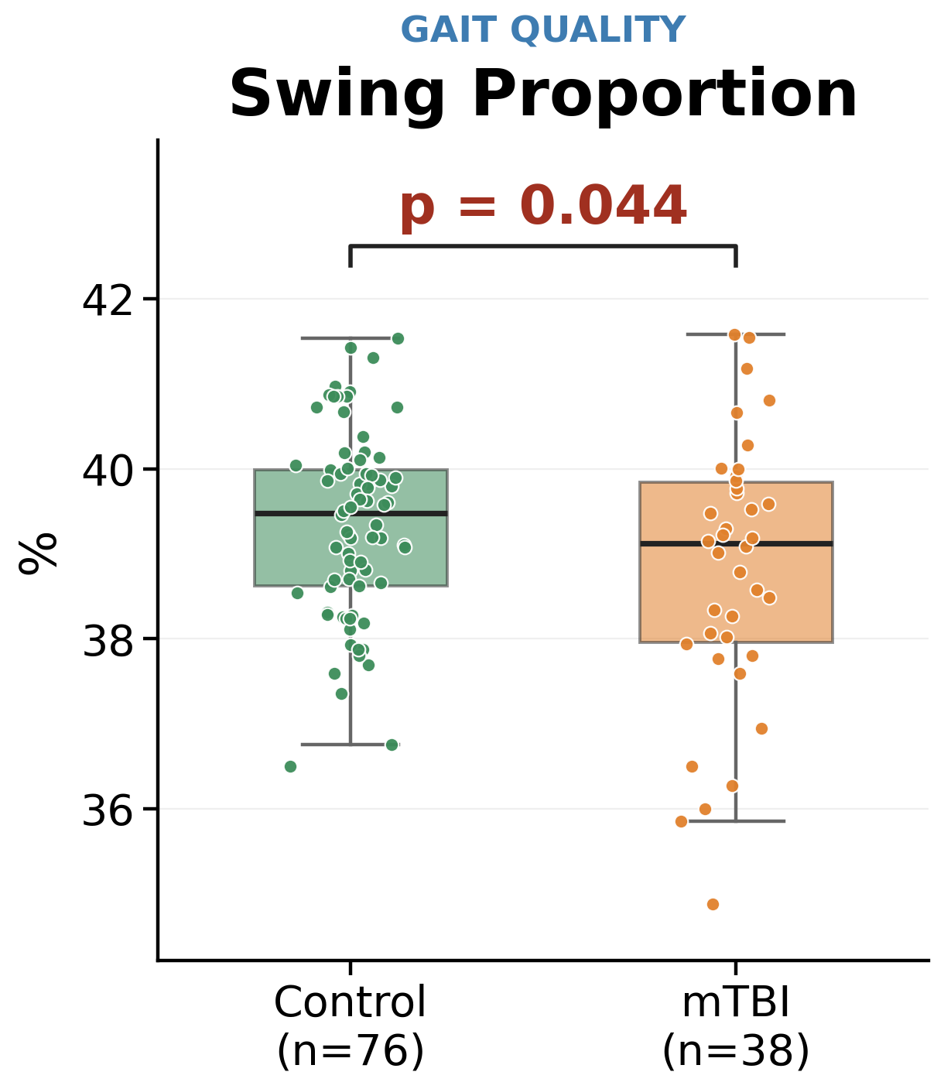
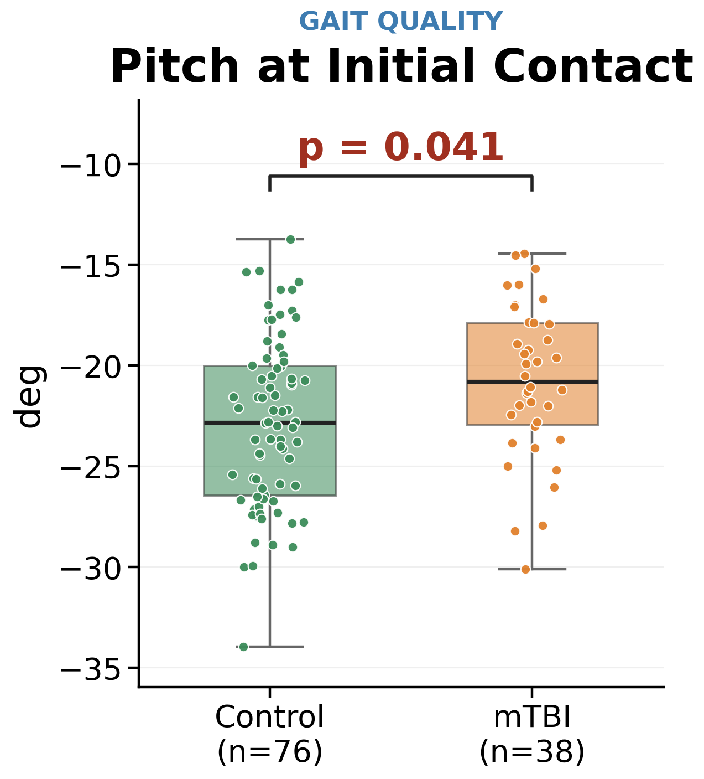
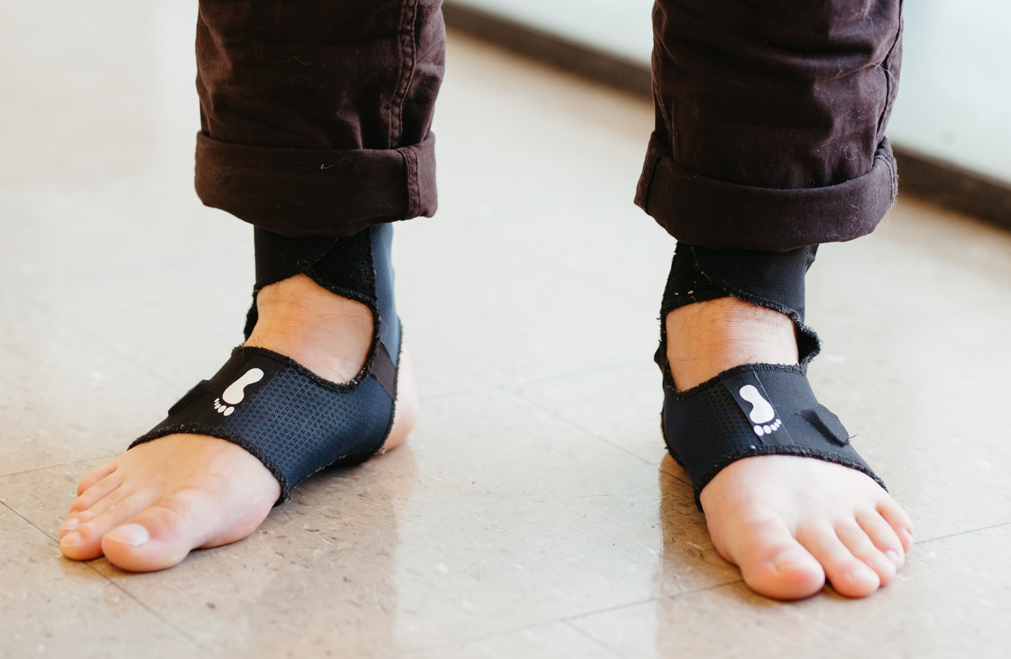
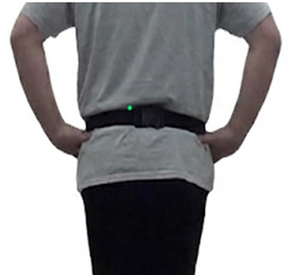
COMPARING DAILY LIFE MOBILITY IN HEALTHY ACTIVE-DUTY SERVICE MEMBERS, HEALTHY CIVILIANS, AND CIVILIANS WITH MILD TRAUMATIC BRAIN INJURY
J. W. Lee¹, M. Sadeghi^{1,} A. R. Weston², W. Liu¹, M. E. Stojak¹, C. W. Hoppes³, P. C. Fino⁴, L. A. King^{1,5}
¹Oregon Health & Science University, Portland, OR, USA; ²Joint Base San Antonio, San Antonio, TX, USA; ³Joint Base San Antonio-Lackland Air Force Base,
San Antonio, TX, USA; ⁴University of Utah, Salt Lake City, UT, USA; ⁵Veterans Affairs Portland Health Care System, Portland OR, USA
Department of Neurology
BACKGROUND
RESULTS
Return-to-duty decisions for active-duty service members (SMs) following mild traumatic brain injury (mTBI) often rely on simple clinical mobility tests.
Although the physical demands and tactical training associated with military service may impact how military service members perform prescribed tasks, the differences in daily mobility between healthy SMs and civilians are unclear.
Healthy civilians and healthy active-duty service members did not significantly differ in daily-life gait or turning
2
Compared with healthy controls, civilians with mTBI showed significant differences in gait quantity and gait quality, but not in turning
1
OBJECTIVE
Characterize and compare the daily-life gait and turning measures between healthy SMs, healthy civilians, and civilians with mTBI
METHODS
Characteristic | Healthy civilians (n=36) | Healthy active-duty SMs (n=40) | Civilians with mTBI (n=38)
Age, years | 35.9 ± 10.3 | 31.7 ± 7.6 | 34.3 ± 9.1
Female, n (%) | 23 (63.9%) | 22 (55.0%) | 29 (76.3%)
Days since injury | — | — | 54.0 ± 35.1
Experimental Procedures
Participants wore Opal Instrumental Socks and a separate Opal sensor on the waist (~7 days, ~8-10 hours/day)
Data and Statistical Analysis
Daily-life mobility metrics were analyzed using custom algorithms developed by Clario
  Gait quantity (e.g., strides/hr, walking turns/hr)
  Gait quality (e.g., gait speed, stride length)
  Turning (e.g., number of steps/turn, turn speed)
Analysis 1: linear mixed models for daily-life gait and turning between healthy civilians (n= 36) and healthy active-duty SMs (n=40), correcting for age and sex
Analysis 2: healthy civilians and healthy active-duty SMs were combined into one control group (n=76); linear mixed models adjusted for age and sex compared daily-life mobility between controls and civilians with mTBI (n=38)
Across study participants, age was associated with turning measures and sex was associated with stride length and gait variability
DISCUSSION/CONCLUSION
Opal Instrumented Socks and a separate Opal on the lumbar
(Clario company, part of Thermo Fisher Scientific)
Military service alone did not appear to influence gait or turning during daily-life mobility. However, the presence of mTBI primarily affected one’s gait quality across multiple measures. Future studies should include active-duty military service members with mTBI.
These findings support the development of normative daily-life mobility data to inform future return-to-duty assessment after mTBI.
This work was supported by the Assistant Secretary of Defense for Health Affairs under Award #HT9425-23-1-0845 (King; PI). Opinions, interpretations, conclusions and recommendations are those of the author and are not necessarily endorsed by the Department of Defense.
Notes:
Pitch
Double support
Swing proportion
pitch

