Slide 1

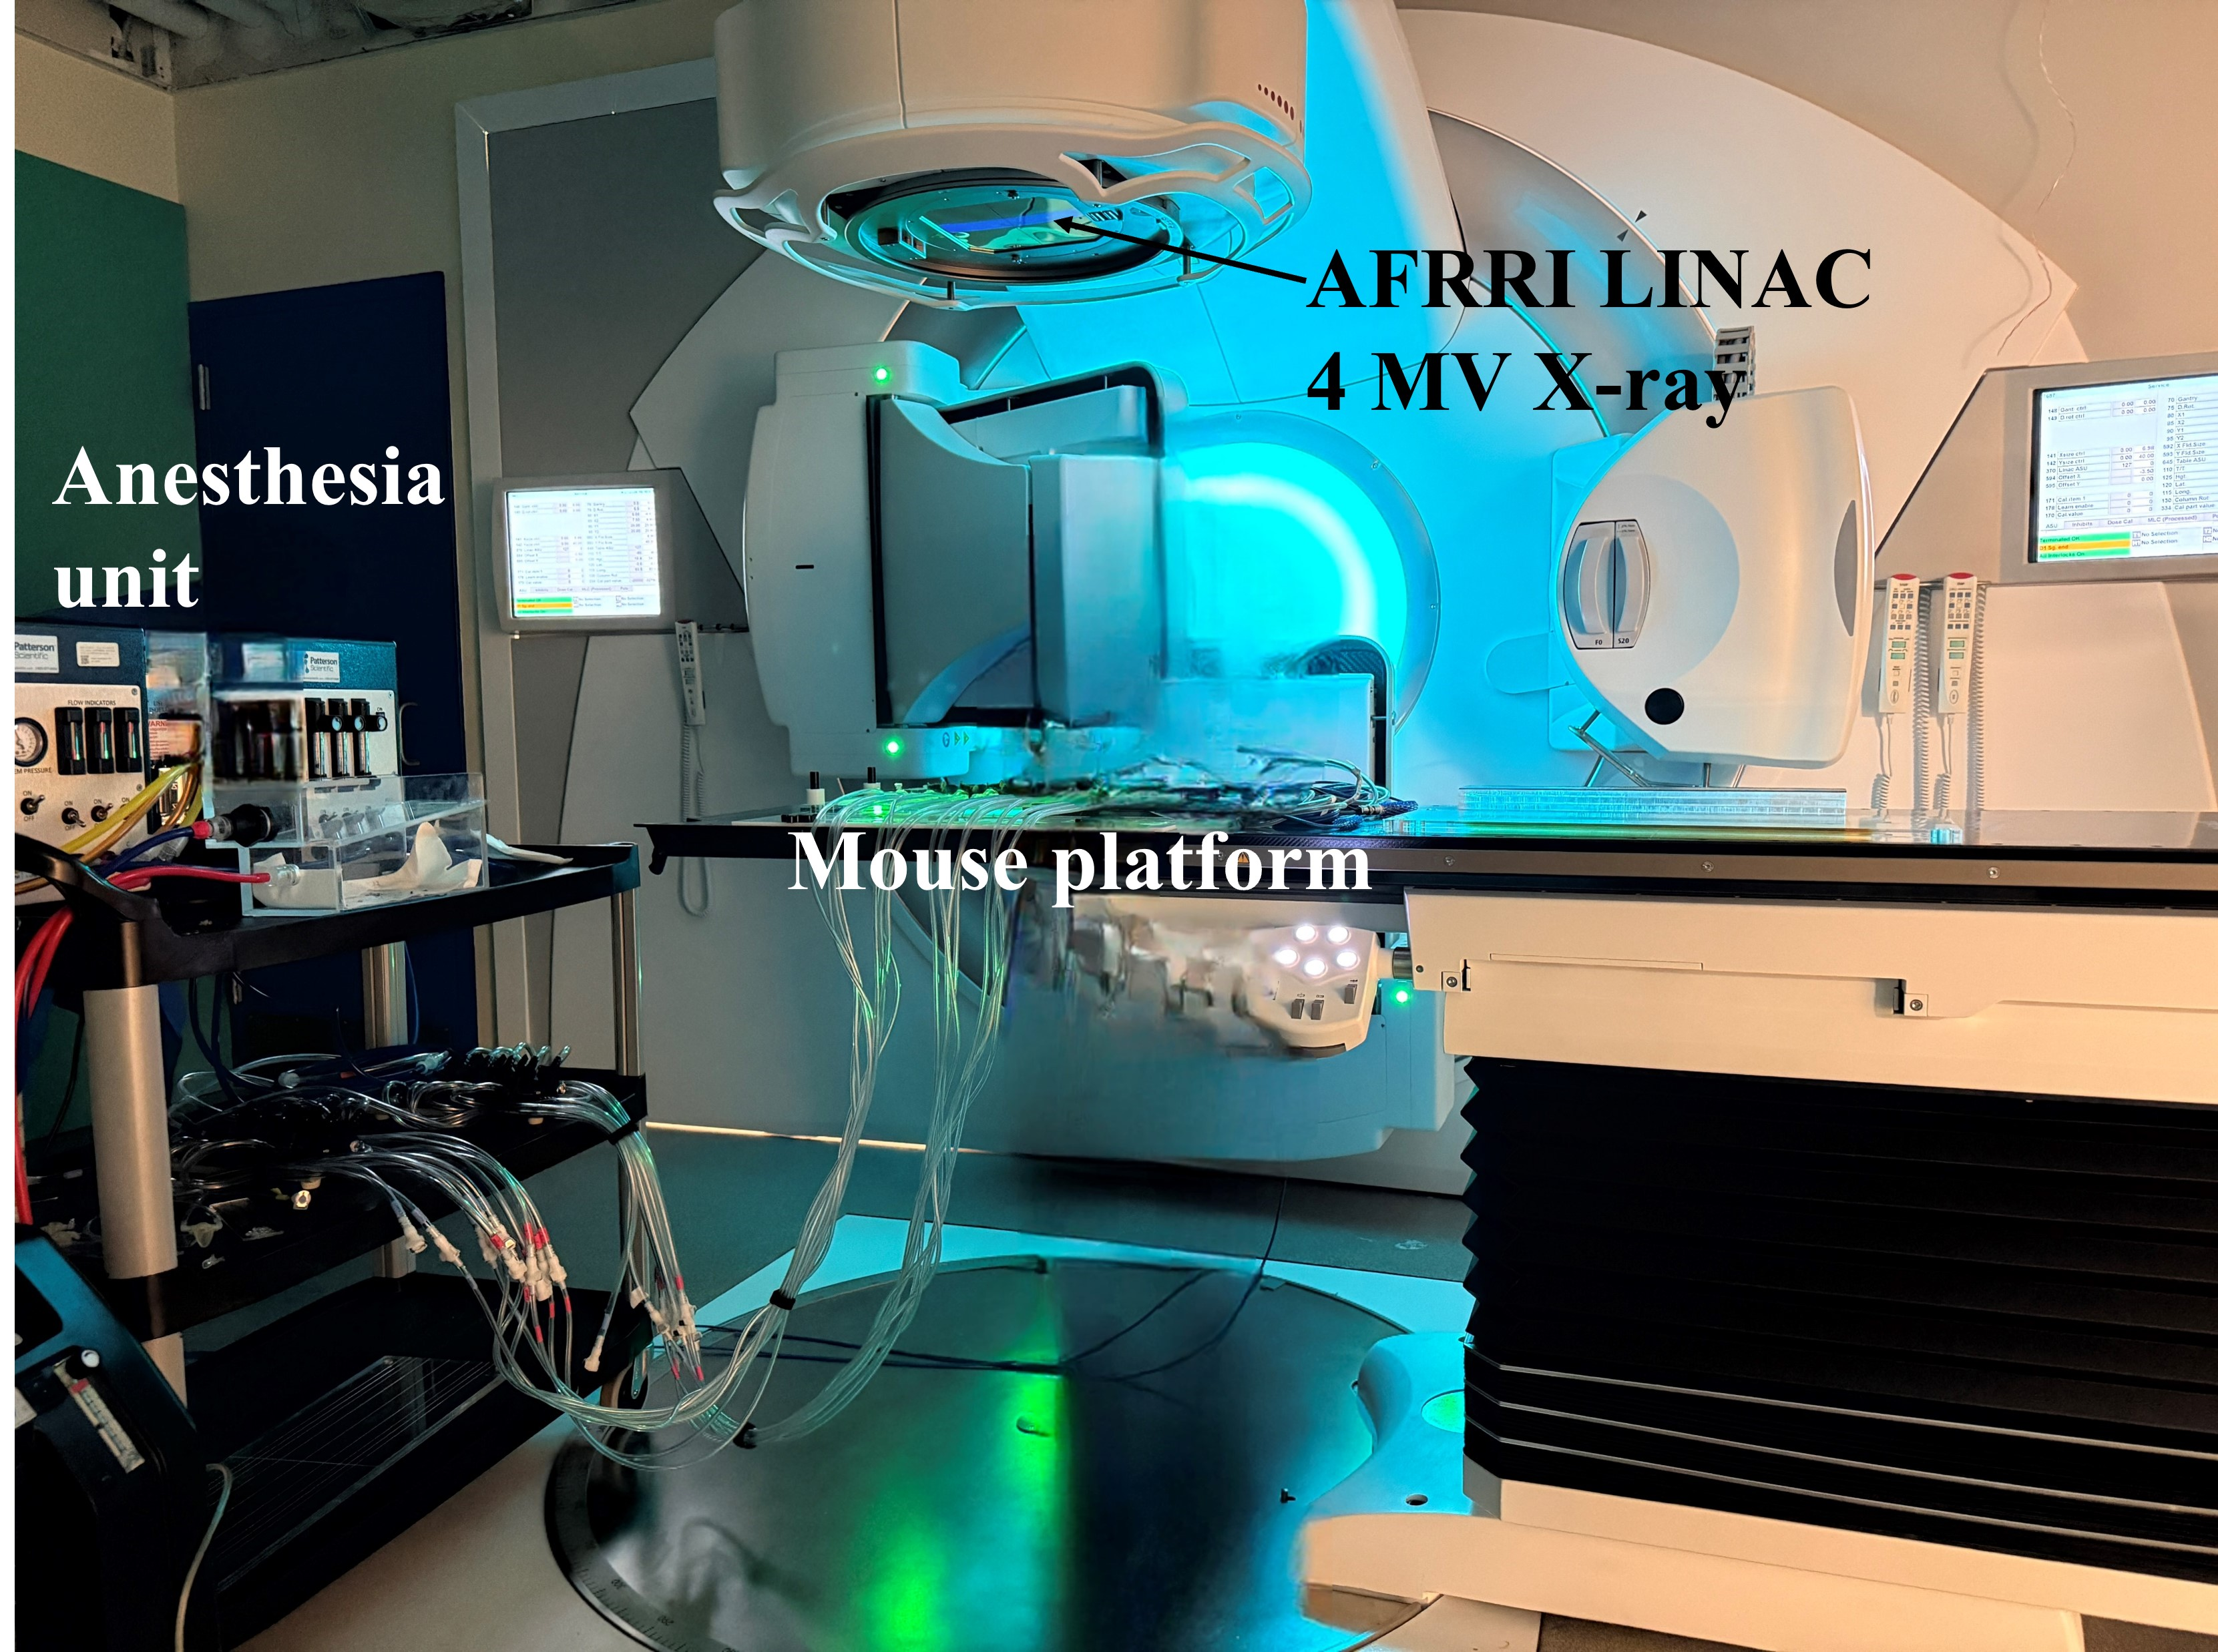
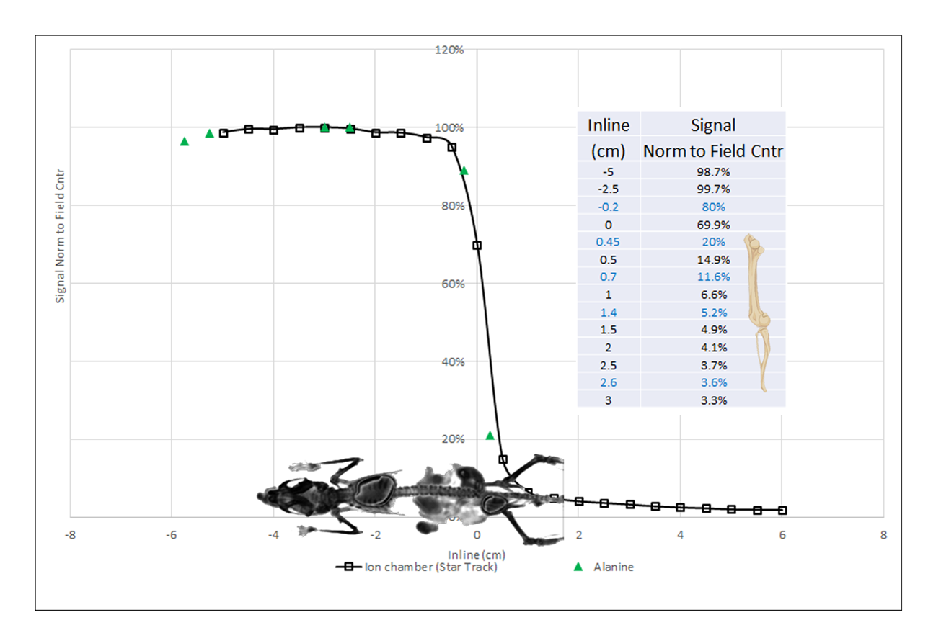
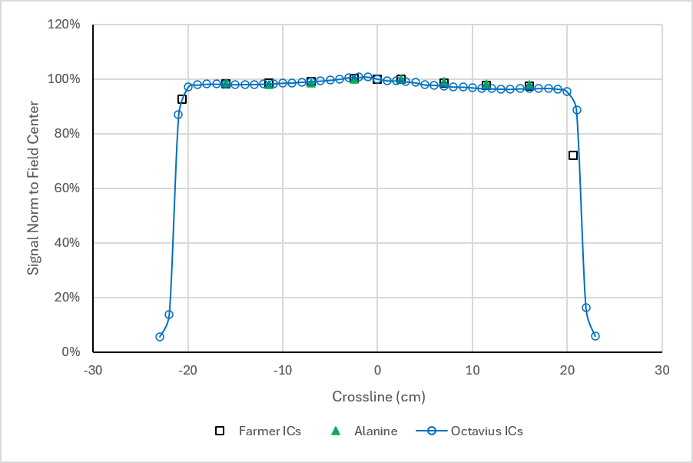
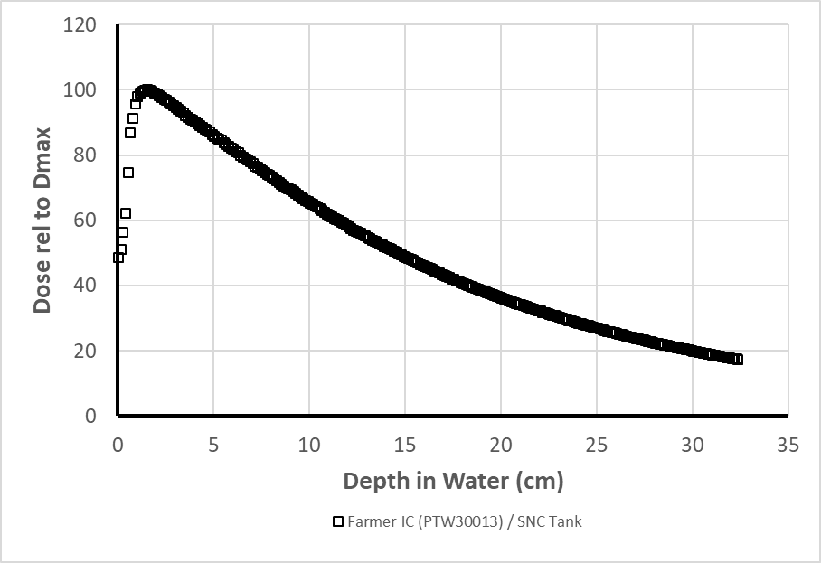
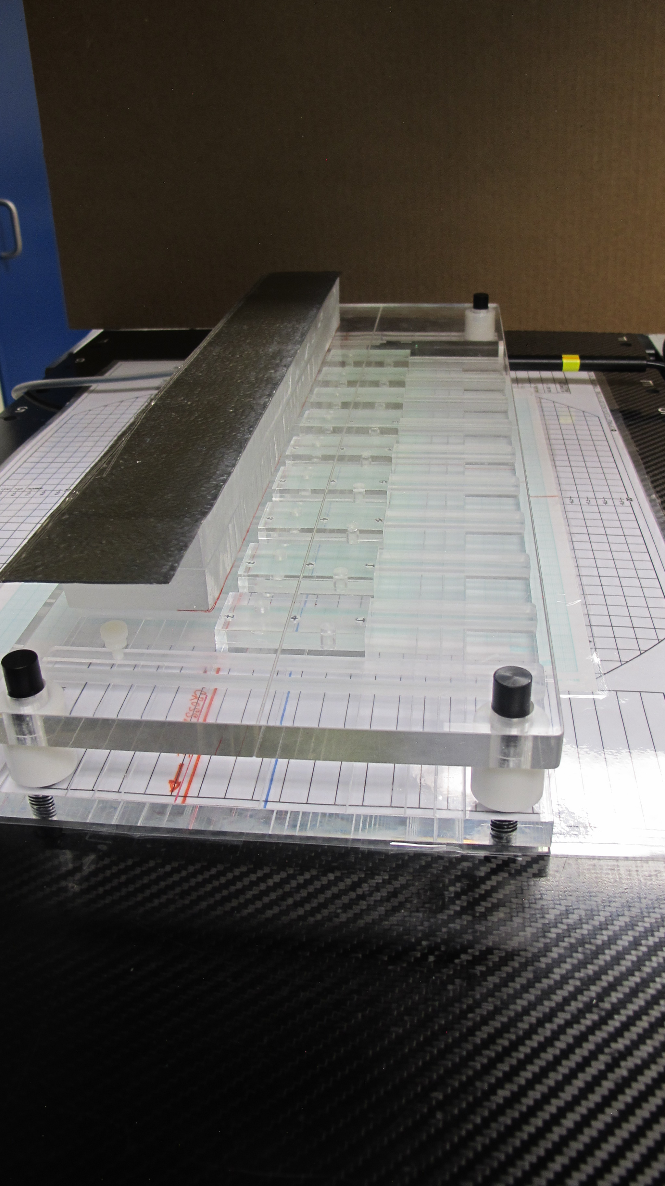
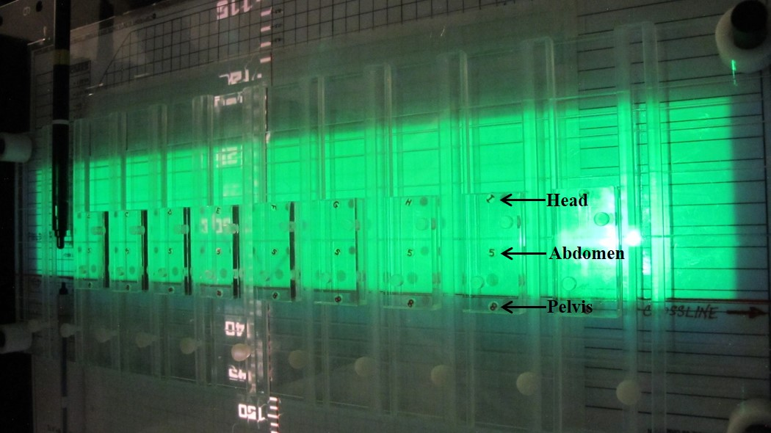
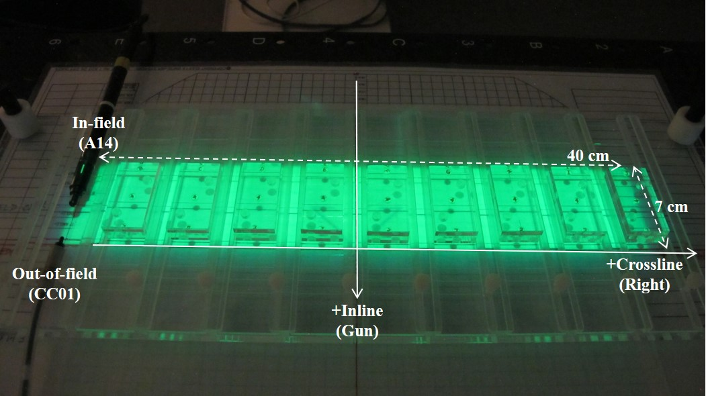
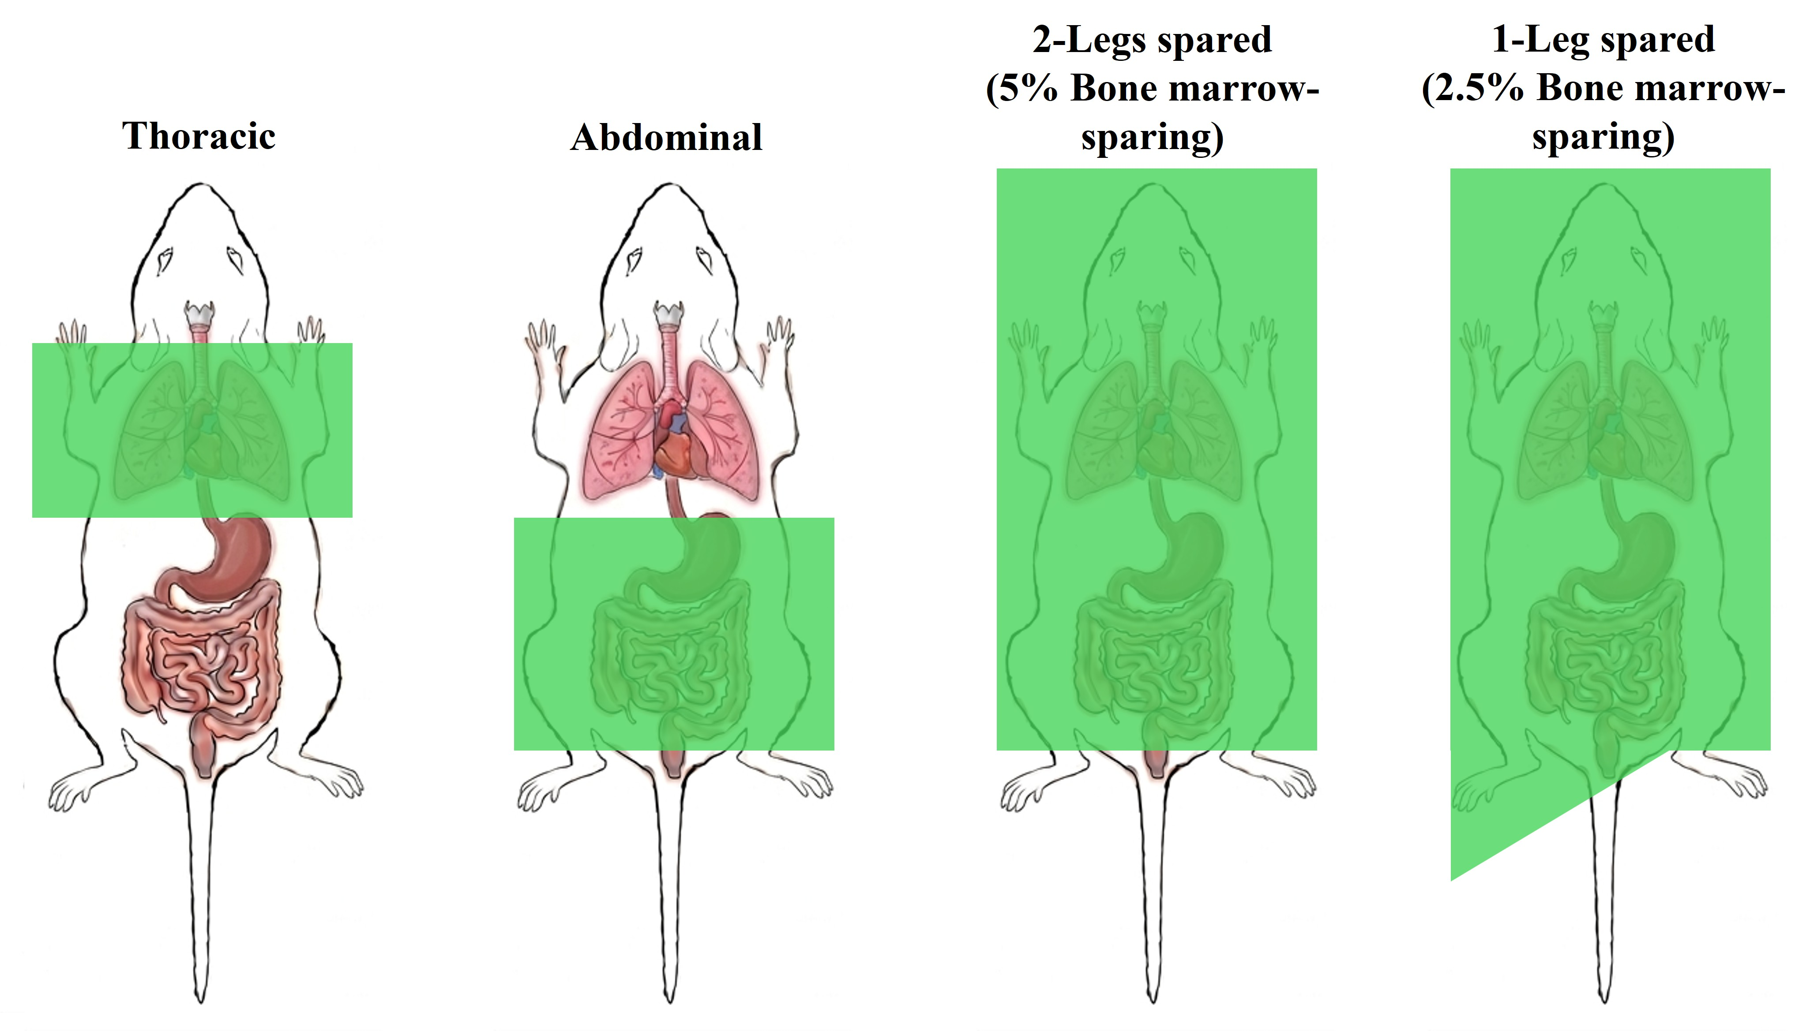
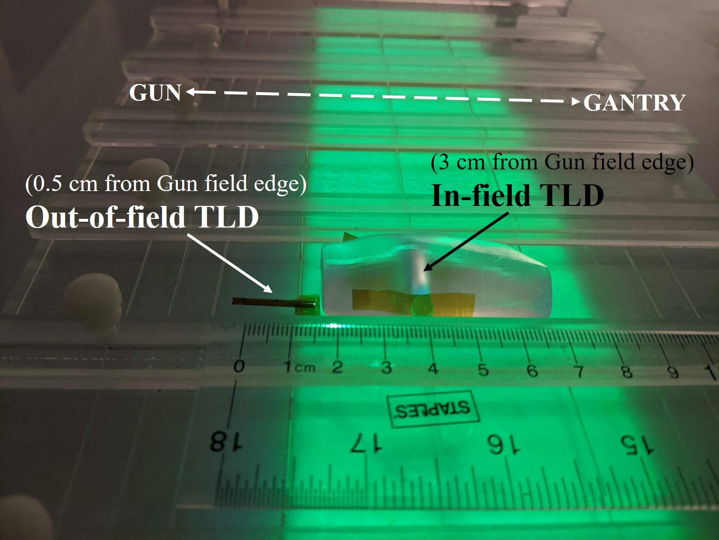
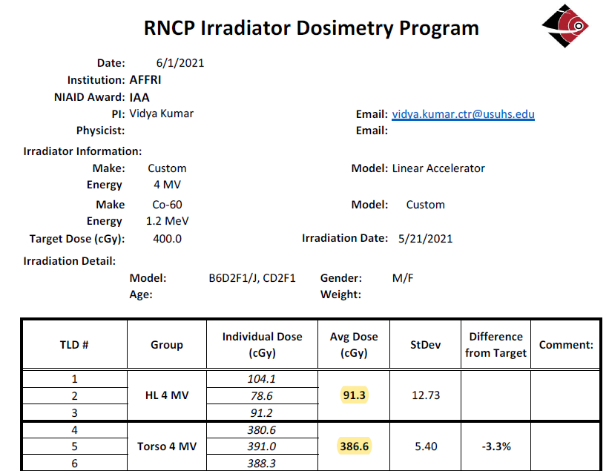
Development of a Murine Irradiation Platform for Screening of Medical Countermeasures against Multi-organ Injuries
Alia Weaver¹, Alena Tsioplaya¹, Kefale Wuddie¹, Shalini Jaiswal², Gregory Holmes-Hampton¹, Sanchita Ghosh¹ and Vidya P. Kumar¹
¹Armed Forces Radiobiology Research Institute, Uniformed Services University of the Health Sciences, Bethesda, MD, 20889
²Biomedical Research Imaging Core, Uniformed Services University of the Health Sciences, Bethesda, MD, 20889
Introduction
AFRRI LINAC Facility
Field Uniformity
Acute radiation syndrome (ARS) is a medical condition that is caused by exposure to high doses of radiation in a short period of time (minutes) to a large region of the body. It manifests in the form of hematopoietic (H), gastrointestinal (GI), and cerebrovascular subsyndromes, each of which presents at increasing dose levels. Medical countermeasures (MCMs) for GI-ARS can be evaluated in a murine model by sparing radiation exposure to a portion of the animal’s bone marrow, thus avoiding H-ARS. This study presents the development of a murine screening platform for GI-ARS countermeasures which utilizes a photon radiation source generated by a clinical linear accelerator (LINAC). It demonstrates how the field-shaping capabilities of this system and precise dosimetry can be applied to reproducibly induce the biological endpoints required to evaluate countermeasures for GI-ARS and radiation-induced pulmonary fibrosis (RIPF).
Elekta Infinity: 4 MV photon beam
uniform absorbed dose to soft tissue vs bone
high throughput: 8 mice per run (drug screening)
monitor unit calculation based on alanine-EPR dosimetry
real-time monitoring of in-field an out-of-field dose: ion chamber dosimetry
Inline (80%-20%) penumbra
6 mm
Crossline uniformity
within 3% of field center
Method
Alanine-EPR Dose Mapping
Irradiation was performed using a 4 MV photon beam from an Elekta Infinity clinical LINAC. H-ARS effects were attenuated by sparing approximately 2.5% of the animal’s bone marrow through the extension of one hind leg outside of the radiation field. This allowed for irradiation to the higher dose levels required to induce GI-ARS and RIPF. Dose mapping for this irradiation geometry was based on alanine electron paramagnetic resonance (EPR). Alanine pellet dosimeters were inserted into mouse phantoms at positions which correspond to the head, abdomen, and pelvis. Verification of dose accuracy and bone marrow sparing was performed through real-time ion chamber dosimetry measurements during mice irradiation, and a thermoluminescent dosimetry (TLD) intercomparison.
Field size: 7 x 40 cm²
green light field: indicates size & shape of radiation field
collimation: tungsten jaws & multi-leaf collimator, penumbra sharpening block (3.8 cm PMMA + 1 mm Pb)
throughput: 8 mice/run, side-by-side
alanine pellets inserted into PMMA phantoms at locations that correspond to the head, abdomen, and pelvis
alanine calibration (NPL):
dose-to-water (⁶⁰Co)
PMMA buildup layer: 1.4 cm
Percent depth-dose (4 MV)
Depth of dose maximum
(in water): 1.4 cm
Position mice at the depth of maximum energy absorption
Real-Time Dosimetry
AFRRI Partial-Body Irradiation Murine Models
Mouse position for 2.5% BM-sparing
IN-field: head & torso (Ḋ: 2.8 Gy/min)
Field edge (superior inline): pelvis
OUT-of-field: hind leg (Ḋ: 0.58 Gy/min)
Dosimetry Intercomparison
Real-time dosimetry measurements were taken during all experimental irradiations of mice:
IN-field (adjacent to abdomen): Standard Imaging A14 chamber (0.015 cm³)
OUT-of-field (adjacent to pelvis): IBA CC01 chamber (0.011 cm³)
Conclusion
Radiation Nuclear Countermeasures Program (RNCP) / National Institute of Allergy and Infectious Diseases (NIAID)
This study demonstrates how the precise delivery of dose from a LINAC can be applied to the partial-body irradiation of mice for countermeasure screening. Hematopoietic damage in this animal model was reduced to a level that enables investigation of GI and late stages of radiation-induced damage to other vital organs such as kidneys, lungs, heart, and brain. Currently, potential MCMs are being tested for their prophylactic and/or mitigating efficacies.
Radiation-induced pulmonary fibrosis²:
destruction of alveolar walls
formation of fibrotic septa
Gastrointestinal ARS¹:
crypt depletion & apoptosis
loss of epithelial integrity
vascular leakage
bacterial translocation
Disclaimer: The opinions and assertions expressed herein are those of the author(s) and do not reflect the official policy or position of the Uniformed Services University of the Health Sciences or the Department of War. Neither I nor my family members have a financial interest in any commercial product, service, or organization providing financial support for this research. Funding for this work was from NIAID-IAA and AFRRI Intramural funds to Dr. Vidya P. Kumar.
¹Kumar V. et al., Radiat Res, 201, 19 – 34, (2024).
²Kumar V. et al., Radiat Res, 201, 460 – 470, (2024).

