Slide 1
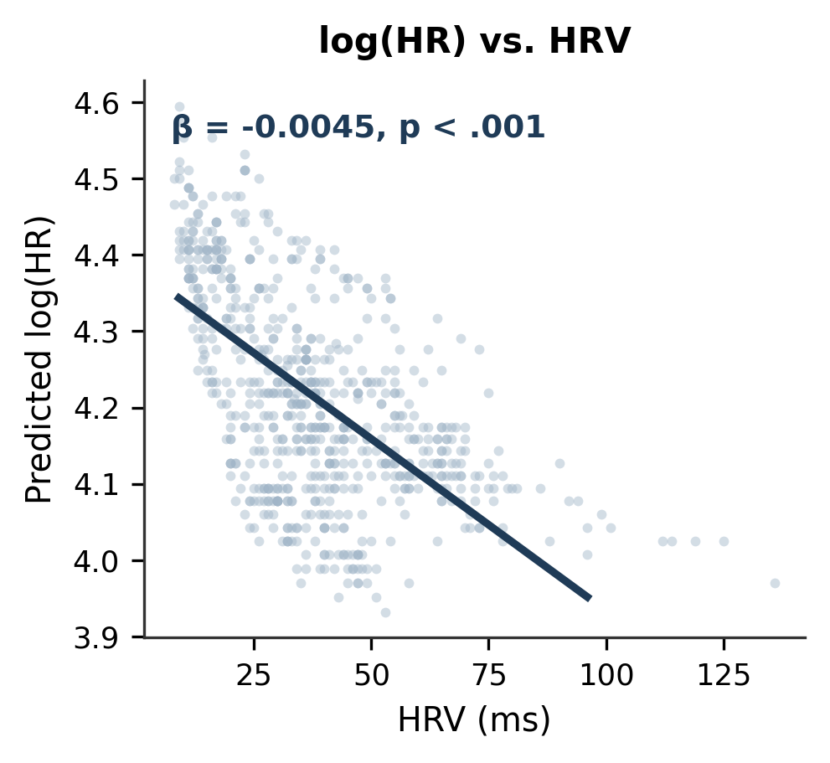
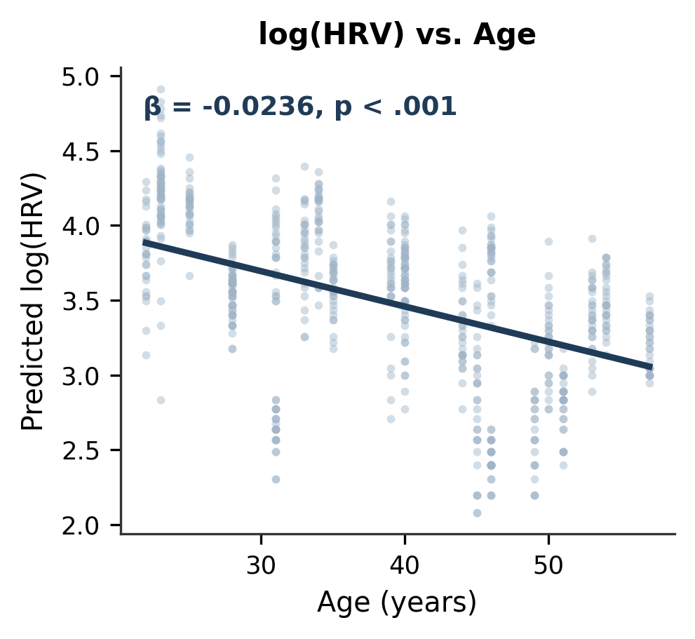
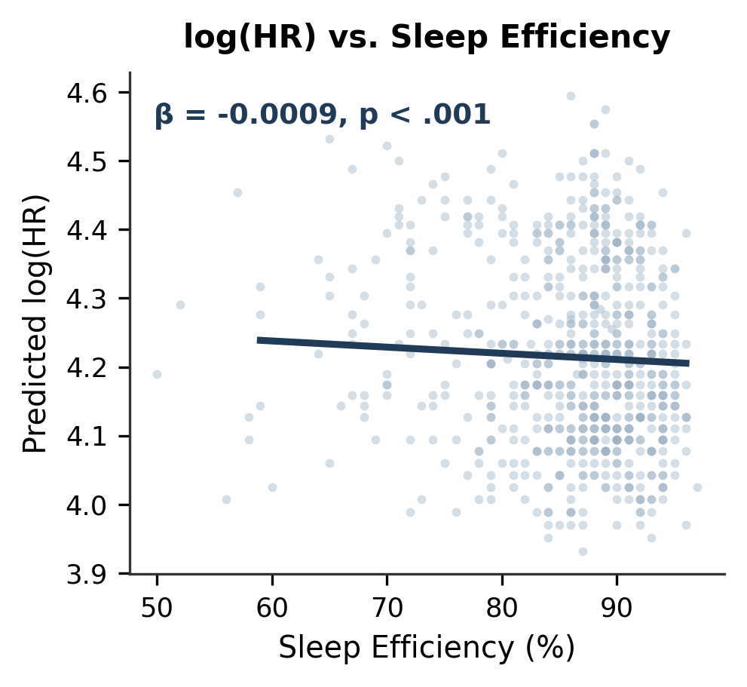
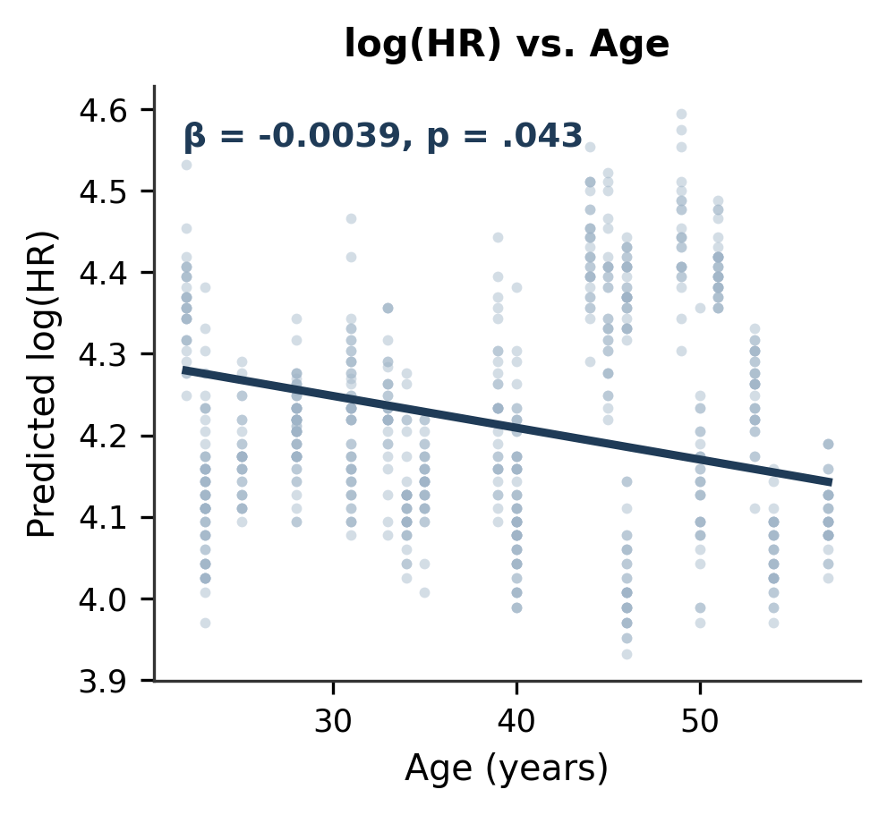
Wearable-derived Biomarkers of Cardiovascular Health, Sleep, and Readiness in Female First Responders
–
John Paul V. Anders¹, Nathan A. Edwards^{1,4}, Angela M. Emerson¹, Alexa Plokin², Samantha J. Brooks⁵, Fode Tounkara³, Morgan Orr¹, Katherine S. Brubaker¹, Stephanie L. Di Stasi², Catherine Saenz^{1,5}, Joshua A. Hagen¹, Carmen E. Quatman^{1,4}
¹Human Performance Collaborative, Ohio State University; ²Department of Health and Rehabilitation Sciences, College of Medicine, ³Biomedical Informatics, College of Medicine; ⁴Department of Emergency Medicine, College of Medicine; ⁵Department of Human Sciences, College of Education and Human Ecology
INTRODUCTION
Table 1. Participant Demographics
Cardiovascular disease is the leading cause of death among women, and those in high-stress occupations (e.g., first responders) face elevated cardiometabolic risk.
This risk is driven in part by occupational stress and circadian misalignment, which impair sleep quality and cardiovascular health.
Wearable technology allows continuous, real-world monitoring of health metrics — supporting short-term readiness assessment (indexed by HRV) as well as long-term tracking of cardiometabolic risk.
Variable | Mean±SD
Age (years) | 38.6±10.9
Weight | 169.5±32.7
VO2max (mL/kg/min) | 33.2±9.5
Body Fat (%) | 31.8±7.9
A longitudinal, exploratory mixed-effects model examined relationships between performance metrics and wearable biomarkers.
Log-transformed HR and HRV improved model fit. Repeated measures were modeled using an autoregressive [AR(1)] structure and with restricted maximum likelihood estimation.
PURPOSE
Two mixed-effects models were identified for log[HR] and log[HRV].
In the log[HR] model, HRV (β=-0.004), SE (β=-0.001), and age (β=-0.039) were significantly (p<0.05) and inversely associated with HR.
In the log[HRV] model, HR (β=-0.050) and age (β=-0.021) were significantly (p<0.05) and inversely associated with HRV.
Examine the relationship between cardiovascular health and wearable-derived biomarkers
Characterize readiness in female first responders
RESULTS
LEARNING OBJECTIVES
Evaluate how high-stress occupations affect cardiometabolic risk, sleep health, and readiness in women.
Analyze relationships among cardiovascular fitness, sleep health, and HRV in shaping readiness profiles.
Explain how wearable data (HR, HRV, sleep efficiency) can inform readiness assessment and individualized interventions.
Table 2. Oura-derived measures over a 30-day observation period.
CONCLUSION
Oura Measure | Mean±SD
HR (bpm) | 68.3±9.5
HRV (ms) | 37.7±19.5
Total Sleep Time (hours) | 6.8 ± 1.5
Time in Bed (hours) | 7.9 ± 1.8
Sleep efficiency (%) | 86.1±7.4
HR= resting heart rate; HRV= heart rate variability
HR was inversely associated with sleep efficiency and HRV, underscoring the links between sleep, cardiovascular health, and readiness.
The inverse relationship between age and HR may reflect greater aerobic fitness in older participants, but this did not offset the age-related decline in HRV.
Cardiovascular and sleep health play interconnected roles in shaping readiness for tactical athletes.
Wearable technology offers a practical tool for monitoring these relationships and informing targeted interventions to optimize performance and mitigate cardiometabolic risk in women in high-stress occupations.
METHODS
Female first responders (n=24) completed laboratory testing of maximal oxygen uptake (VO₂max) and and dual x-ray absorptiometry
Participants were provided an Oura Ring (Gen4) and instructed to wear for 30 days

