Slide 1

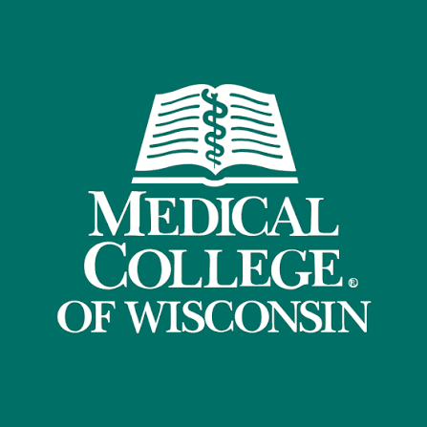
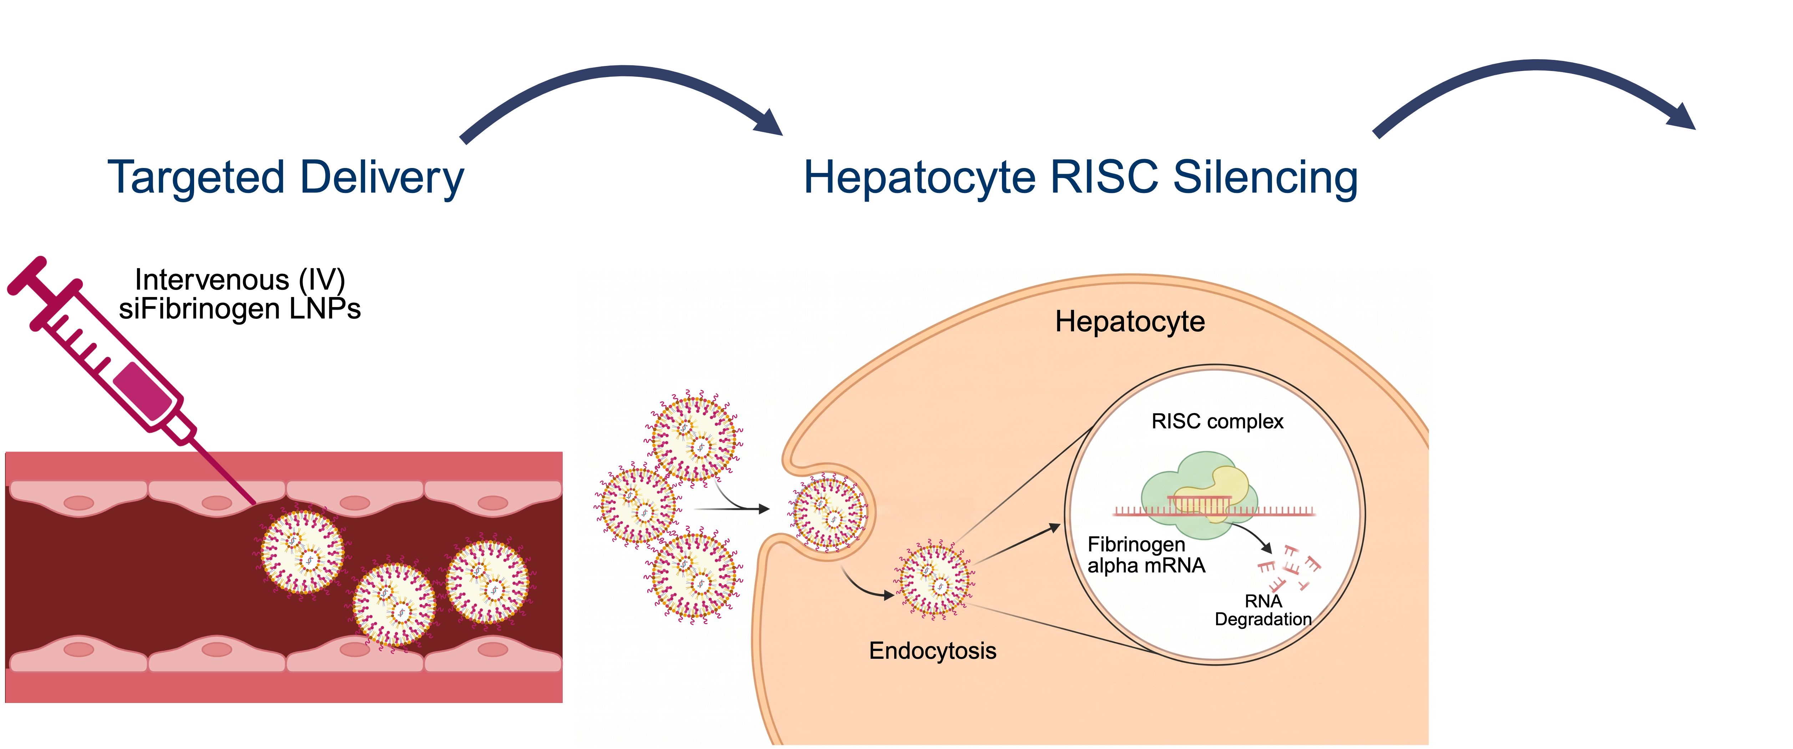
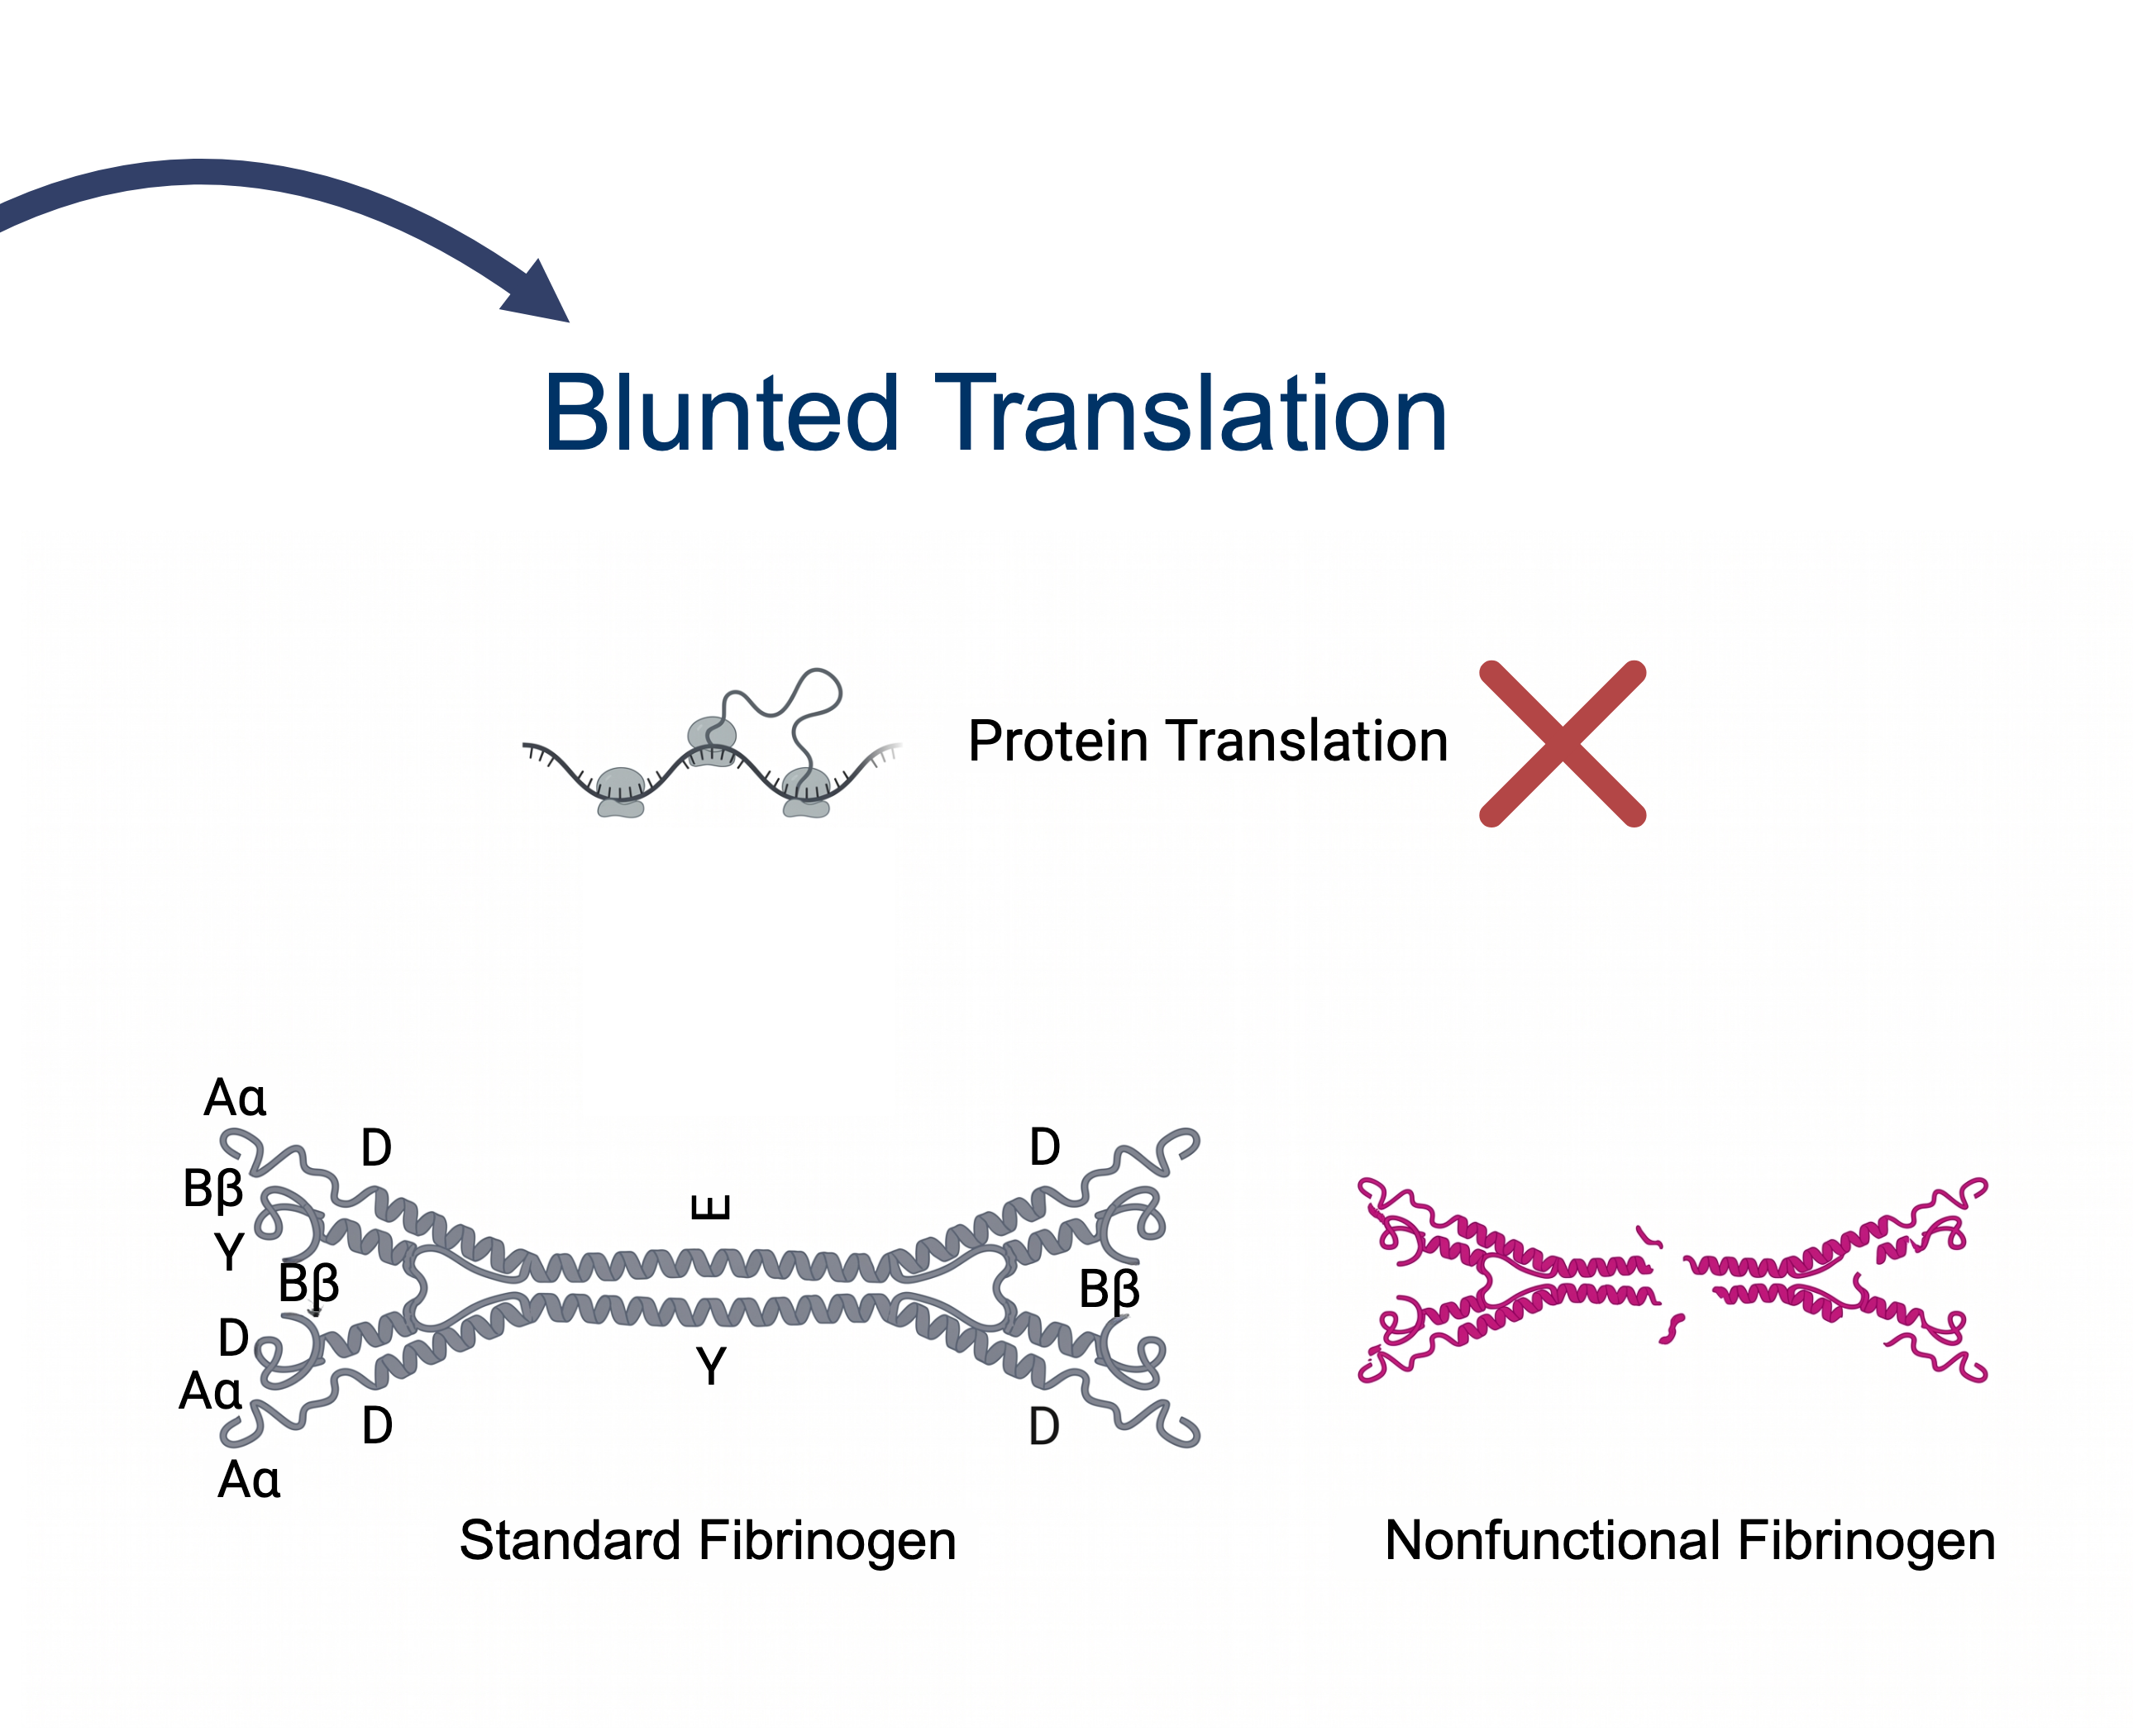
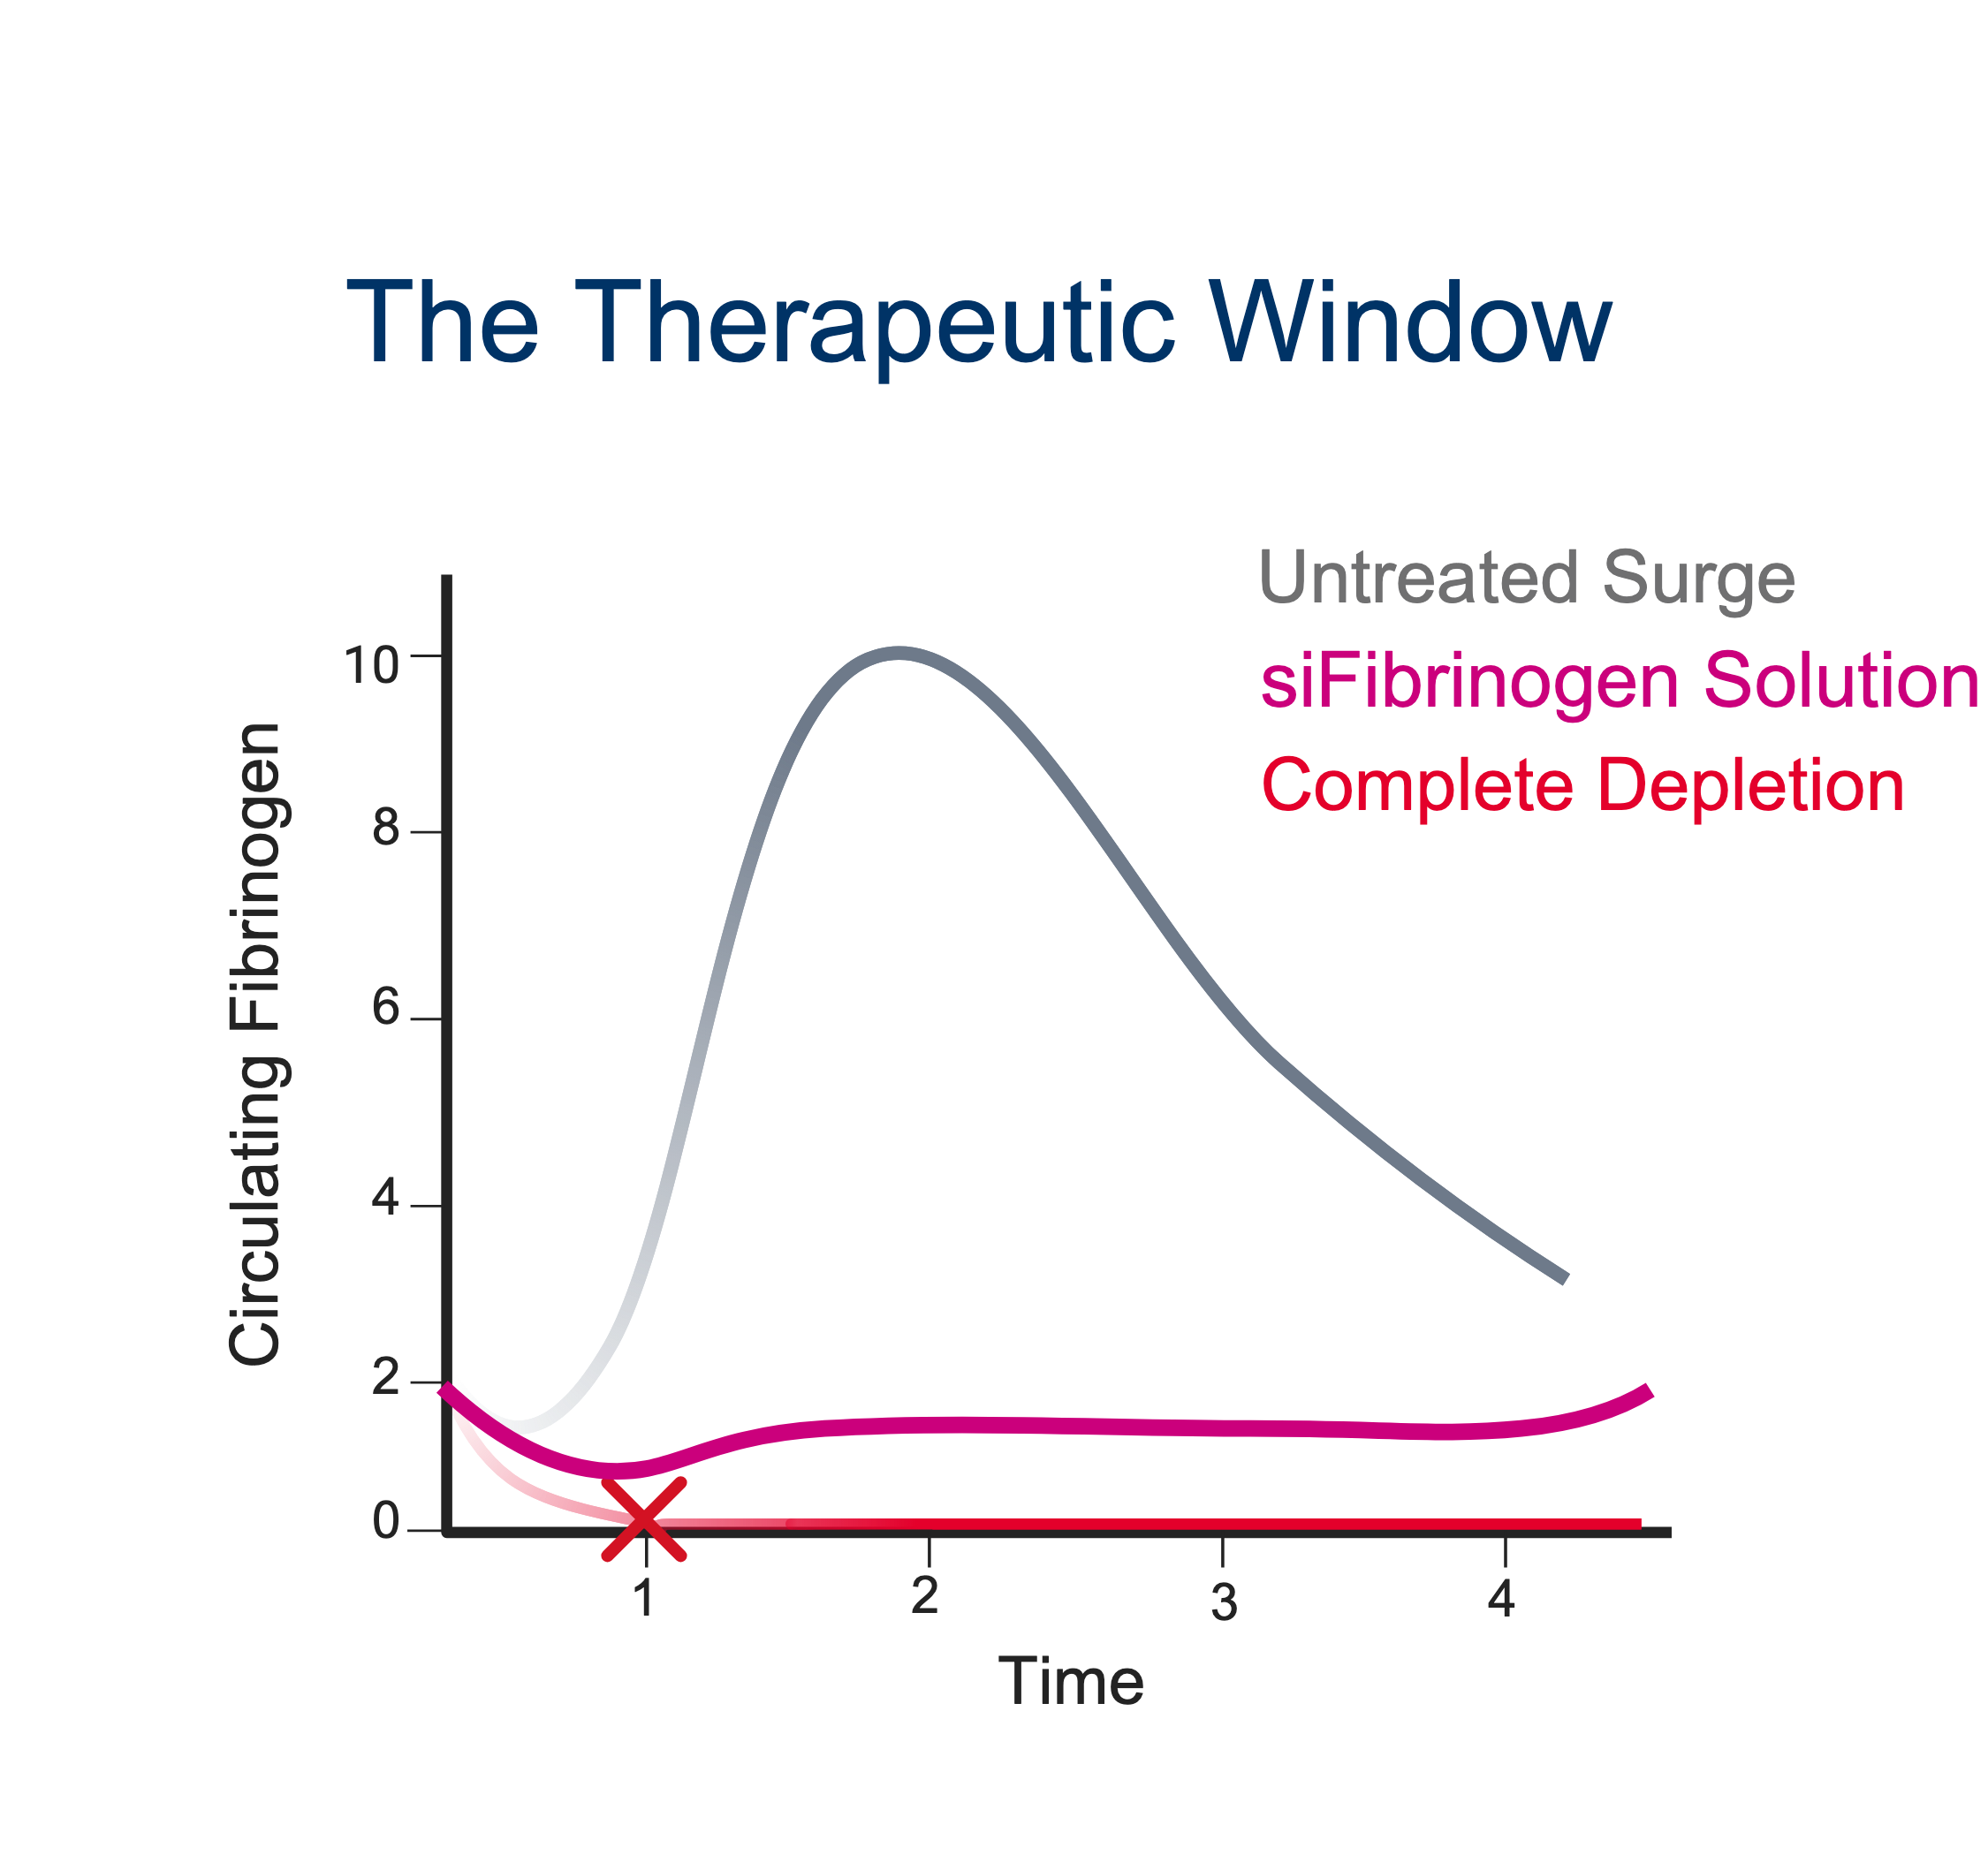
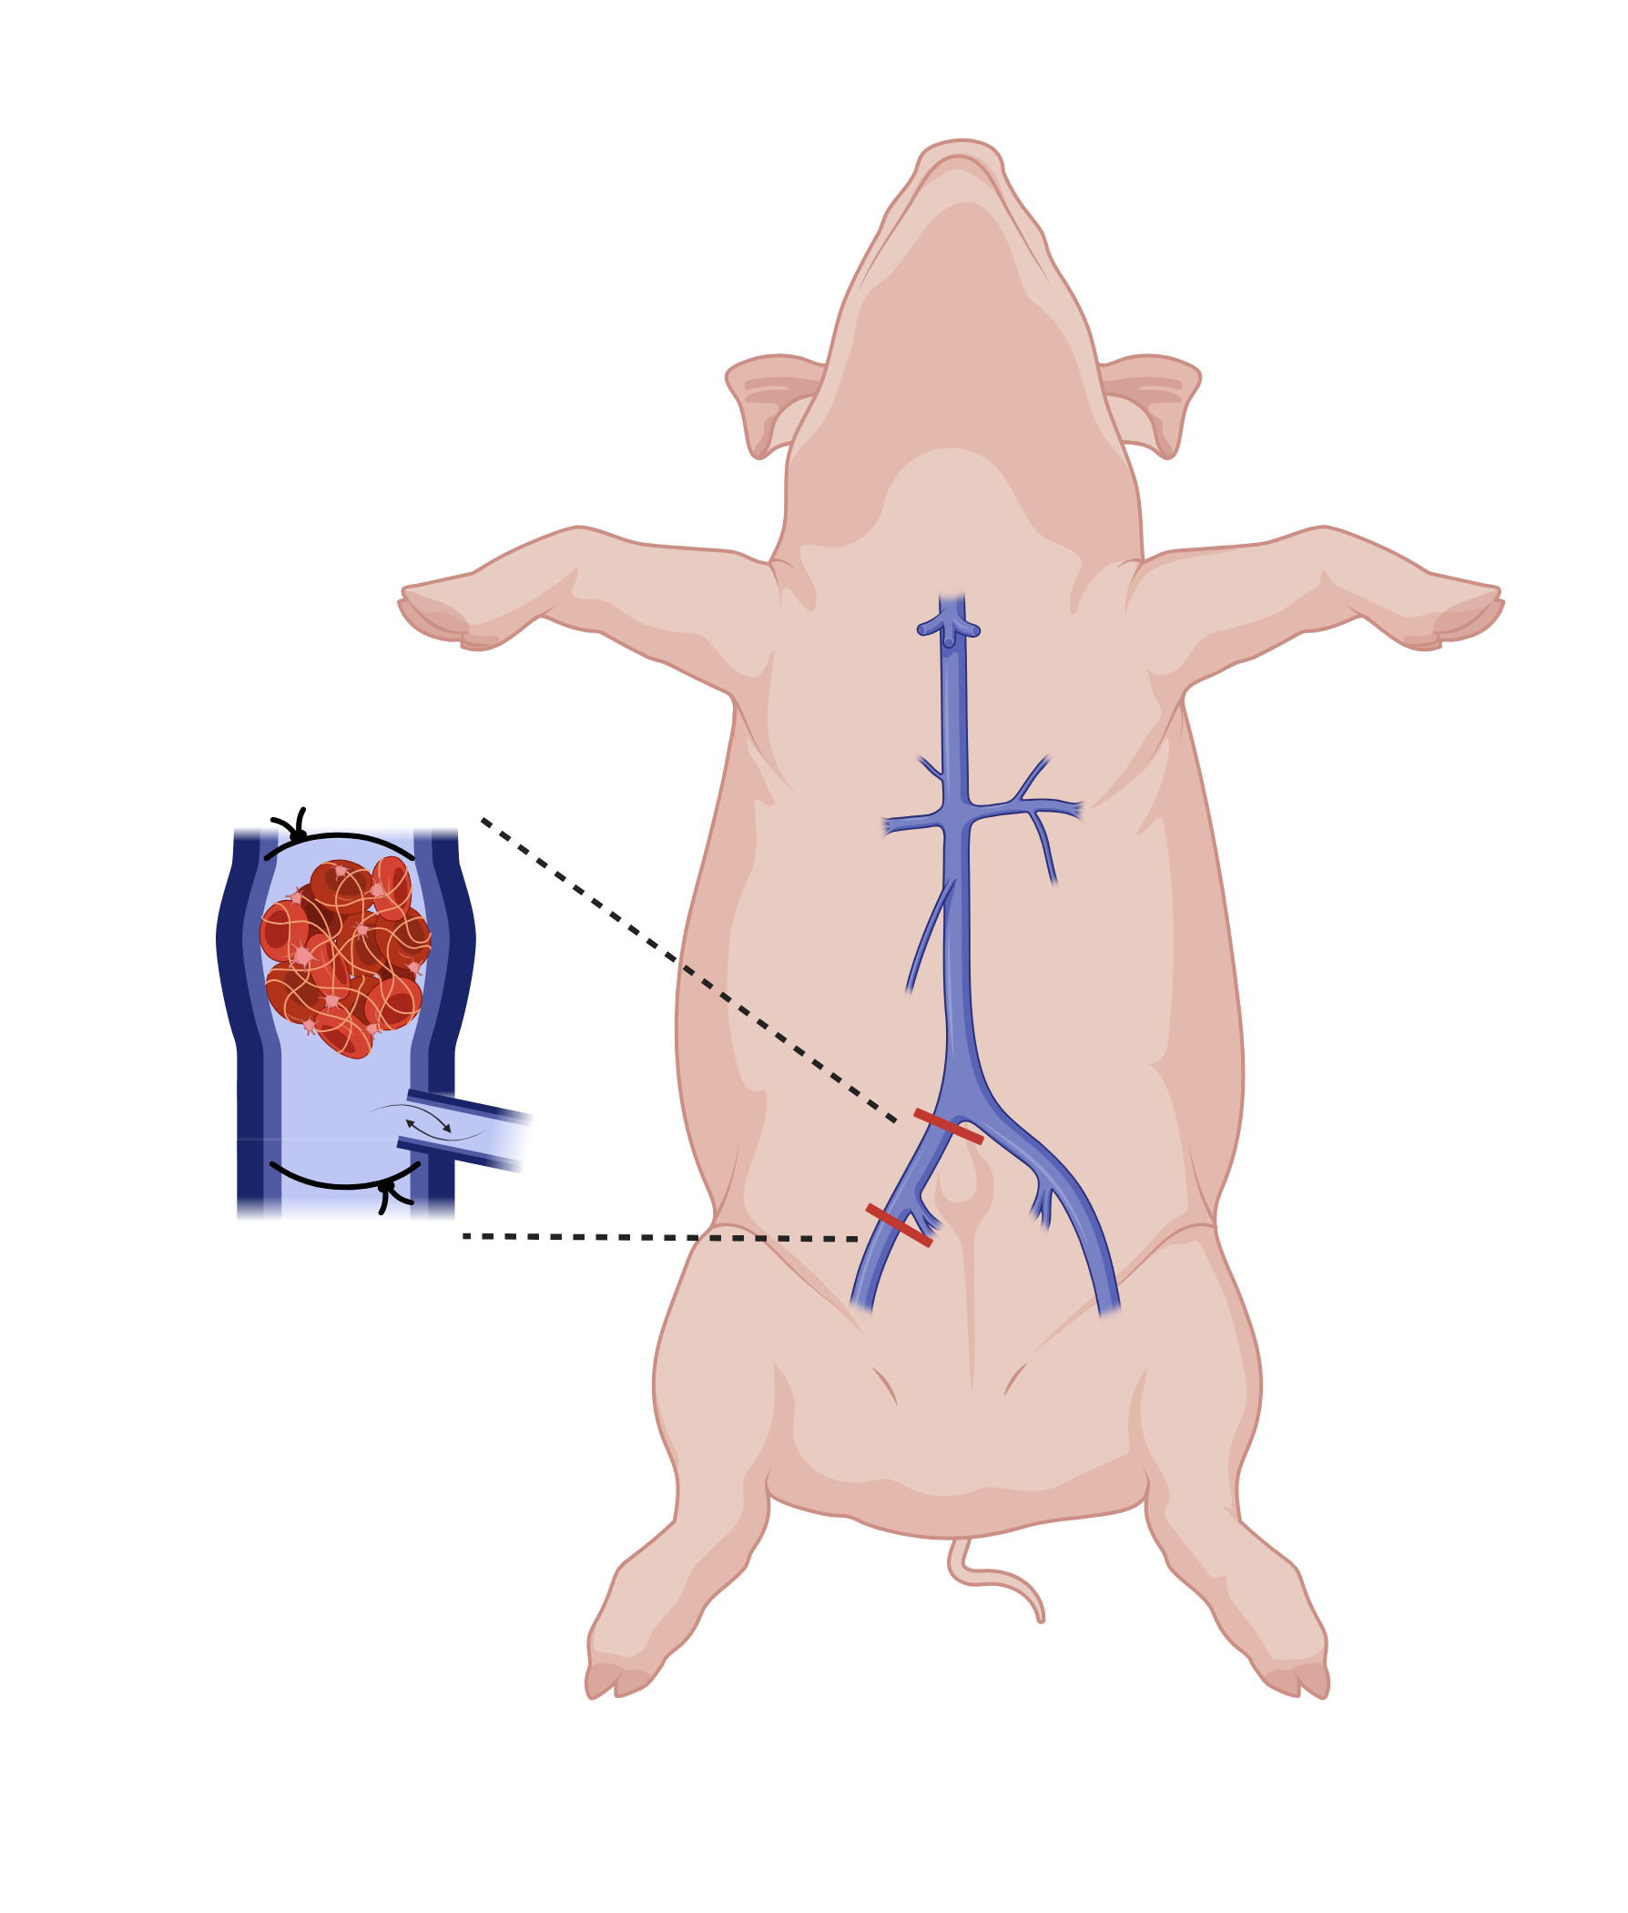
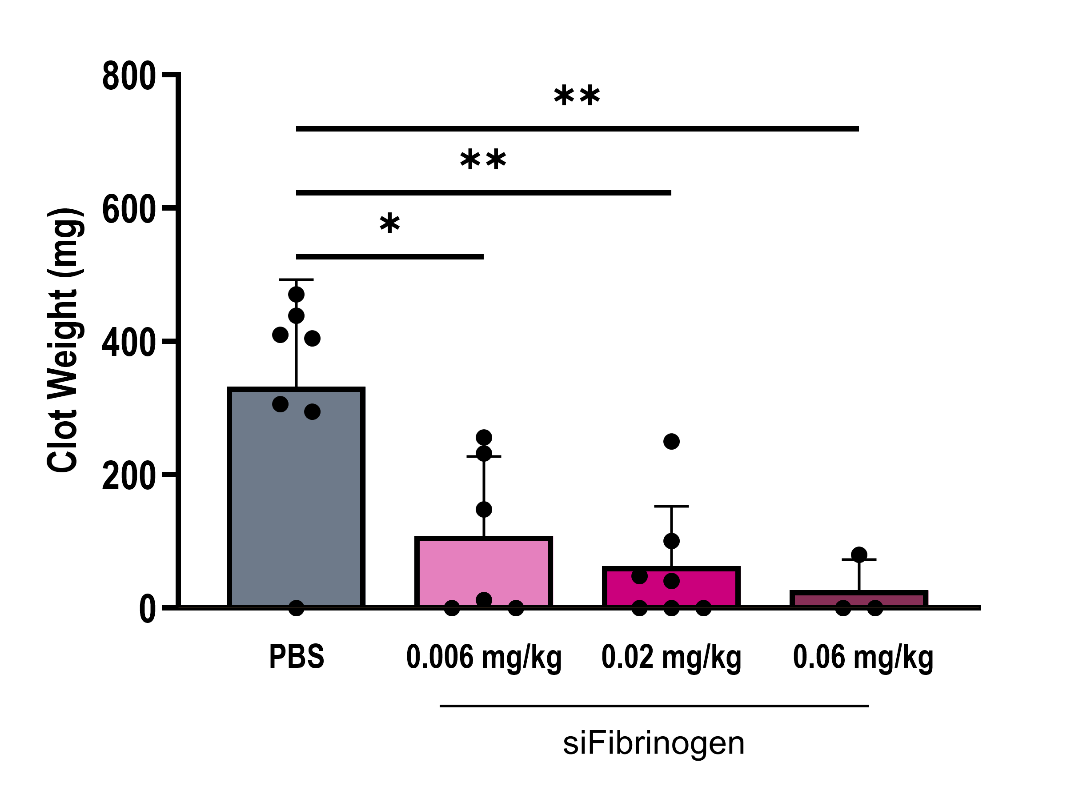
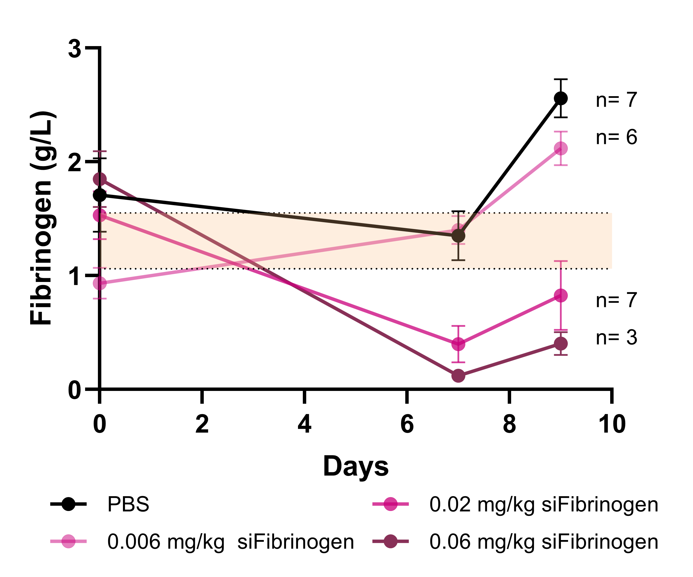
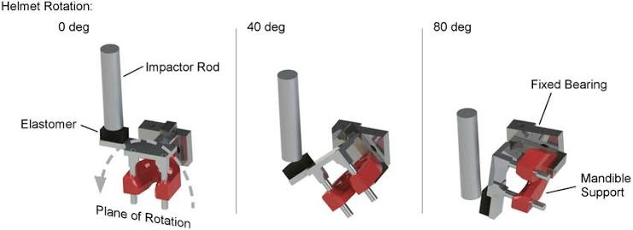
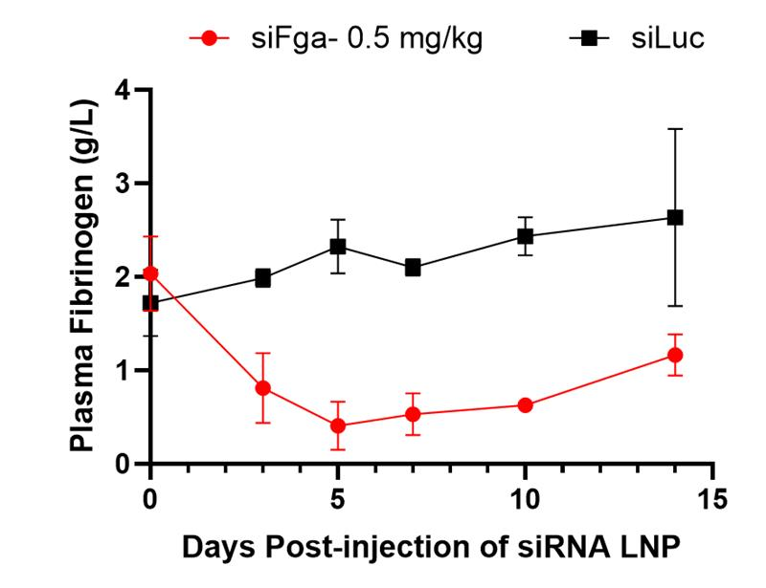
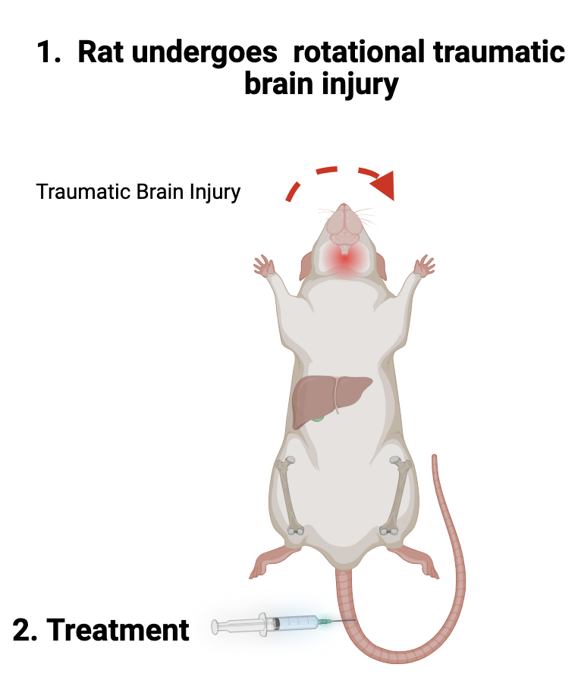
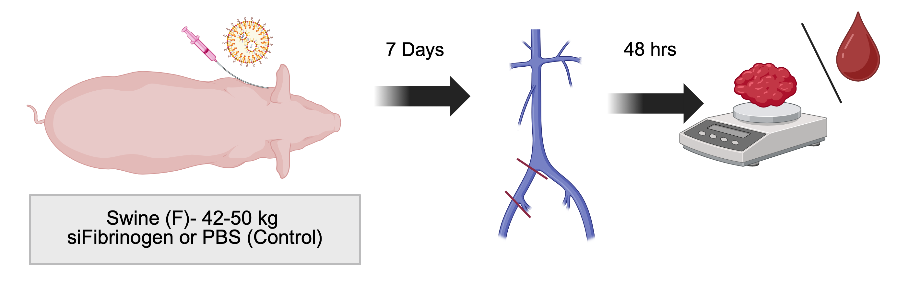
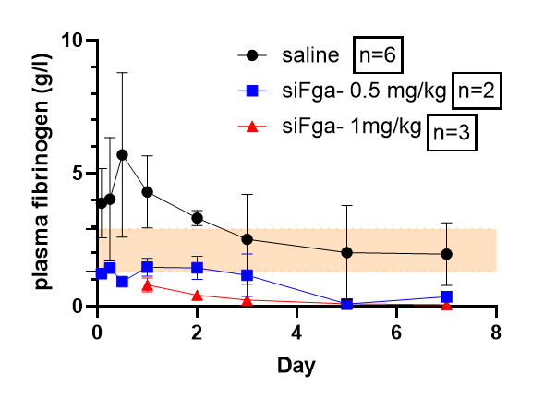
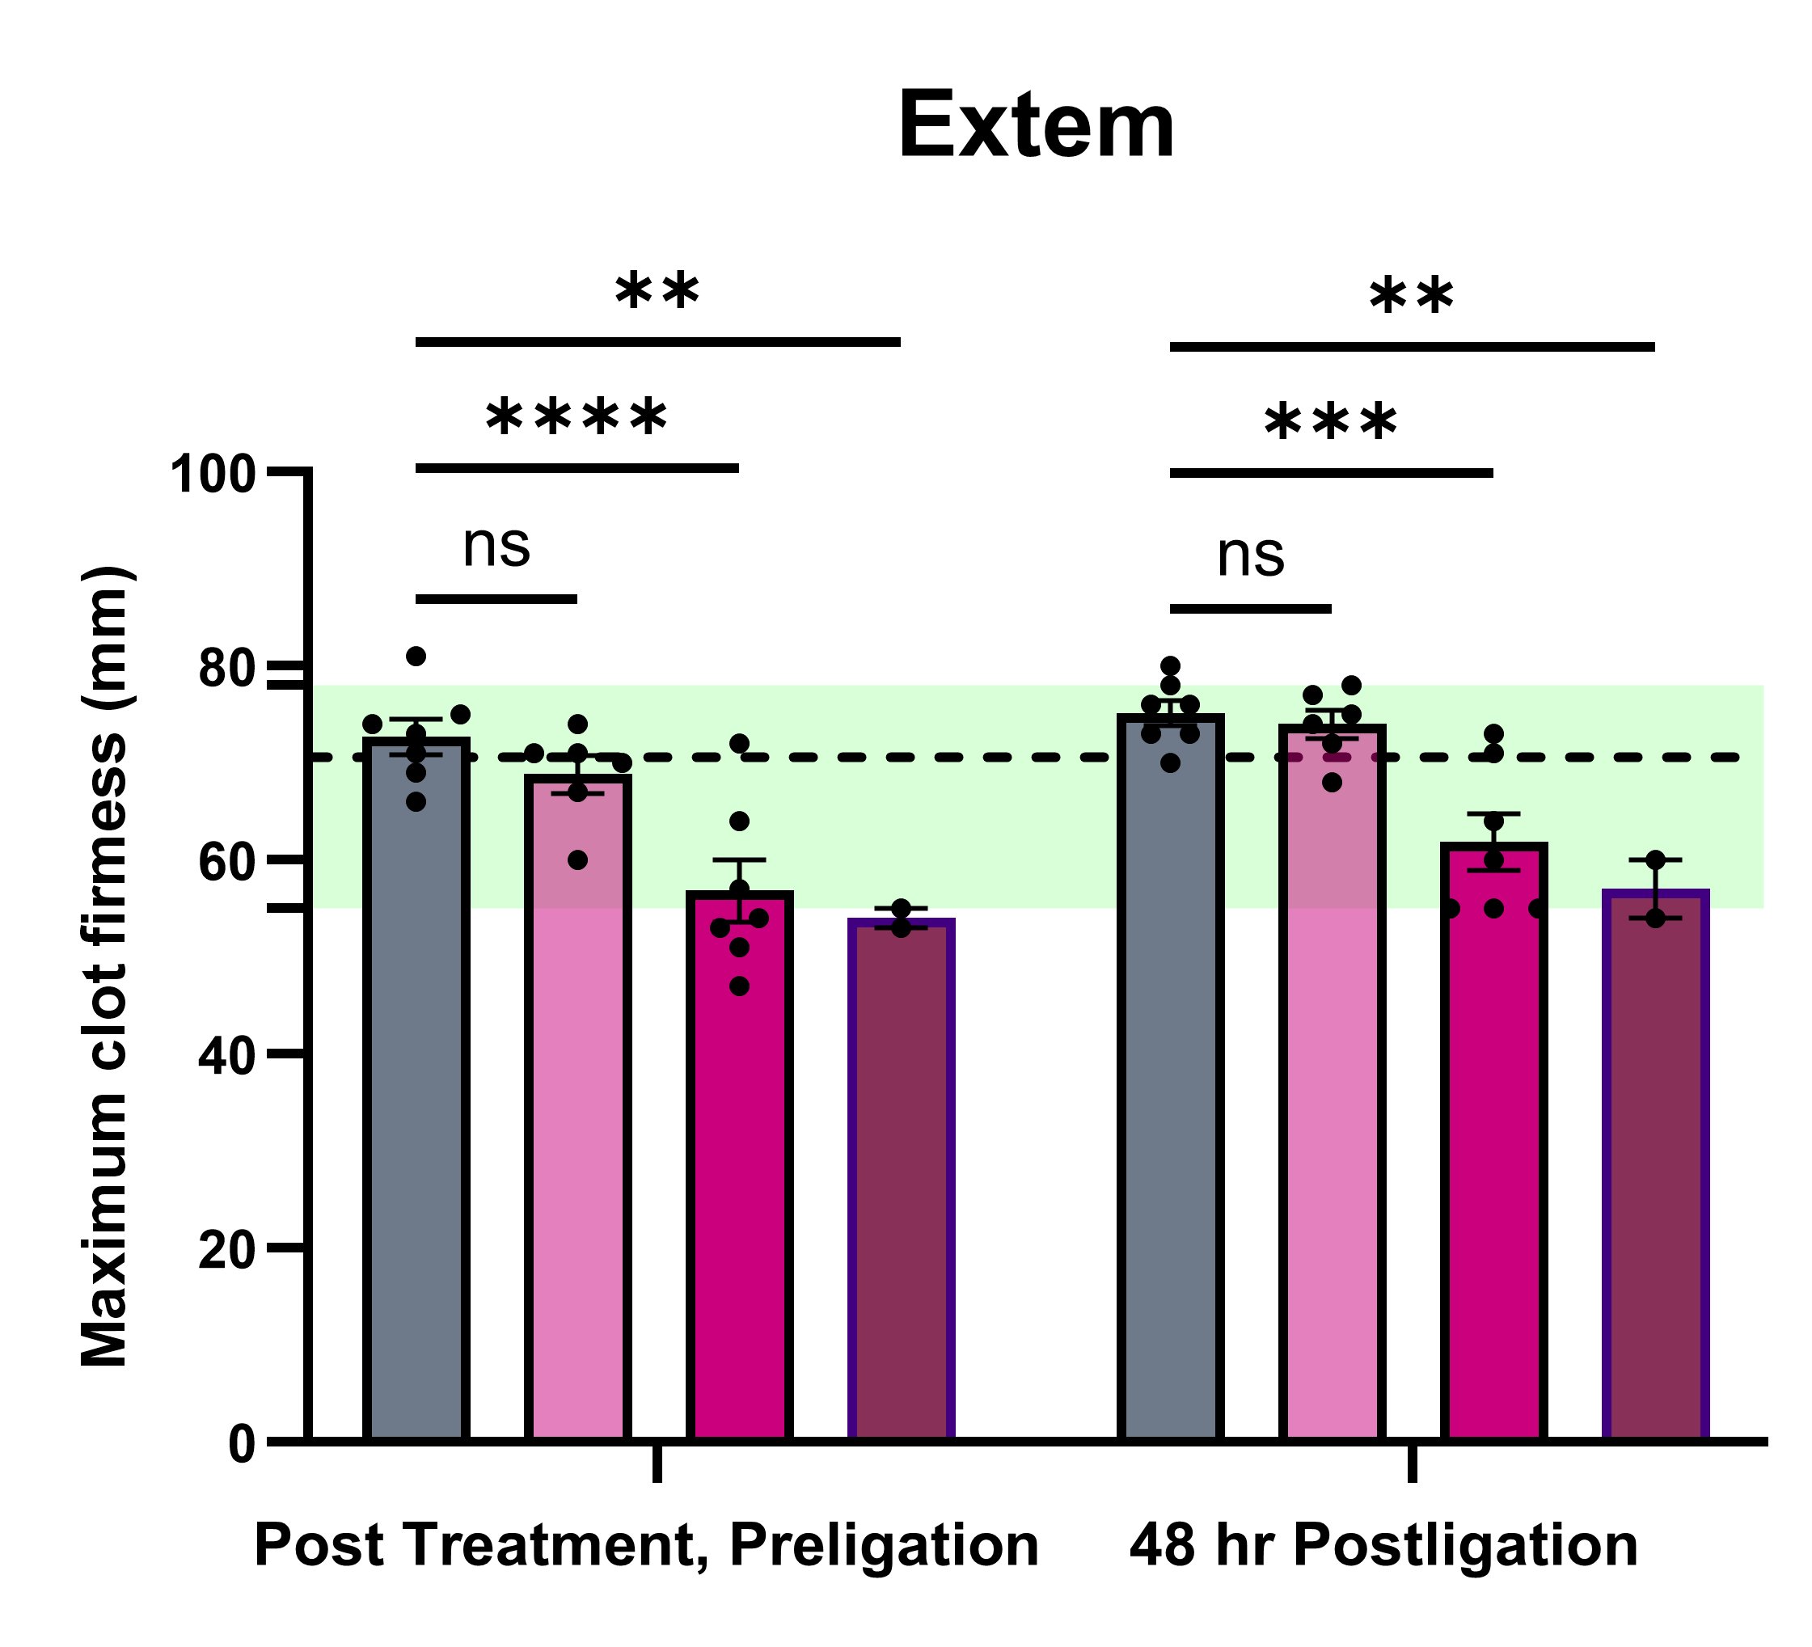
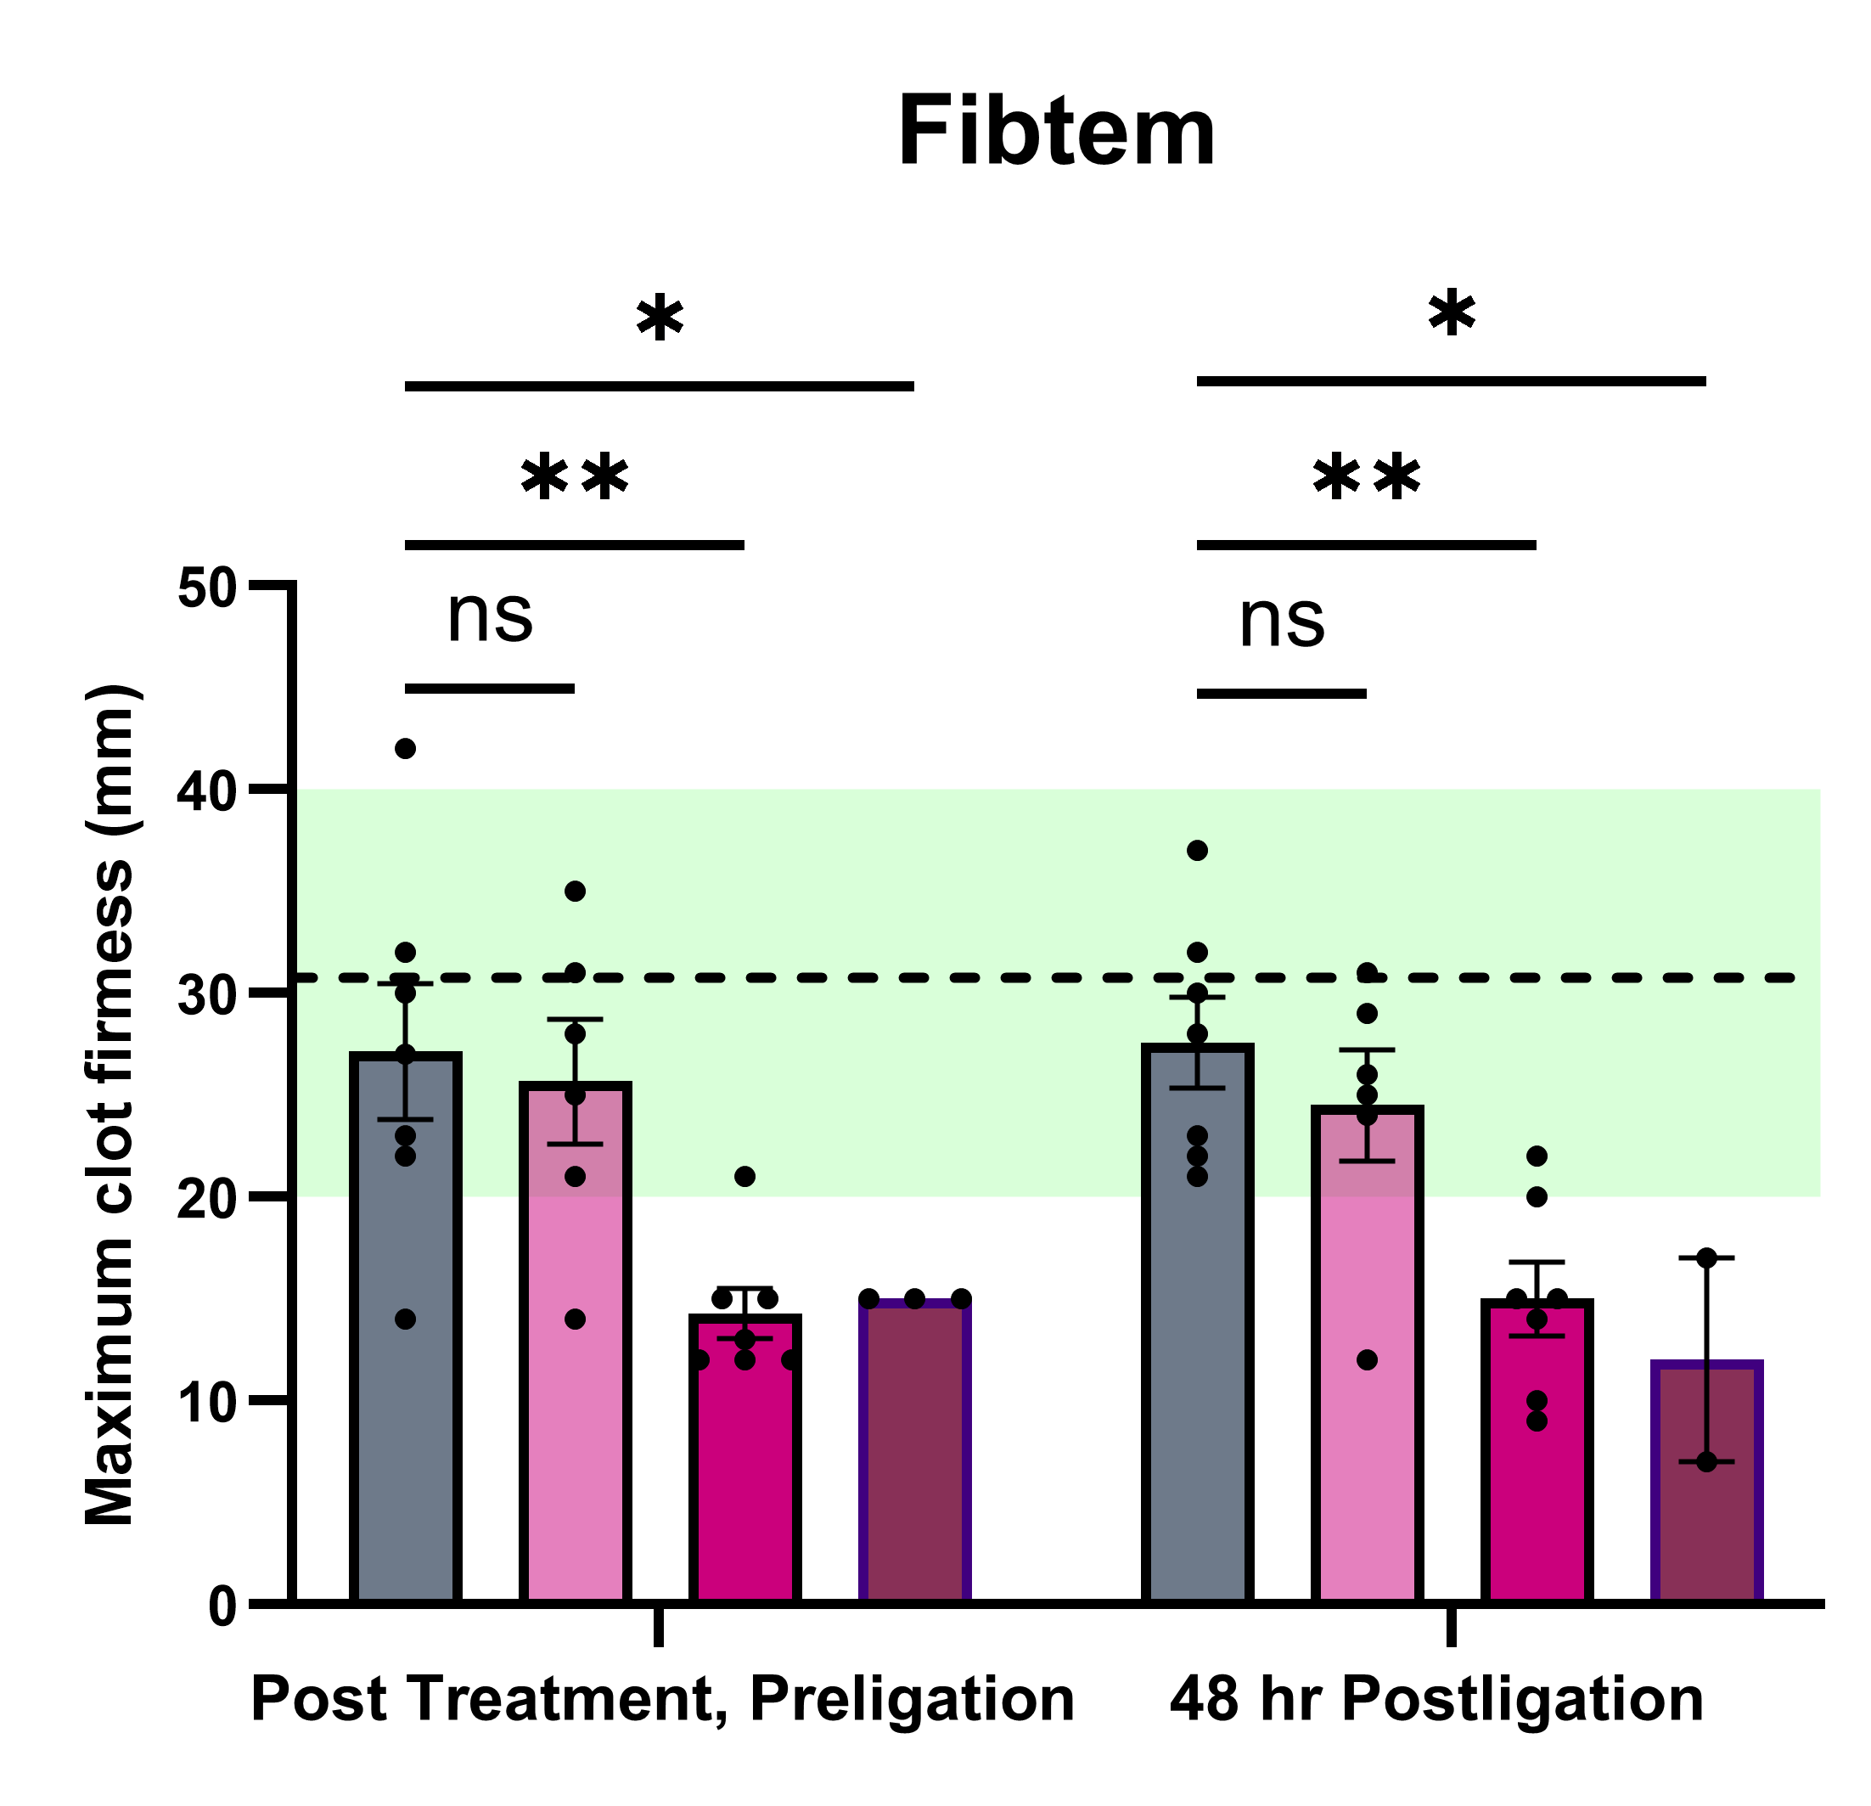
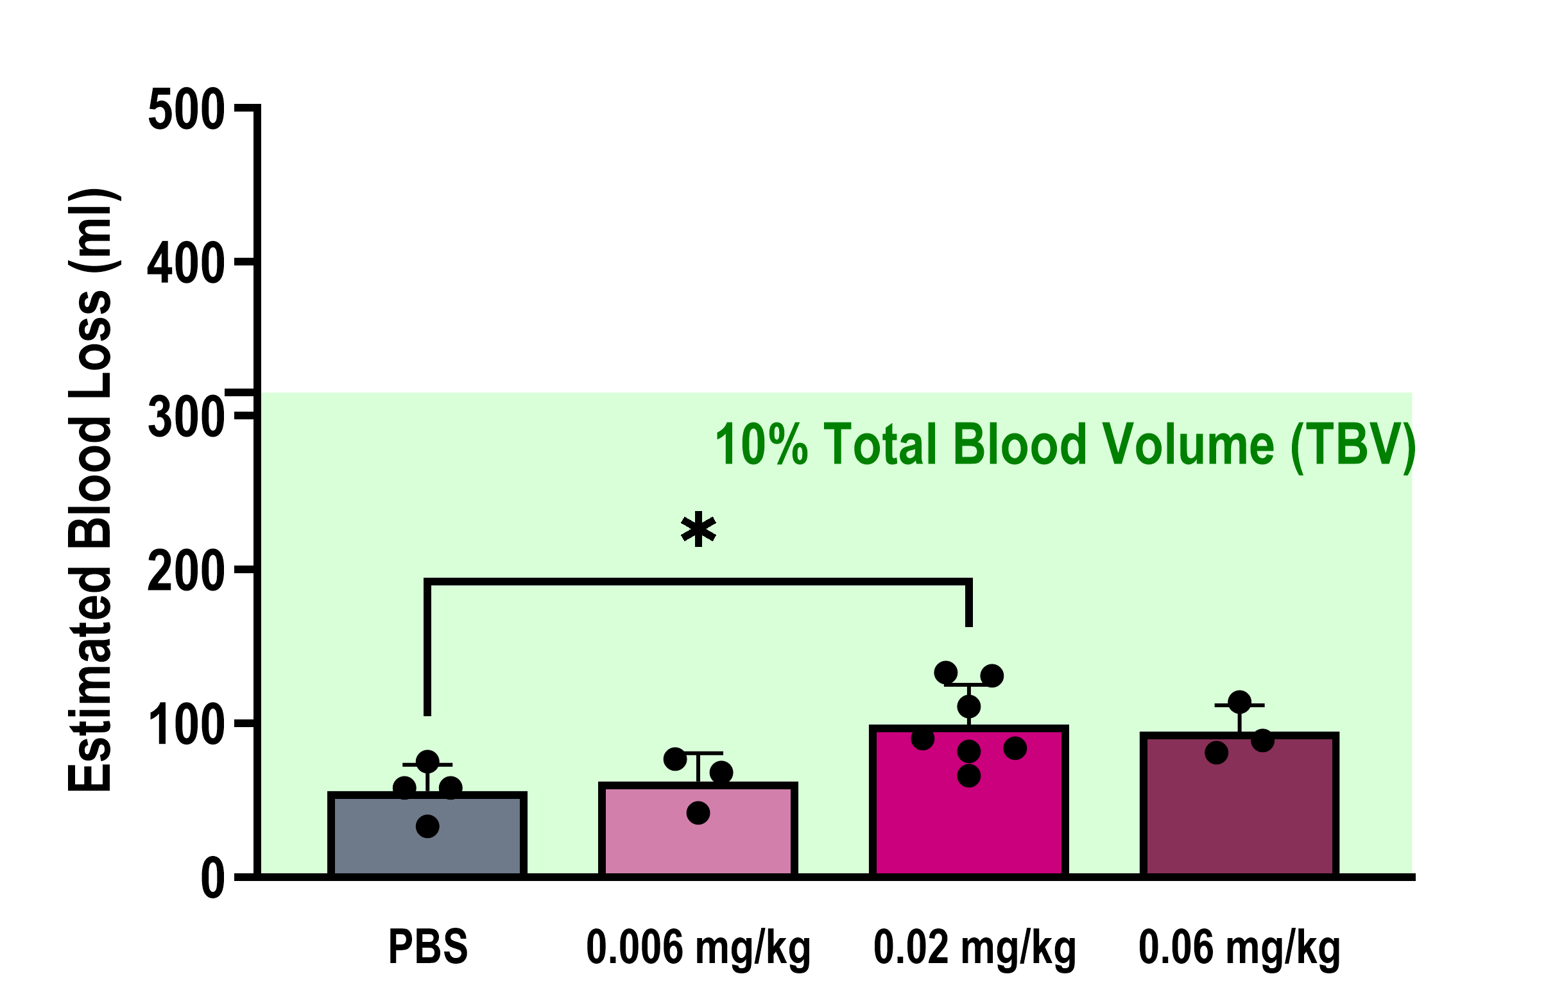



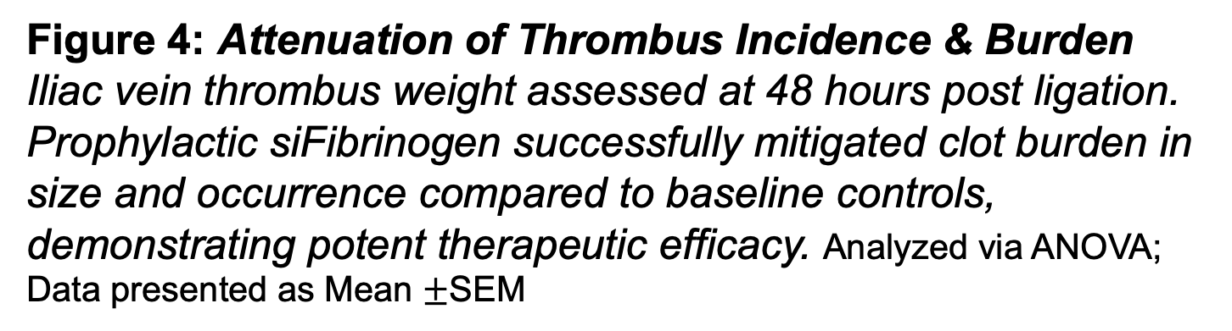

Reversible siRNA-Mediated Fibrinogen Reduction Prevents Post-Traumatic Venous Thromboembolism and Traumatic Brain Injury
Muskan Bansal ^{1, 2} , Laura Ketelboeter ¹ , Michelle Bordas ² , Christopher J. Roberts ², Mitchell R. Dyer ^{1, 2}, Christian J. Kastrup ^{1, 2}
¹ Versiti Blood Research Institute, Milwaukee, WI, United States, ² Medical College of Wisconsin, Milwaukee, WI, United States
TAKEAWAY
Left callout
CENTRAL MECHANISM SCHEMATIC
4-step BioRender flow + “Therapeutic Window” inset (Band 2 hero graphic — the whole pitch in one image)
TAKEAWAY
Right callout
THE CLINICAL CHALLENGE
Post-trauma morbidity is heavily driven by Systemic Thrombosis (VTE)
Standard anticoagulants sharply increase Bleeding Risks in emergency or mass-casualty trauma settings
MECHANISM OF ACTION: BLUNTING THE FIBRINOGEN SURGE
THE siRNA APPROACH
Fibrinogen acutely spikes post-injury to drive both thrombosis and inflammatory signaling
siFibrinogen LNPs safely blunt this surge without causing dangerous complete consumptive depletion.
TBI STUDIES
VTE STUDIES
We recently established an optimized LNP-siRNA swine specific sequence demonstrating safe, dose-dependent, and effective fibrinogen reduction (JTH, 2026). To rigorously translate these findings, we advanced this therapeutic to evaluate its impact on thrombus burden utilizing a novel, clinically relevant model of Deep Vein Thrombosis (DVT).
We previously demonstrated that therapeutic treatment with LNP-siRNA successfully blunts the acute post-trauma fibrinogen surge without complete consumptive depletion (Journal of Acute Trauma, 2024). To advance these findings to other injury models, I designed a rat specific siFibrinogen, to investigate if LNP-siRNA can successfully blunt the acute fibrinogen surge in a traumatic brain injury model.
Novel
Schematic 1A: Rotational Acceleration Framework Rats are placed in a helmet with mandible support and subjected to 6-8 simultaneously injuries of1250 krad/s/s/injury.
Schematic 2: Partial Iliac Vein Ligation Model: Schematic of the novel large-animal DVT model. Unlike complete stasis, partial ligation of the iliac vein preserves reduced downstream flow. This highly mimics the clinical hemodynamics of human DVT, providing a rigorous translational challenge for thromboprophylaxis.
Figure 1: siFibrinogen sustains reduction of circulating fibrinogen for 1 week. Time course of fibrinogen levels after a single dose of siFga in rats at 0.5 mg/kg, n=3.
Figure 2: Plasma Fibrinogen Kinetics Plasma fibrinogen levels (mg/mL) evaluated over 7 days following TBI. Rats therapeutically treated with 0.5-1mg/kg siFibrinogen exhibited a sustained, safe reduction in circulating fibrinogen compared to siLuc LNP controls post ligation, successfully blunting the post-injury acute phase response.
Figure 5: Dose-Dependent Fibrinogen Kinetics Plasma fibrinogen kinetics tracked across pre-injection, pre-ligation (Day 7), and endpoint (Day 9). siFibrinogen administration produced a robust, dose-dependent attenuation of the acute phase fibrinogen response following surgical challenge. The boxed section is the normal level of circulating fibrinogen in swine.
Figure 4: Attenuation of Thrombus Incidence & Burden Iliac vein thrombus weight assessed at 48 hours post ligation. Prophylactic siFibrinogen successfully mitigated clot burden in size and occurrence compared to baseline controls, demonstrating potent therapeutic efficacy. Analyzed via ANOVA; Data presented as Mean $±$SEM
Schematic 3: Thrombosis Model Swine received prophylactic siFibrinogen or control on Day 0. Ligation challenge was performed on Day 7, with thrombus burden assessed 48 hours post-operation.
Figure 6: Preservation of Baseline Clot Dynamics Rotational thromboelastometry (ROTEM) assessment of Maximum Clot Firmness (MCF) via EXTEM (global coagulation) and FIBTEM (fibrin-specific coagulation) assays. Shaded boxes show established normal swine MCF reference ranges, while dotted lines indicate the average pre-injection baseline of this study cohort. All functional hemostatic parameters in siFibrinogen-treated swine remained safely within normal limits, confirming systemic hemostatic preservation. Analyzed via repeated measures ANOVA; Data presented as Mean $±$SEM.
Figure 7: Laparotomy Blood Loss Evaluation Quantified surgical blood loss during the laparotomy procedure. A modest but statistically significant increase was observed at 0.02 mg/kg, remaining well below the 10% TBV threshold for clinical concern verifying the safety profile of blunting, rather than completely depleting, systemic fibrinogen. Analyzed via ANOVA; Data presented as Mean $±$SEM.
Schematic 1B: Experimental Model
Rats are treated 15-30 minutes post-traumatic brain injury and survival and
t
CONCLUSIONS
Post-Injury Therapeutic Efficiency: siFibrinogen successfully blunts the acute rise of fibrinogen in a traumatic brain injury model recapitulating published murine model of polytrauma injury
Translational Efficacy: Prophylactic LNP-siFibrinogen successfully blunts the acute phase response and significantly mitigates acute venous thrombus burden in clinically relevant swine models.
Preserved Hemostasis: Unlike standard therapies, targeted suppression of fibrinogen preserves global clot dynamics and avoids excessive surgical bleeding.
FUTURE DIRECTIONS
Neuroinflammation: Determine effects of fibrinogen reduction on neuroglial inflammation post-TBI
Vein Wall Remodeling: Evaluate the long-term downstream effects of blunted fibrinogen on chronic post-thrombotic syndrome, specifically understanding how fibrinogen attenuation impacts thrombus architecture, dynamics, vein wall fibrosis, and valve preservation.
Therapeutic Window Optimization: Conduct advanced pharmacokinetic and pharmacodynamic (PK/PD) profiling to establish the ideal dosing interval for translating this prophylactic strategy to therapeutic dosing to expand towards high-risk human surgical and trauma populations.
Expanded Pathobiology: Investigate the efficacy of siFibrinogen in other inflammatory, high-shear, or arterial models of thrombosis and disease states that have secondary complications of thrombosis
FUNDING
This research was supported by the Medical Scientist Training Program (MSTP) at the Medical College of Wisconsin (NIH Grant T32GM080202), the Versiti Blood Research Institute, and the laboratories of Dr. Christian Kastrup and Dr. Mitchell Dyer (DoD Grant DM230092; NIH Grant K08HL177422).
CITATIONS
Seadler MS, Ferraresso F, Bansal M, et al. Suppressing upregulation of fibrinogen after polytrauma mitigates thrombosis in mice. J Trauma Acute Care Surg. 2024;97(6):948-953. doi:10.1097/TA.0000000000004442
Stemper, Brian & Shah, Alok & Budde, Matthew & Olsen, Christopher & Glavaski-Joksimovic, Aleksandra & Kurpad, Shekar & Mccrea, Michael & Pintar, Frank. (2016). Behavioral Outcomes Differ between Rotational Acceleration and Blast Mechanisms of Mild Traumatic Brain Injury. Frontiers in Neurology. 7. 10.3389/fneur.2016.00031.
Seadler MS, Ferraresso F, Turner HM, et al. Preclinical safety and bleeding evaluation in swine for a small interfering RNA-lipid nanoparticle that prevents excess fibrinogen synthesis. J Thromb Haemost. 2026;24(2):508-519. doi:10.1016/j.jtha.2025.09.012
Check out the
Kastrup Lab!

