Slide 1

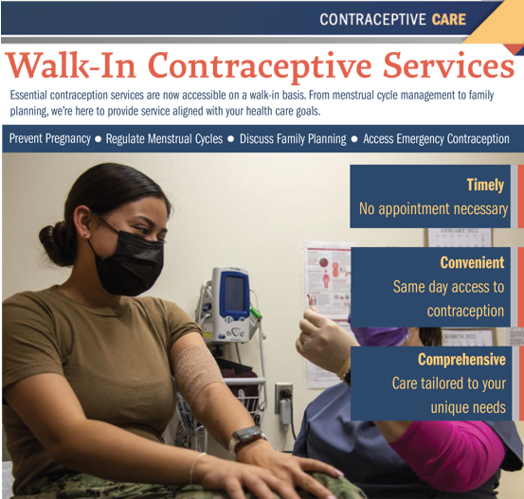
Walk-in Contraceptive Services (WiCS) Directly Mitigate Threats to Force Readiness
Susanna Didrickson, PhD, RNC-OB, WHNP-BC¹; Kimberly Taylor MS, PMP¹ ; Kathleen Pombier, Maj, USAF, MC, FACOG¹
Introduction
Methods/Technical Approach
Results
¹ Defense Health Agency , Falls Church, VA
Policy Mandate: Since January 2023, the Defense Health Agency (DHA) has maintained walk-in contraception services (WiCS) at 129 Military Medical Treatment Facilities (MTFs) in accordance with a July 2022 Health Affairs (HA) memorandum, subsequently codified in DHA-Administrative Instruction 6025.09.
Services: WiCS provides same-day, no appointment, no referral, full-scope contraception services.
  Short-acting reversible contraception (SARC)
  Long-acting reversible contraception (LARC)
  Contraception Counseling
  Emergency Contraception
  Vasectomy Counseling (at select MTFs)
The DHA Women's Health Collaborative (WHC) has demonstrated success in developing and implementing enterprise-wide clinical and policy solutions that directly enhance the medical readiness and lethality of the warfighter. The WHC has fielded a high-impact capability: WiCS. This effort exemplifies the translation of mature research into fielded capabilities that fill critical military medical gaps.
An integrated, multi-disciplinary team that included ADSMs, clinical SMEs, researchers, and data analysts. The program leveraged previous pilot studies and data analysis on ND trends to design the enterprise-level program. This intramural collaboration was essential for managing the project's cost, schedule, and performance, resulting in an evidence-based procedural instruction that was seamlessly integrated into existing DHA clinical workflows (Figure 2).
The program has maintained an average of apx. 1,350 same-day contraceptive appointments each month across MTFs globally. This metric validates the program's reach and impact, demonstrating a mature program that has transitioned from concept to an active, MHS-wide project (Figure 3).
Figure 3 WiCS Encounters by Appointment Type
Figure 2 WiCS Methods for Policy Creation and Implementation
Develops WiCS implementation infrastructure and resources
Network Leads
Identify and support MTF WiCS Champion(s)
MTF Champion
Oversees execution of the WiCS implementation within the MTF
Adjudicates compliance component challenges
Reports MHS progress towards WiCS DHA-AI compliance to DHA leadership
Report updates to the WH lead at DHHQ
Oversees the continuous monitoring & quarterly compliance data submission, reporting, and provides coaching as needed
Coordinates across Depts within the MTF and reports to the WH Market Lead on compliance
Assesses and reports implementation compliance (monthly)
Policy Drivers
Navy piloted Process Improvement for Non-Delayed Contraception (PINC) clinics and doubled the rates of contraception prescribed and LARCs dispensed
DHA-Administrative Instruction (DHA-AI) 6025.09, “Walk-in Contraception Services at Military Medical Treatment Facilities”
WHCMT DHHQ
Secretary of Defense Memorandum for Director, DHA, “Walk-in Contraception Services at Military Medical Treatment Facilities”
Women’s Health Team in Medical Affairs works with clinicians and policy SMEs on an enterprise-wide policy
The Joint Outpatient Experience Survey for WiCS: Developed with WiCS SMEs in 2023 it allows patients to provide feedback on their WiCS experiences. The questions reflect several domains of contraceptive access identified as promoters of autonomy and quality contraceptive care. The results are overwhelmingly positive for each domain. (Figures 4-7)
Capability Description
A program that directly mitigates threats to force readiness, namely unplanned pregnancies which are a leading cause of non-deployability (ND) among Service members. The WiCS program provides same-day full-scope contraceptive services to service members including education on menstrual suppression and emergency contraception.
Figure 4 WiCS Access to Care Improvement
Figure 5 WiCS Met Needs
1
Figure 1 WiCS poster advertising multiple services available
Applicability to Medical Roles of Care
Figure 6 WiCS Questions Answered
Figure 7 Recommend WiCS to a Friend
The WiCS program represents a tangible, fielded product that fills a significant medical capability gap. The development and implementation of the WiCS procedural instruction provides a standardized, evidence-based approach to contraceptive care that is applicable across all MTFs, enhancing the consistency and quality of care provided.
Impact to the Warfighter/Significance
Developmental Status of the Technology
The WiCS program directly enhances force readiness and lethality by reducing unplanned pregnancies, a leading cause of ND. This initiative ensures more warfighters are medically prepared and available for deployment, maximizing mission capability.
The WiCS program is a fully implemented and fielded high-impact capability past the concept phase and is actively delivering services in military treatment facilities globally. The program has translated mature research into actionable clinical and policy solutions reaching thousands of beneficiaries monthly.
^{UNCLASSIFIED}
This poster was developed for the Military Health Science Research Symposium August 3-6, 2026. The views expressed are those of the authors and do not reflect the official policy or position of the Defense Health Agency, Department of War, or the United States Government.

